Slide 1
Structure-from-Motion (SfM)
A lot of slides borrowed from Noah Snavely + Shree Nayar’s YT series: First principals of Computer Vision
CS194: Intro to Computer Vision and Comp. Photo
Alexei Efros, UC Berkeley, Fall 2024

Slide 2
Recall: Camera calibration & triangulation
Suppose we know 3D points and their matches in an image
How can we compute the camera parameters?
Suppose we know camera parameters for multiple cameras, each observing a point
How can we compute the 3D location of that point?

Slide 3
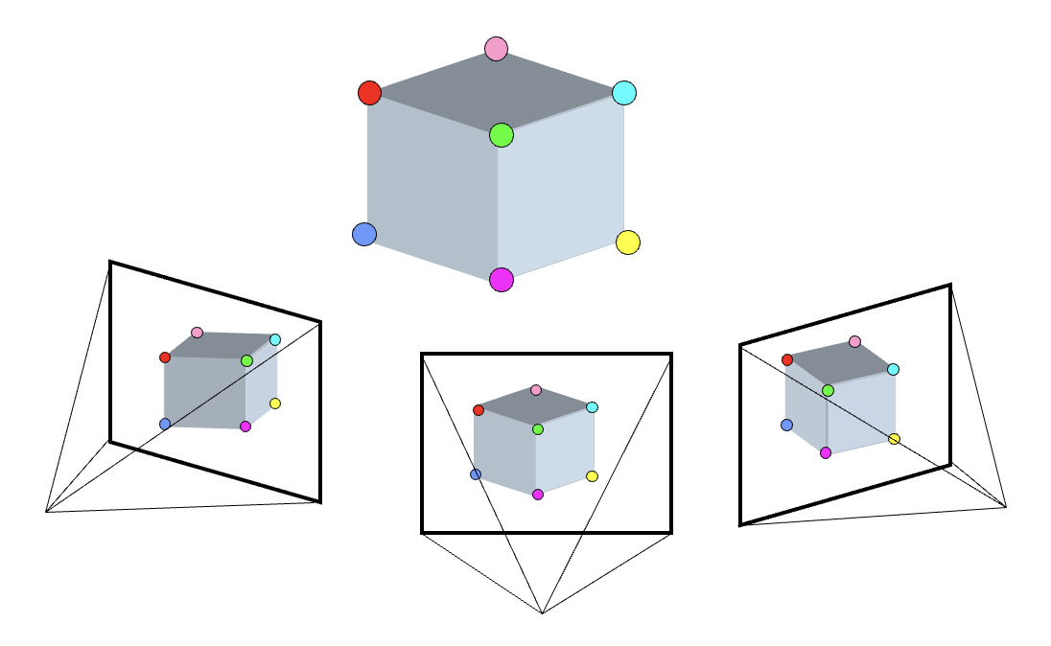
if you know 2 you get the other:
3D Points
(Structure)
Correspondences
Camera
(Motion)
Notes:
You have to start from something, always. It’s chicken and egg if you don’t know anything
What was this problem called?
3D points + Correspondences ➔ Camera
Camera ➔ Correspondences
Correspondences + Camera ➔ 3D points

Slide 4
Camera Calibration; aka Perspective-n-Point
3D Points
(Structure)
Correspondences
Camera
(Motion)
Notes:
You have to start from something, always. It’s chicken and egg if you don’t know anything
What was this problem called?
3D points + Correspondences ➔ Camera
Camera ➔ Correspondences
Correspondences + Camera ➔ 3D points

Slide 5
Stereo (w/2 cameras); aka Triangulation
3D Points
(Structure)
Correspondences
Camera
(Motion)
Notes:
You have to start from something, always. It’s chicken and egg if you don’t know anything
What was this problem called?
3D points + Correspondences ➔ Camera
Camera ➔ Correspondences
Correspondences + Camera ➔ 3D points

Slide 6
?
3D Points
(Structure)
Correspondences
Camera
(Motion)

Slide 7
Ultimate: Structure-from-Motion
UNKNOWN
3D Points
(Structure)
Correspondences
Camera
(Motion)
UNKNOWN
UNKNOWN
Start from nothing known (except maybe intrinsics), exploit the relationship to slowly get the right answer
Notes:
You have to start from something, always. It’s chicken and egg if you don’t know anything
What was this problem called?
3D points + Correspondences ➔ Camera
Camera ➔ Correspondences
Correspondences + Camera ➔ 3D points

Slide 8
Structure from Motion (SfM)
SfM solves both of these problems at once
A kind of chicken-and-egg problem
(but solvable)

Slide 9
Photo Tourism
Noah Snavely, Steven M. Seitz, Richard Szeliski, "Photo tourism: Exploring photo collections in 3D," SIGGRAPH 2006
https://youtu.be/mTBPGuPLI5Y

Slide 11
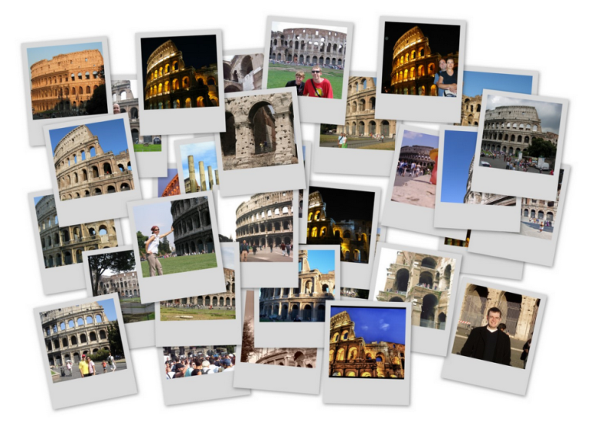
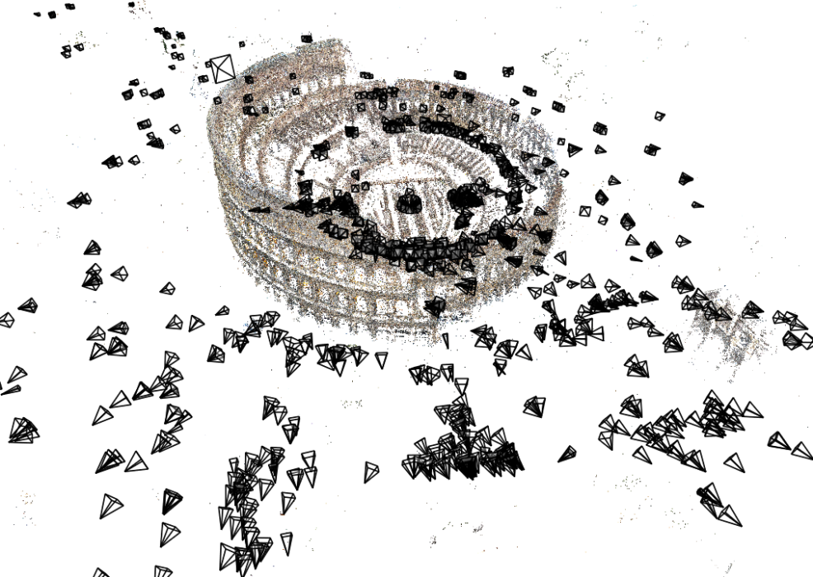
Structure from Motion (SfM)
Given many images, how can we
a) figure out where they were all taken from?
b) build a 3D model of the scene?
This is (roughly) the structure from motion problem

Slide 12
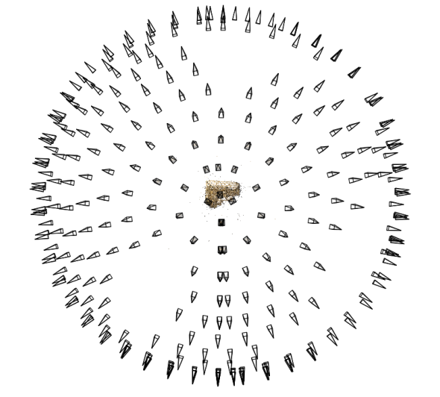
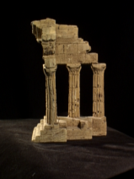
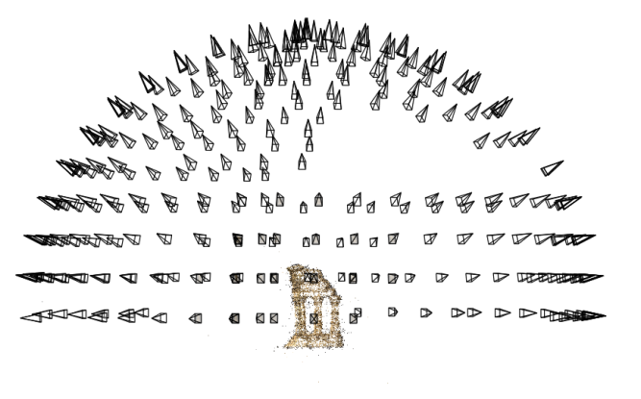
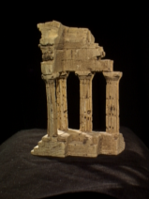
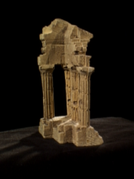
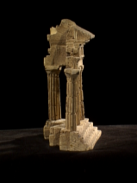
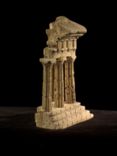
Structure from motion
Reconstruction (side)
(top)
Input: images with points in correspondence p_{i,j} = (u_{i,j},v_{i,j})
Output
structure: 3D location x_{i} for each point p_{i}
motion: camera parameters R_{j} , t_{j} possibly K_{j}
Objective function: minimize reprojection error

Slide 13
Large-scale structure from motion
Dubrovnik, Croatia. 4,619 images (out of an initial 57,845).
Total reconstruction time: 23 hours
Number of cores: 352
Building Rome in a Day, Agarwal et al. ICCV 2009

Slide 14
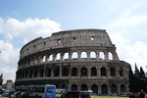
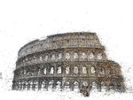
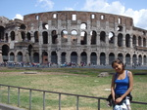
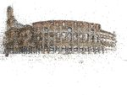
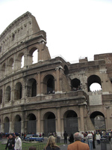
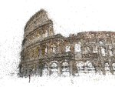
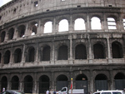
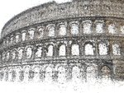
Large-scale structure from motion
Rome’s Colosseum
Building Rome in a Day, Agarwal et al. ICCV 2009

Slide 15
First step: Correspondence
Feature detection and matching

Slide 16
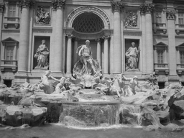
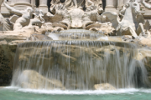
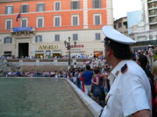
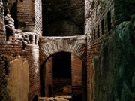
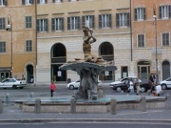
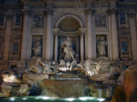
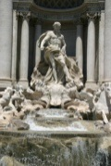
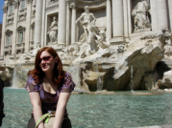
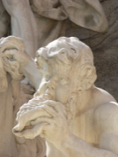
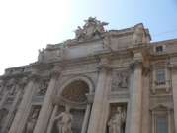
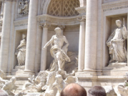
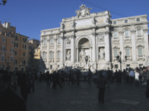
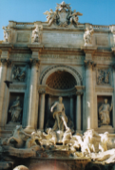
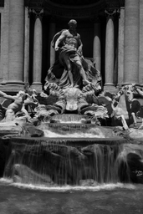
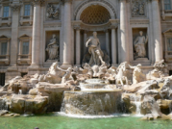
Feature detection
Detect features using SIFT [Lowe, IJCV 2004]
Notes:
So, we begin by detecting SIFT features in each photo.
[We detect SIFT features in each photo, resulting in a set of feature locations and 128-byte feature descriptors…]

Slide 17
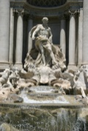
Feature detection
Detect features using SIFT [Lowe, IJCV 2004]

Slide 18
Feature matching
Match features between each pair of images
Notes:
Next, we match features across each pair of photos using approximate nearest neighbor matching.

Slide 19
Feature matching
Refine matching using RANSAC to estimate fundamental matrix between each pair
Notes:
The matches are refined by using RANSAC, which is a robust model-fitting technique, to estimate a fundamental matrix between each pair of matching images and keeping only matches consistent with that fundamental matrix.
We then link connected components of pairwise feature matches together to form correspondences across multiple images.
Once we have correspondences, we run structure from motion to recover the camera and scene geometry. Structure from motion solves the following problem:

Slide 20
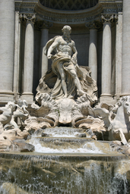
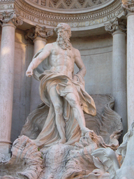
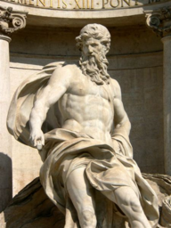
Correspondence estimation
Link up pairwise matches to form connected components of matches across several images
Image 1
Image 2
Image 3
Image 4
Notes:
The next step of our reconstruction algorithm is to link up matches between pairs of images into correspondences between multiple images, by finding connected components of matches. Suppose among these images, these features are matched only between consecutive pairs of images, perhaps because the scales of the images are so different. During correspondence estimation we link these matches and consider them to be 2D projections of a single 3D point in the scene.

Slide 21
The story so far…
Input images
Feature detection
Matching + track generation
Images with feature correspondence

Slide 22
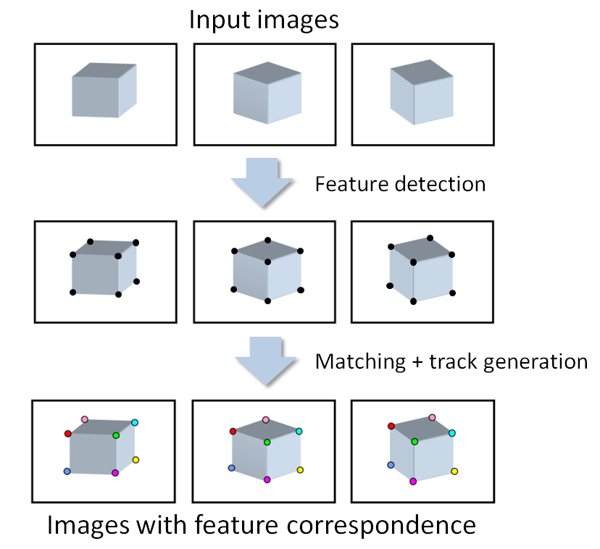
The story so far…
Next step:
Use structure from motion to solve for geometry (cameras and points)
First: what are cameras and points?

Slide 23
Review: Points and cameras
Point: 3D position in space ( )
Camera ( ):
A 3D position ( )
A 3D orientation ( )
Intrinsic parameters (focal length, aspect ratio, …)
7 parameters (3+3+1) in total

Slide 24
Structure from motion
X₄
X₁
X₃
minimize
X₂
g(R, T, X)
X₅
non-linear least squares
X₇
X₆
p_{1,1}
p_{1,3}
p_{1,2}
Camera 1
Camera 3
R₁,t₁
R₃,t₃
Camera 2
R₂,t₂
Notes:
Structure from motion solves the following problem:
Given a set of images of a static scene with 2D points in correspondence, shown here as color-coded points, find…
a set of 3D points P and
a rotation R and position t of the cameras that explain the observed correspondences. In other words, when we project a point into any of the cameras, the reprojection error between the projected and observed 2D points is low.
This problem can be formulated as an optimization problem where we want to find the rotations R, positions t, and 3D point locations P that minimize sum of squared reprojection errors f. This is a non-linear least squares problem and can be solved with algorithms such as Levenberg-Marquart. However, because the problem is non-linear, it can be susceptible to local minima. Therefore, it’s important to initialize the parameters of the system carefully. In addition, we need to be able to deal with erroneous correspondences.

Slide 25
Structure from motion
Minimize sum of squared reprojection errors:
Minimizing this function is called bundle adjustment
Optimized using non-linear least squares, e.g. Levenberg-Marquardt
predicted
image location
observed
image location
indicator variable:
is point i visible in image j ?

Slide 26
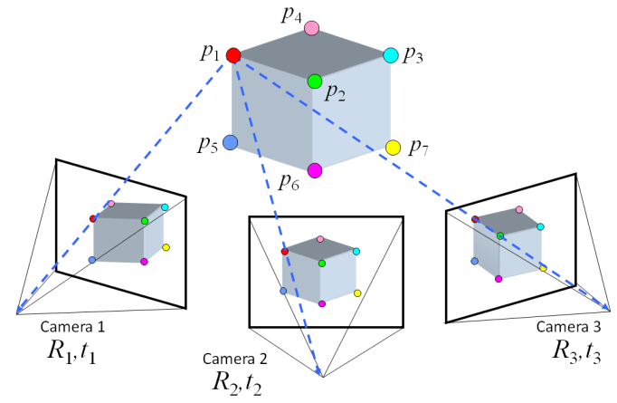
Solving structure from motion
Inputs: feature tracks
Outputs: 3D cameras and points
Challenges:
Large number of parameters (1000’s of cameras, millions of points)
Very non-linear objective function

Slide 27
Solving structure from motion
Inputs: feature tracks
Outputs: 3D cameras and points
Important tool: Bundle Adjustment [Triggs et al. ’00]
Joint non-linear optimization of both cameras and points
Very powerful, elegant tool
The bad news:
Starting from a random initialization is very likely to give the wrong answer
Difficult to initialize all the cameras at once
Notes:
This is optimization afterall

Slide 28
Solving structure from motion
Inputs: feature tracks
Outputs: 3D cameras and points
The good news:
Structure from motion with two cameras is (relatively) easy
Once we have an initial model, it’s easy to add new cameras
Idea:
Start with a small seed reconstruction, and grow

Slide 29
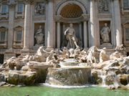
Incremental SfM
Automatically select an initial pair of images
Notes:
To help get good initializations for all of the parameters of the system, we reconstruct the scene incrementally, starting from two photographs and the points they observe.

Slide 30
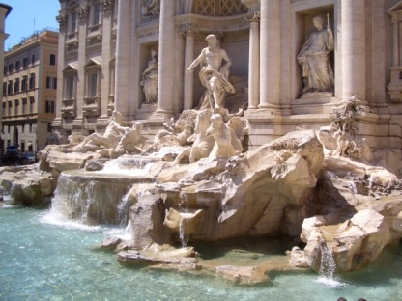
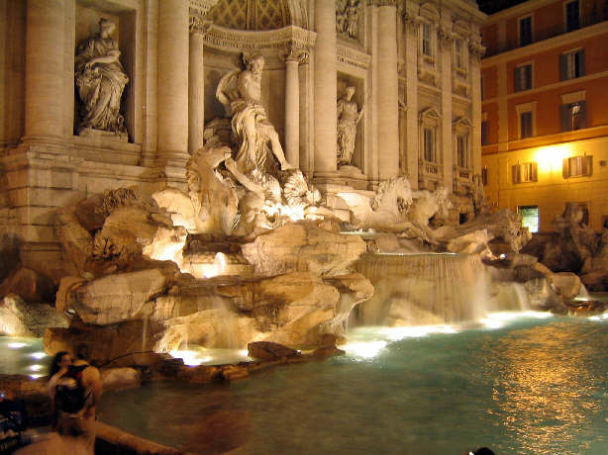
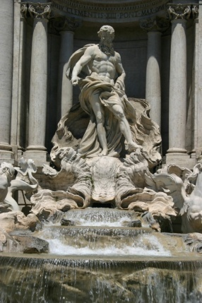
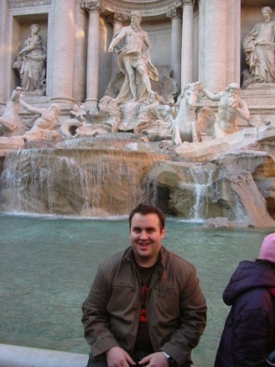
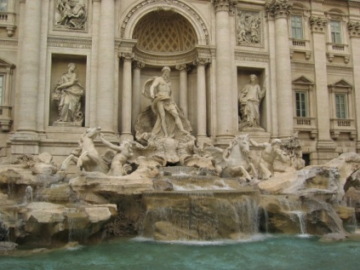
1. Picking the initial pair
We want a pair with many matches, but which has as large a baseline as possible
large baseline
very few matches
lots of matches
small baseline
large baseline
lots of matches

Slide 31
1. Picking the initial pair
Many possible heuristics
E.g.
Choose the pair with at least 100 matches, such that the ratio
is as small as possible
A homography will be a bad fit if there is sufficient parallax (and the scene is not planar)

Slide 32
2. Two-frame reconstruction
Input: two images with correspondence
Output: camera parameters, 3D points
In general, there can be ambiguities if the cameras are uncalibrated (camera intrinsics are unknown)
Usually assume that the only intrinsic parameter is an unknown focal length

Slide 33
2. Two-view reconstruction
Two-view SfM: Given two calibrated images with corresponding points, compute the camera and point positions
Solved by finding the essential matrix between the images

Slide 34
Incremental SfM: Algorithm
Pick a strong initial pair of images
Initialize the model using two-frame SfM
While there are connected images remaining:
Pick the image which sees the most existing 3D points
Estimate the pose of that camera
Triangulate any new points
Run bundle adjustment

Slide 35
Visual Simultaneous Localization and Mapping (V-SLAM)
Main differences with SfM:
Continuous visual input from sensor(s) over time
Gives rise to problems such as loop closure
Often the goal is to be online / real-time
Video from Daniel Cremer’s Lab
Notes:
More emphasis on the camera (localization) over structure, but you need the structure to localize yourself. Often in robots, does not have to use vision only.

