Slide 1
SfM / MVS / NeRF..
A lot of slides from Noah Snavely + Shree Nayar’s YT series: First principals of Computer Vision
CS180: Intro to Computer Vision and Comp. Photo
Angjoo Kanazawa & Alexei Efros, UC Berkeley, Fall 2025

Slide 2
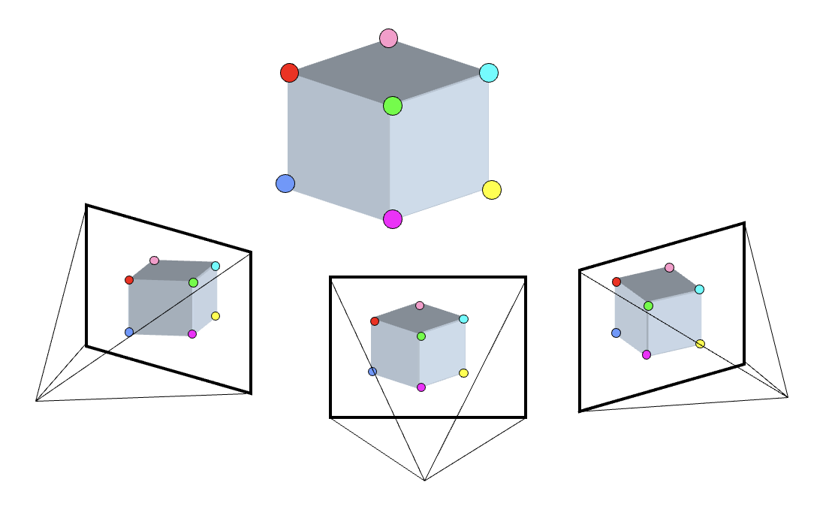
End of last lecture: Camera from Corresp
3D Points
(Structure)
Correspondences
Camera
(Motion)
Notes:
3D points + Correspondences ➔ Camera
Camera ➔ Correspondences
Correspondences + Camera ➔ 3D points

Slide 3
How to estimate the camera?
1. Estimate the fundamental/essential matrix with correspondences!
2. Another method: Calibration

Slide 4
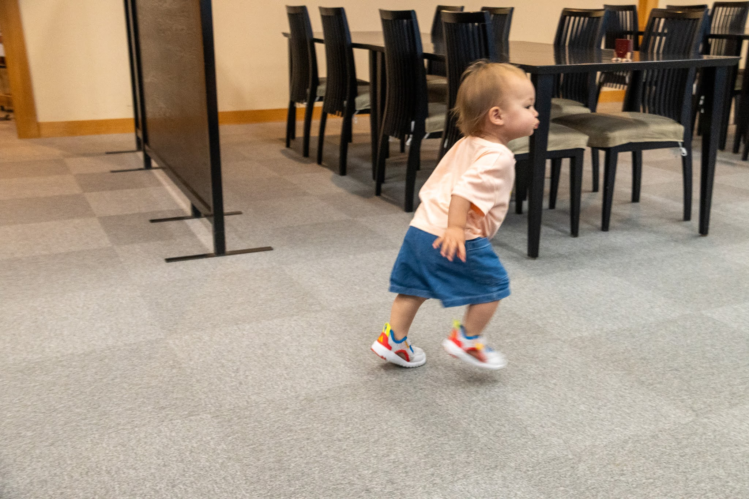
Problem: Solve for the camera
What are the camerea parameters?
Extrinsics (R, T)
Intrinsics (K)
How am I situated in the world + what is the shape of the ray
World origin
Focal length
Camera Rotation
Camera Translation

Slide 5
Calibration
Definition: Solve for camera using a known 3D structure + where it is in the image
Invasive / active
Can’t be done on existing pictures
World origin
Only have to do it once if the cameras are static

Slide 6
How to calibrate the camera?
If we know the points in 3D we can estimate the camera!!

Slide 7
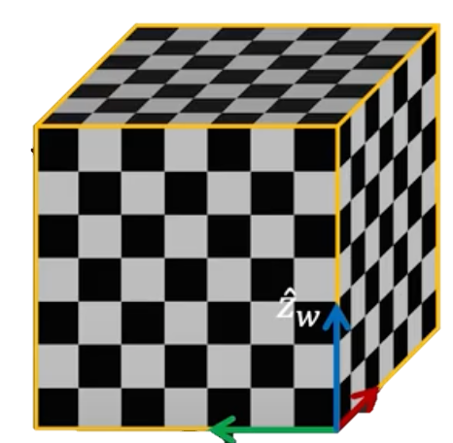
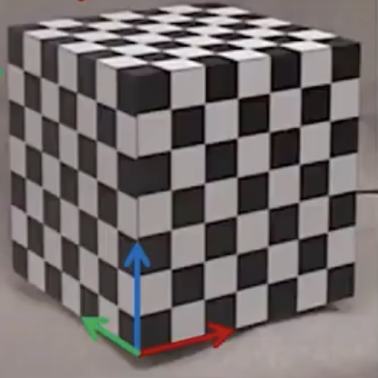
Step 1: With a known 3D object
1. Take a picture of an object with known 3D geometry
x’_{w}
y’_{w}
2. Identify correspondences
Slide from Shree Nayar

Slide 8
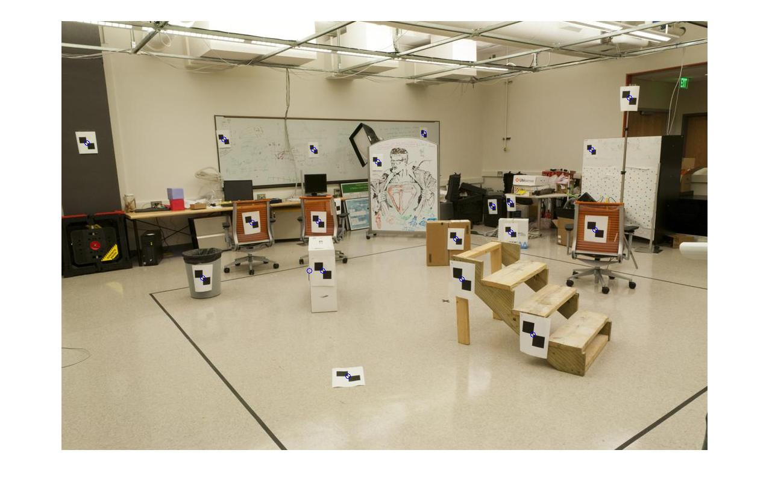
How do we calibrate a camera?
880 214
43 203
270 197
886 347
745 302
943 128
476 590
419 214
317 335
783 521
235 427
665 429
655 362
427 333
412 415
746 351
434 415
525 234
716 308
602 187
312.747 309.140 30.086
305.796 311.649 30.356
307.694 312.358 30.418
310.149 307.186 29.298
311.937 310.105 29.216
311.202 307.572 30.682
307.106 306.876 28.660
309.317 312.490 30.230
307.435 310.151 29.318
308.253 306.300 28.881
306.650 309.301 28.905
308.069 306.831 29.189
309.671 308.834 29.029
308.255 309.955 29.267
307.546 308.613 28.963
311.036 309.206 28.913
307.518 308.175 29.069
309.950 311.262 29.990
312.160 310.772 29.080
311.988 312.709 30.514
Notes:
Point in 3D to known point in 2D

Slide 9
Method: Set up a linear system
Solve for m’s entries using linear least squares
Ax=0 form
Similar to how you solved for homography!
Notes:
write as linear equation for every point. same way you solved for H Set m_34 to 1 for scale or enforce ||p||^2 = 1
Exactly the same as Homography! (but here we have 11 unknowns instead of 8)
solve with eigen value p is smallest eigenvalue of A^TA You go x = MX → x cross MX = 0 and get the equation

Slide 10
Can we factorize M back to K [R | T]?
Yes.
Why? because K and R have a very special form:
QR decomposition
Practically, use camera calibration packages (there is a good one in OpenCV)
Notes:
R is orthonormal & K is upper triangular → QR factorization
T can be recovered as K^{-1} [m14; m24; m34]
There’s lens parameters.. we’re ignoring distortions

Slide 11
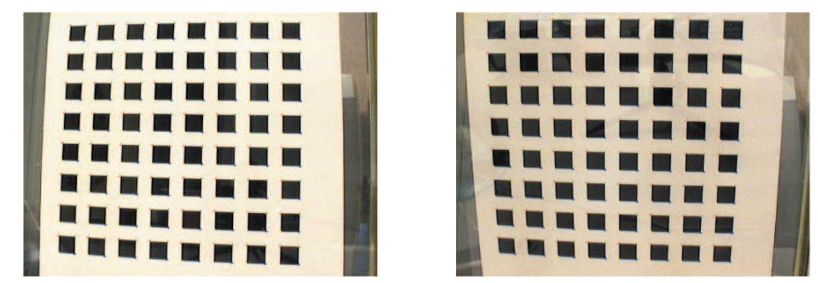
Inserting a 3D known object…
Also called “Tsai’scalibration” requires non-coplanar 3D points, is not very practical…
Modern day calibration uses a planar calibration target
Developed in 2000 by Zhang at Microsoft research
Zhang, A flexible new technique for camera calibration, IEEE Transactions on Pattern Analysis and Machine Intelligence, 2000

Slide 12
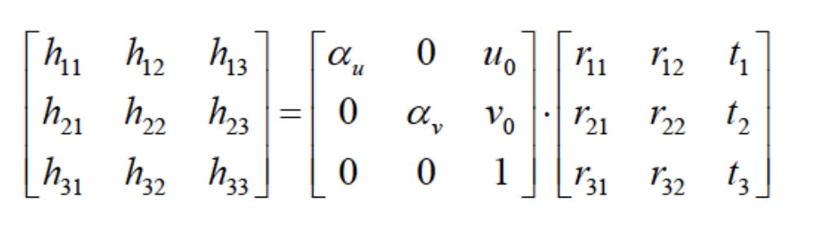
Doesn’t plane give you homography?
Yes! If it’s a plane, it’s only a homography, so instead of recovering 3x4 matrix, you will recover 3x3 in Zhang’s method
The 3x3 gives first two columns of R and T

Slide 13
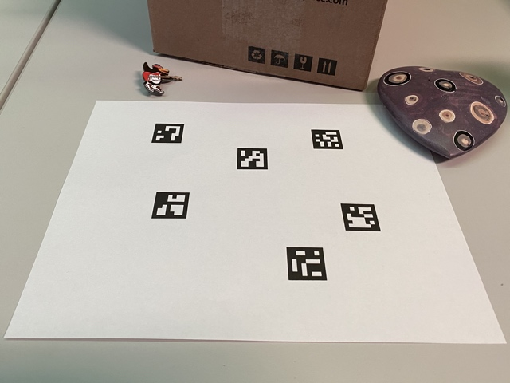
You will use Aruco tags

Slide 14
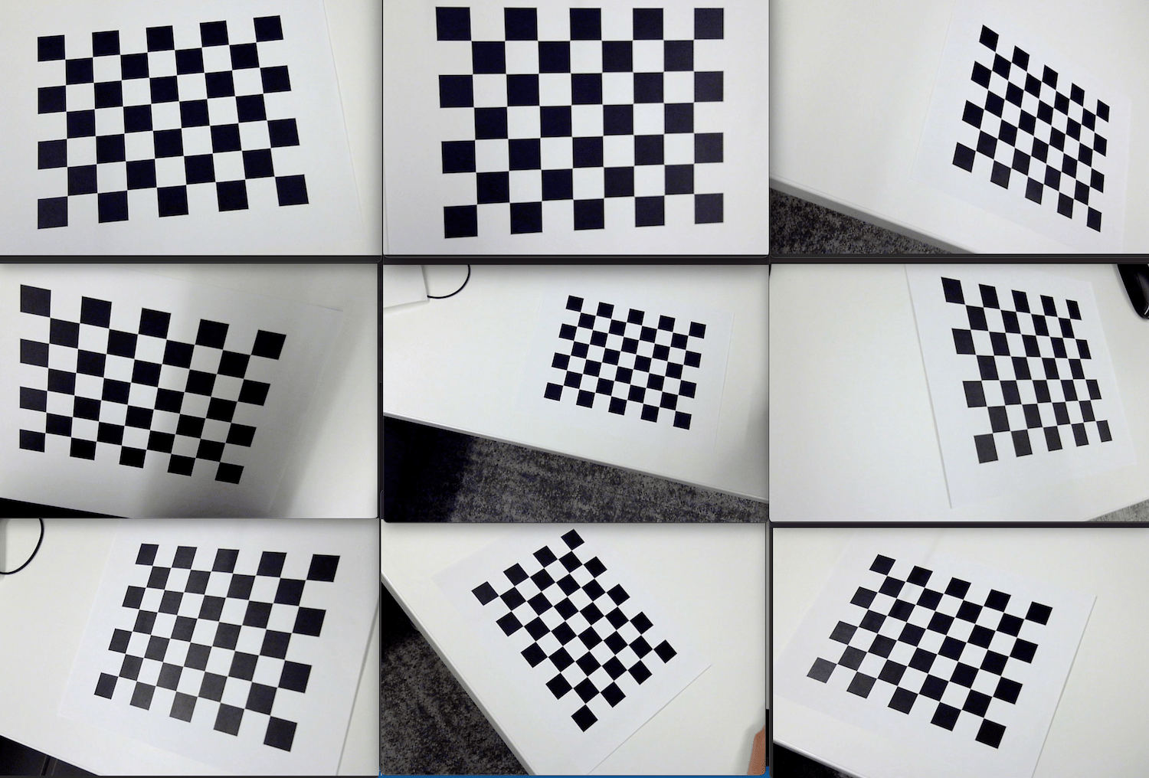
In practice: Step 0
Calibrate your intrinsics first, also estimates lens distortion (cv2.calibrateCamera)

Slide 15
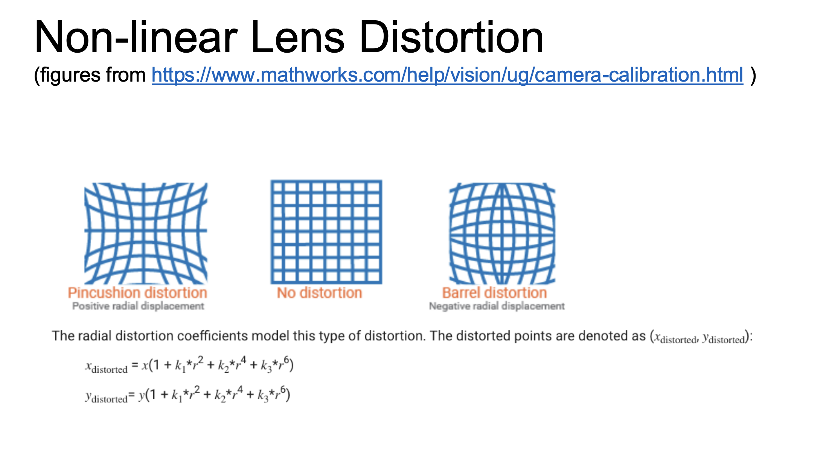
Step 1: Undistort your image

Slide 16
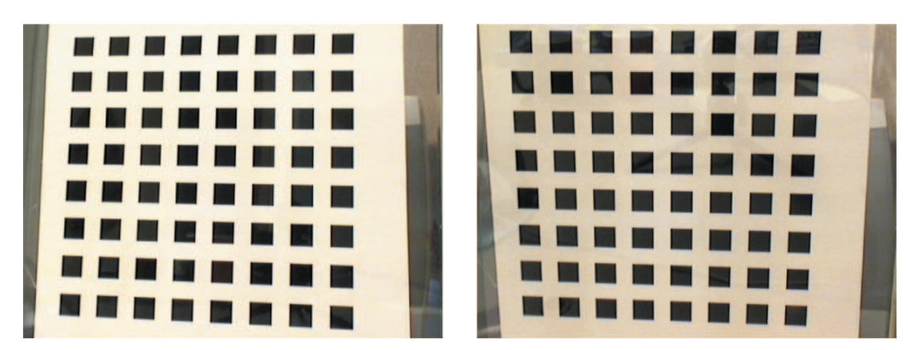
Step 1: Undistort your image
Cv2.undistort()

Slide 17
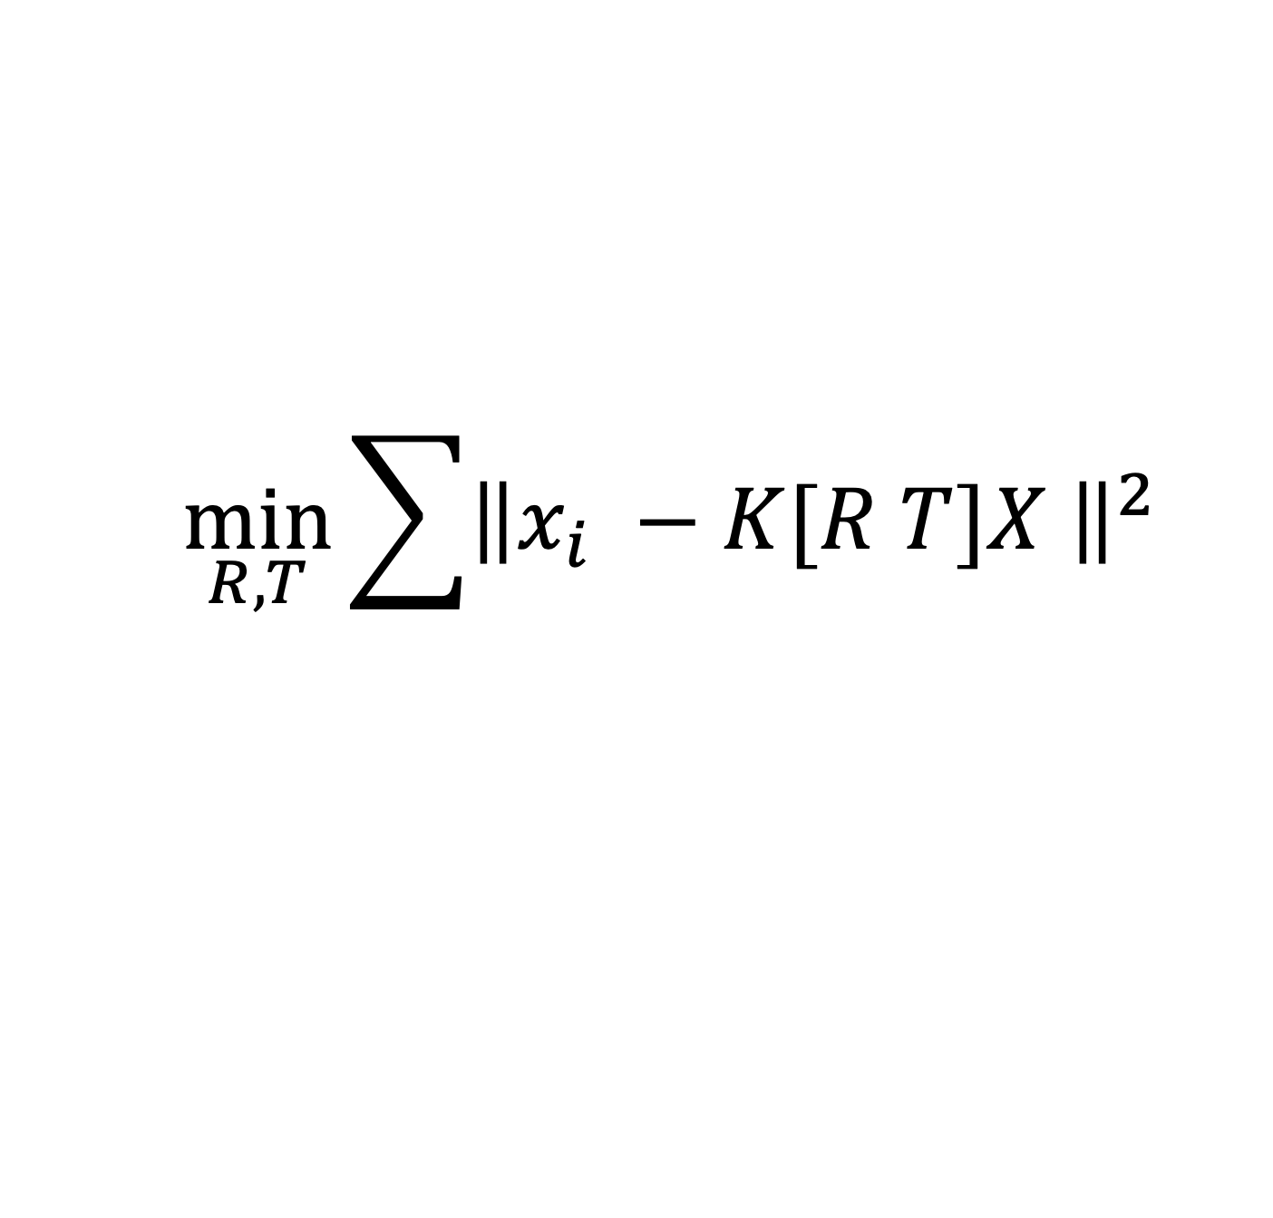
Step 2: Estimate camera with PnP
cv2.solvePnP()
PnP – “Perspective-n-Point” problem:
Estimate extrinsic parameters given n correspondences
Minimize reprojection loss with non-linear least squares
$$\min_{R, T}{\sum{{\left\|x_{i} −K[R T]X \right\|}^{2}}}$$
In general you do DLT first (Ax=0), then use that as initialization, or do other algorithms like Efficient PnP

Slide 18
Putting it all together
Structure-from-Motion: You know nothing! (except ok maybe intrinsics)
3D Points
(Structure)
UNKNOWN
Correspondences
Camera
(Motion)
ESTIMATED
UNKNOWN
Notes:
How this works: Corresp → Camera, for ransac verification, then you get initial estimate for points with triangulation, then you update the camera etc..

Slide 19
(after that): Neural Rendering
UNKNOWN
3D Representation
(Structure)
Correspondences
Camera
(Motion)
KNOWN
A form of multi-view stereo, more on this in the NeRF lecture.
Notes:
You have to start from something, always. It’s chicken and egg if you don’t know anything
What was this problem called?
3D points + Correspondences ➔ Camera
Camera ➔ Correspondences
Correspondences + Camera ➔ 3D points

Slide 20
Recap
Calibration: Known 3D point + correspondences → camera
Epipolar Geometry:
Camera → Correspondence (1D search!)
Correspondence → Camera (Estimate Essential Matrix)
Triangulation: Known Correspondences + Camera → 3D point

Slide 21
if you know 2 you get the other:
3D Points
(Structure)
Correspondences
Camera
(Motion)
Notes:
You have to start from something, always. It’s chicken and egg if you don’t know anything
What was this problem called?
3D points + Correspondences ➔ Camera
Camera ➔ Correspondences
Correspondences + Camera ➔ 3D points

Slide 22
Camera Calibration; aka Perspective-n-Point
3D Points
(Structure)
Correspondences
Camera
(Motion)
Notes:
You have to start from something, always. It’s chicken and egg if you don’t know anything
What was this problem called?
3D points + Correspondences ➔ Camera
Camera ➔ Correspondences
Correspondences + Camera ➔ 3D points

Slide 23
Stereo (w/2 cameras); aka Triangulation
3D Points
(Structure)
Correspondences
Camera
(Motion)
Notes:
You have to start from something, always. It’s chicken and egg if you don’t know anything
What was this problem called?
3D points + Correspondences ➔ Camera
Camera ➔ Correspondences
Correspondences + Camera ➔ 3D points

Slide 24
You can easily get correspondence via projection from 3D points + Camera
3D Points
(Structure)
Correspondences
Camera
(Motion)

Slide 25
Ultimate: Structure-from-Motion
UNKNOWN
3D Points
(Structure)
Correspondences
Camera
(Motion)
UNKNOWN
UNKNOWN
Start from nothing known (except maybe intrinsics), exploit the relationship to slowly get the right answer
Notes:
You have to start from something, always. It’s chicken and egg if you don’t know anything
What was this problem called?
3D points + Correspondences ➔ Camera
Camera ➔ Correspondences
Correspondences + Camera ➔ 3D points

Slide 26
Structure from Motion (SfM)
SfM solves both of these problems at once
A kind of chicken-and-egg problem
(but solvable)

Slide 27
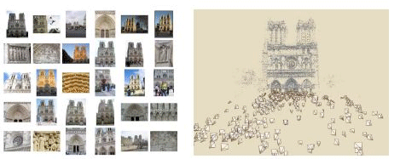
Photo Tourism
Noah Snavely, Steven M. Seitz, Richard Szeliski, "Photo tourism: Exploring photo collections in 3D," SIGGRAPH 2006
https://youtu.be/mTBPGuPLI5Y

Slide 28
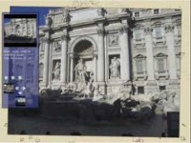

Slide 29
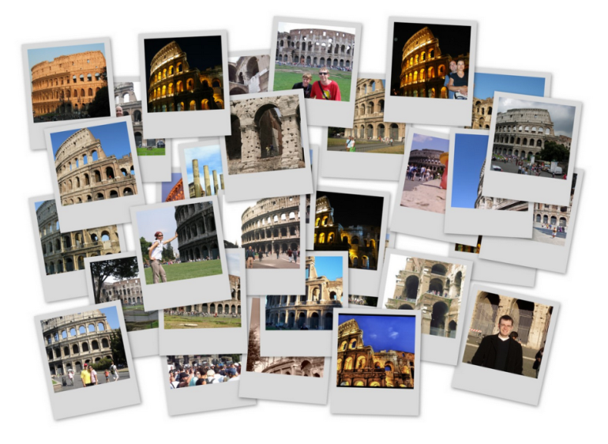
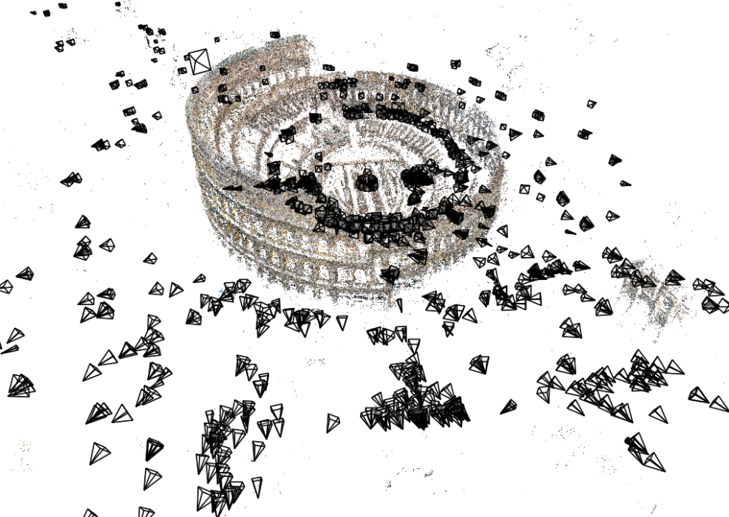
Structure from Motion (SfM)
Given many images, how can we
a) figure out where they were all taken from?
b) build a 3D model of the scene?
This is (roughly) the structure from motion problem

Slide 30
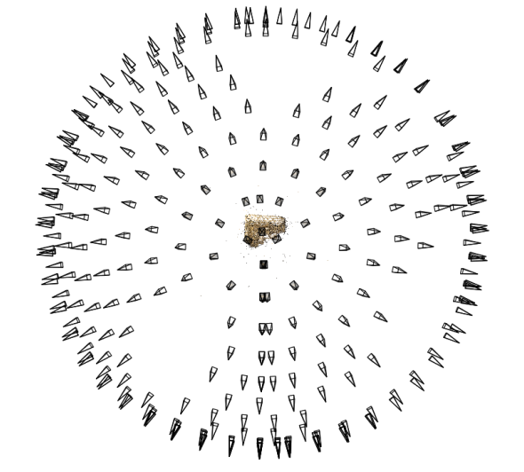
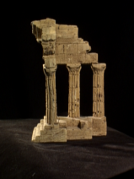
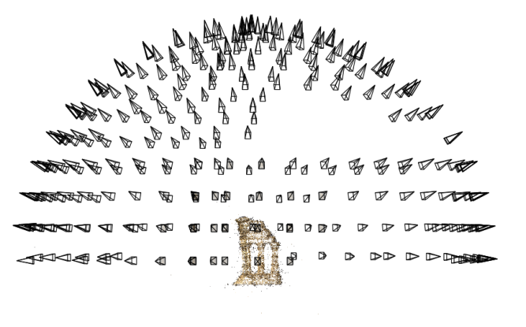
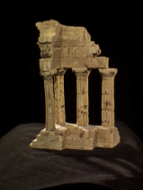
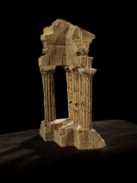
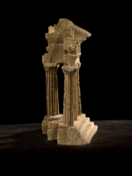
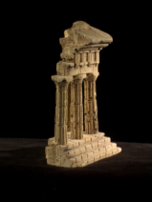
Structure from motion
Reconstruction (side)
(top)
Input: images with points in correspondence p_{i,j} = (u_{i,j},v_{i,j})
Output
structure: 3D location x_{i} for each point p_{i}
motion: camera parameters R_{j} , t_{j} possibly K_{j}
Objective function: minimize reprojection error

Slide 31

Large-scale structure from motion
Dubrovnik, Croatia. 4,619 images (out of an initial 57,845).
Total reconstruction time: 23 hours
Number of cores: 352
Building Rome in a Day, Agarwal et al. ICCV 2009

Slide 32
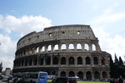
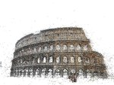
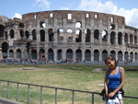
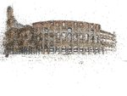
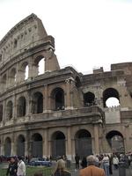
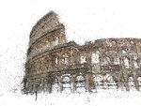
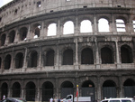
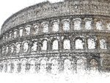
Large-scale structure from motion
Rome’s Colosseum
Building Rome in a Day, Agarwal et al. ICCV 2009

Slide 33
First step: Correspondence
Feature detection and matching

Slide 34
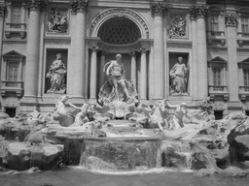
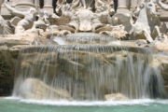
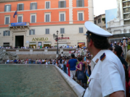
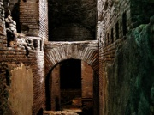

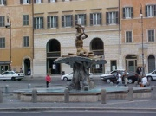
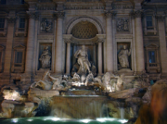
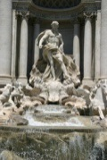

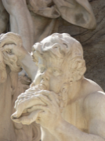
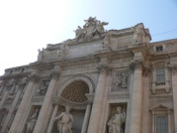
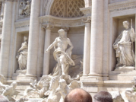
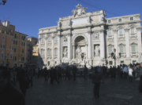
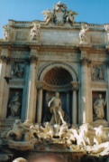
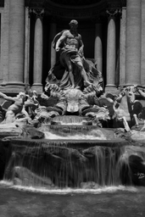

Feature detection
Detect features using SIFT [Lowe, IJCV 2004]
Notes:
So, we begin by detecting SIFT features in each photo.
[We detect SIFT features in each photo, resulting in a set of feature locations and 128-byte feature descriptors…]

Slide 35


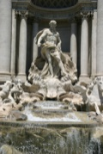


Feature detection
Detect features using SIFT [Lowe, IJCV 2004]

Slide 36
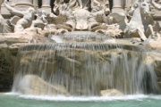




Feature matching
Match features between each pair of images
Notes:
Next, we match features across each pair of photos using approximate nearest neighbor matching.

Slide 37



Feature matching
Refine matching using RANSAC to estimate fundamental matrix between each pair
Notes:
The matches are refined by using RANSAC, which is a robust model-fitting technique, to estimate a fundamental matrix between each pair of matching images and keeping only matches consistent with that fundamental matrix.
We then link connected components of pairwise feature matches together to form correspondences across multiple images.
Once we have correspondences, we run structure from motion to recover the camera and scene geometry. Structure from motion solves the following problem:

Slide 38

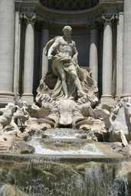
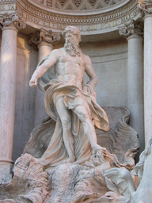
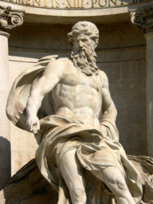
Correspondence estimation
Link up pairwise matches to form connected components of matches across several images
Image 1
Image 2
Image 3
Image 4
Notes:
The next step of our reconstruction algorithm is to link up matches between pairs of images into correspondences between multiple images, by finding connected components of matches. Suppose among these images, these features are matched only between consecutive pairs of images, perhaps because the scales of the images are so different. During correspondence estimation we link these matches and consider them to be 2D projections of a single 3D point in the scene.

Slide 39
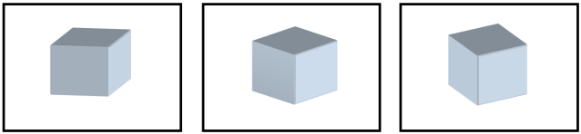

The story so far…
Input images
Feature detection
Matching + track generation
Images with feature correspondence

Slide 40

What comes after correspondences?
Next step:
Use structure from motion to solve for geometry (cameras and points)
First: what are cameras and points?

Slide 41





Review: Points and cameras
Point: 3D position in space ( )
Camera ( ):
A 3D position ( )
A 3D orientation ( )
Intrinsic parameters (focal length, aspect ratio, …)
7 parameters (3+3+1) in total
Notes:
We fix the scale by convention like the first baseline is 1, so that we solve for a globally consistent scale

Slide 42

Structure from motion
X₄
X₁
X₃
minimize
X₂
g(R, T, X)
X₅
non-linear least squares
X₇
X₆
p_{1,1}
p_{1,3}
p_{1,2}
Camera 1
Camera 3
R₁,t₁
R₃,t₃
Camera 2
R₂,t₂
Notes:
Structure from motion solves the following problem:
Given a set of images of a static scene with 2D points in correspondence, shown here as color-coded points, find…
a set of 3D points P and
a rotation R and position t of the cameras that explain the observed correspondences. In other words, when we project a point into any of the cameras, the reprojection error between the projected and observed 2D points is low.
This problem can be formulated as an optimization problem where we want to find the rotations R, positions t, and 3D point locations P that minimize sum of squared reprojection errors f. This is a non-linear least squares problem and can be solved with algorithms such as Levenberg-Marquart. However, because the problem is non-linear, it can be susceptible to local minima. Therefore, it’s important to initialize the parameters of the system carefully. In addition, we need to be able to deal with erroneous correspondences.

Slide 43


Structure from motion
Minimize sum of squared reprojection errors:
Minimizing this function is called bundle adjustment
Optimized using non-linear least squares, e.g. Levenberg-Marquardt
predicted
image location
observed
image location
indicator variable:
is point i visible in image j ?

Slide 44

Solving structure from motion
Inputs: feature tracks
Outputs: 3D cameras and points
Challenges:
Large number of parameters (1000’s of cameras, millions of points)
Very non-linear objective function

Slide 45
Solving structure from motion
Inputs: feature tracks
Outputs: 3D cameras and points
Important tool: Bundle Adjustment [Triggs et al. ’00]
Joint non-linear optimization of both cameras and points
Very powerful, elegant tool
The bad news:
Starting from a random initialization is very likely to give the wrong answer
Difficult to initialize all the cameras at once
Notes:
This is optimization afterall

Slide 46
Solving structure from motion
Inputs: feature tracks
Outputs: 3D cameras and points
The good news:
Structure from motion with two cameras is (relatively) easy
Once we have an initial model, it’s easy to add new cameras
Idea:
Start with a small seed reconstruction, and grow

Slide 47








Incremental SfM
Automatically select an initial pair of images
Notes:
To help get good initializations for all of the parameters of the system, we reconstruct the scene incrementally, starting from two photographs and the points they observe.

Slide 48








1. Picking the initial pair
We want a pair with many matches, but which has as large a baseline as possible
large baseline
very few matches
lots of matches
small baseline
large baseline
lots of matches

Slide 49

1. Picking the initial pair
Many possible heuristics
E.g.
Choose the pair with at least 100 matches, such that the ratio
is as small as possible
A homography will be a bad fit if there is sufficient parallax (and the scene is not planar)

Slide 50
2. Two-frame reconstruction
Input: two images with correspondence
Output: camera parameters, 3D points
In general, there can be ambiguities if the cameras are uncalibrated (camera intrinsics are unknown)
Usually assume that the only intrinsic parameter is an unknown focal length

Slide 51
2. Two-view reconstruction
Two-view SfM: Given two calibrated images with corresponding points, compute the camera and point positions
Solved by finding the essential matrix between the images

Slide 52
Incremental SfM: Algorithm
Pick a strong initial pair of images
Initialize the model using two-frame SfM
While there are connected images remaining:
Pick the image which sees the most existing 3D points
Estimate the pose of that camera
Triangulate any new points
Run bundle adjustment

Slide 53

Visual Simultaneous Localization and Mapping (V-SLAM)
Main differences with SfM:
Continuous visual input from sensor(s) over time
Gives rise to problems such as loop closure
Often the goal is to be online / real-time
Video from Daniel Cremer’s Lab
Notes:
More emphasis on the camera (localization) over structure, but you need the structure to localize yourself. Often in robots, does not have to use vision only.

Slide 54

Now what, are we done?
What does SfM give you
Sparse points!!! Why?

Slide 55

What if we want solid models?
Slide credit: Noah Snavely
Notes:
For example, Google maps and google earth make heavy use of this to reconstruct cities,

Slide 56
Multi-View Stereo (after SfM), i.e. known camera

Slide 57



Multi-view Stereo (Lots of calibrated images)
Input: calibrated images from several viewpoints (known camera: intrinsics and extrinsics)
Output: 3D Model
Figures by Carlos Hernandez
In general, conducted in a controlled environment with multi-camera setup that are all calibrated
Slide credit: Noah Snavely
Notes:
In general MVS gives you more dense points
It’s common to derive something like a triangle mesh from such point clouds or depth maps, but that is more of a topic for computational geometry.

Slide 58

Notes:
It’s used in indoor settings for robotics applications, virtual real estate, and people are trying out new applications in this space all the time

Slide 59




Multi-view Stereo
Problem formulation: given several images of the same object or scene, compute a representation of its 3D shape
Binocular Stereo
Multi-view stereo
Slide credit: Noah Snavely

Slide 60






Multi-view stereo: Basic idea
Is this a surface point?
reference view
neighbor views
Source: Y. Furukawa
Notes:
So the basic idea of Multiview stereo starts with
*a single reference view of the scene
*And some number of neighboring views
*Now, much like with regular stereo, we’re going to tackle the problem by trying to figure out the depth of each pixel in our reference image
*which we can do by sampling depths along the ray corresponding to each reference PIXEL
*So for each depth we sample, we can project the corresponding point into the other images and if the corresponding patches look like they image the same part of the scene

Slide 61
Multi-view stereo: Basic idea
Evaluate the likelihood of geometry at a particular depth for a particular reference patch:
Corresponding patches at depth guess in other views
?
Patch from reference View
reference view
neighbor views
Source: Y. Furukawa
Notes:
So, again, we’re evaluating the likelihood of a particular depth based on this idea that
IF THERE REALLY IS visible surface geometry at that depth, then these patches should look like the corresponding one in our reference view
And we can use something like sum of squared differences to measure error according to that similarity

Slide 62

Multi-view stereo: Basic idea
Photometric error across different depths
reference view
neighbor views
Source: Y. Furukawa
Notes:
So now for each reference pixel we have different error values across different guesses for the corresponding depth

Slide 63
Multi-view stereo: Basic idea
Photometric error across different depths
reference view
neighbor views
Source: Y. Furukawa
Notes:
And we can search along

Slide 64
Multi-view stereo: Basic idea
Photometric error across different depths
In this manner, solve for a depth map over the whole reference view
reference view
neighbor views
Source: Y. Furukawa
Notes:
Until we find some convincing minimum for this error
*and if we do this for every pixel in the reference image then we get a depth map

Slide 65
Multi-view stereo: advantages over 2 view
Can match windows using more than 1 other image, giving a stronger match signal
If you have lots of potential images, can choose the best subset of images to match per reference image
Can reconstruct a depth map for each reference frame, and the merge into a complete 3D model
Source: Y. Furukawa
Notes:
So why is Multiview stereo better than regular 2-image stereo?
*well, you have multiple neighbors with which to compare, which tends to make results more robust to things like noise or occlusion
*and if you have lots of neighbors, some may be more useful than others, but you at least have the ability to choose some best subset to use.
*and each image can be a reference frame, which you can combine later to get a more complete 3D model

Slide 66
Choosing the baseline
all of these
points project
to the same
pair of pixels
width of
a pixel
Large Baseline
Small Baseline
What’s the optimal baseline?
Too small: large depth error
Too large: difficult search problem
Slide credit: Noah Snavely
Notes:
Now one thing that has a pretty big effect on your results is the size of the baseline between your cameras.
*if it’s too small, then you end up with poor depth resolution. Intuitively, you can think of the limit of this being no baseline at all, which means you have just one image, and each pixel could be at any depth.
*and if the baseline is too large then it means that a point in one image could appear in a lot of different places in the other image, which can turn into a hard search problem

Slide 67


Single depth map often isn’t enough
Source: N. Snavely

Slide 68
Really want full coverage
Source: N. Snavely

Slide 69




Idea: Combine many depth maps
Source: N. Snavely

Slide 70
Volumetric stereo
Discretized
Scene Volume
Input Images
(Calibrated)
Goal: Assign RGB values to voxels in V
photo-consistent with images

Slide 71
Space Carving
Image 1
Image N
…...
Space Carving Algorithm
Initialize to a volume V containing the true scene
Choose a voxel on the outside of the volume
Project to visible input images
Carve if not photo-consistent
Repeat until convergence
K. N. Kutulakos and S. M. Seitz, A Theory of Shape by Space Carving, ICCV 1999

Slide 72




Space Carving Results
Input Image (1 of 45)
Reconstruction
Reconstruction
Reconstruction
Source: S. Seitz

Slide 73
Tool for you: COLMAP
https://github.com/colmap/colmap
A general SfM + MVS pipeline

Slide 74
Multi-View Stereo
3D Points
(Structure)
Correspondences
Camera
(Motion)
Notes:
You have to start from something, always. It’s chicken and egg if you don’t know anything
What was this problem called?
3D points + Correspondences ➔ Camera
Camera ➔ Correspondences
Correspondences + Camera ➔ 3D points

Slide 75
Volumetric “Neural” Rendering
3D Points
(Structure)
Correspondences
Camera
(Motion)
Does not use explicit correspondences,
relies on reconstruction loss (Analysis-by-Synthesis)
Notes:
not explicity

Slide 76

Neural Radiance Fields
Video from the original ECCV’20 paper

