Slide 1
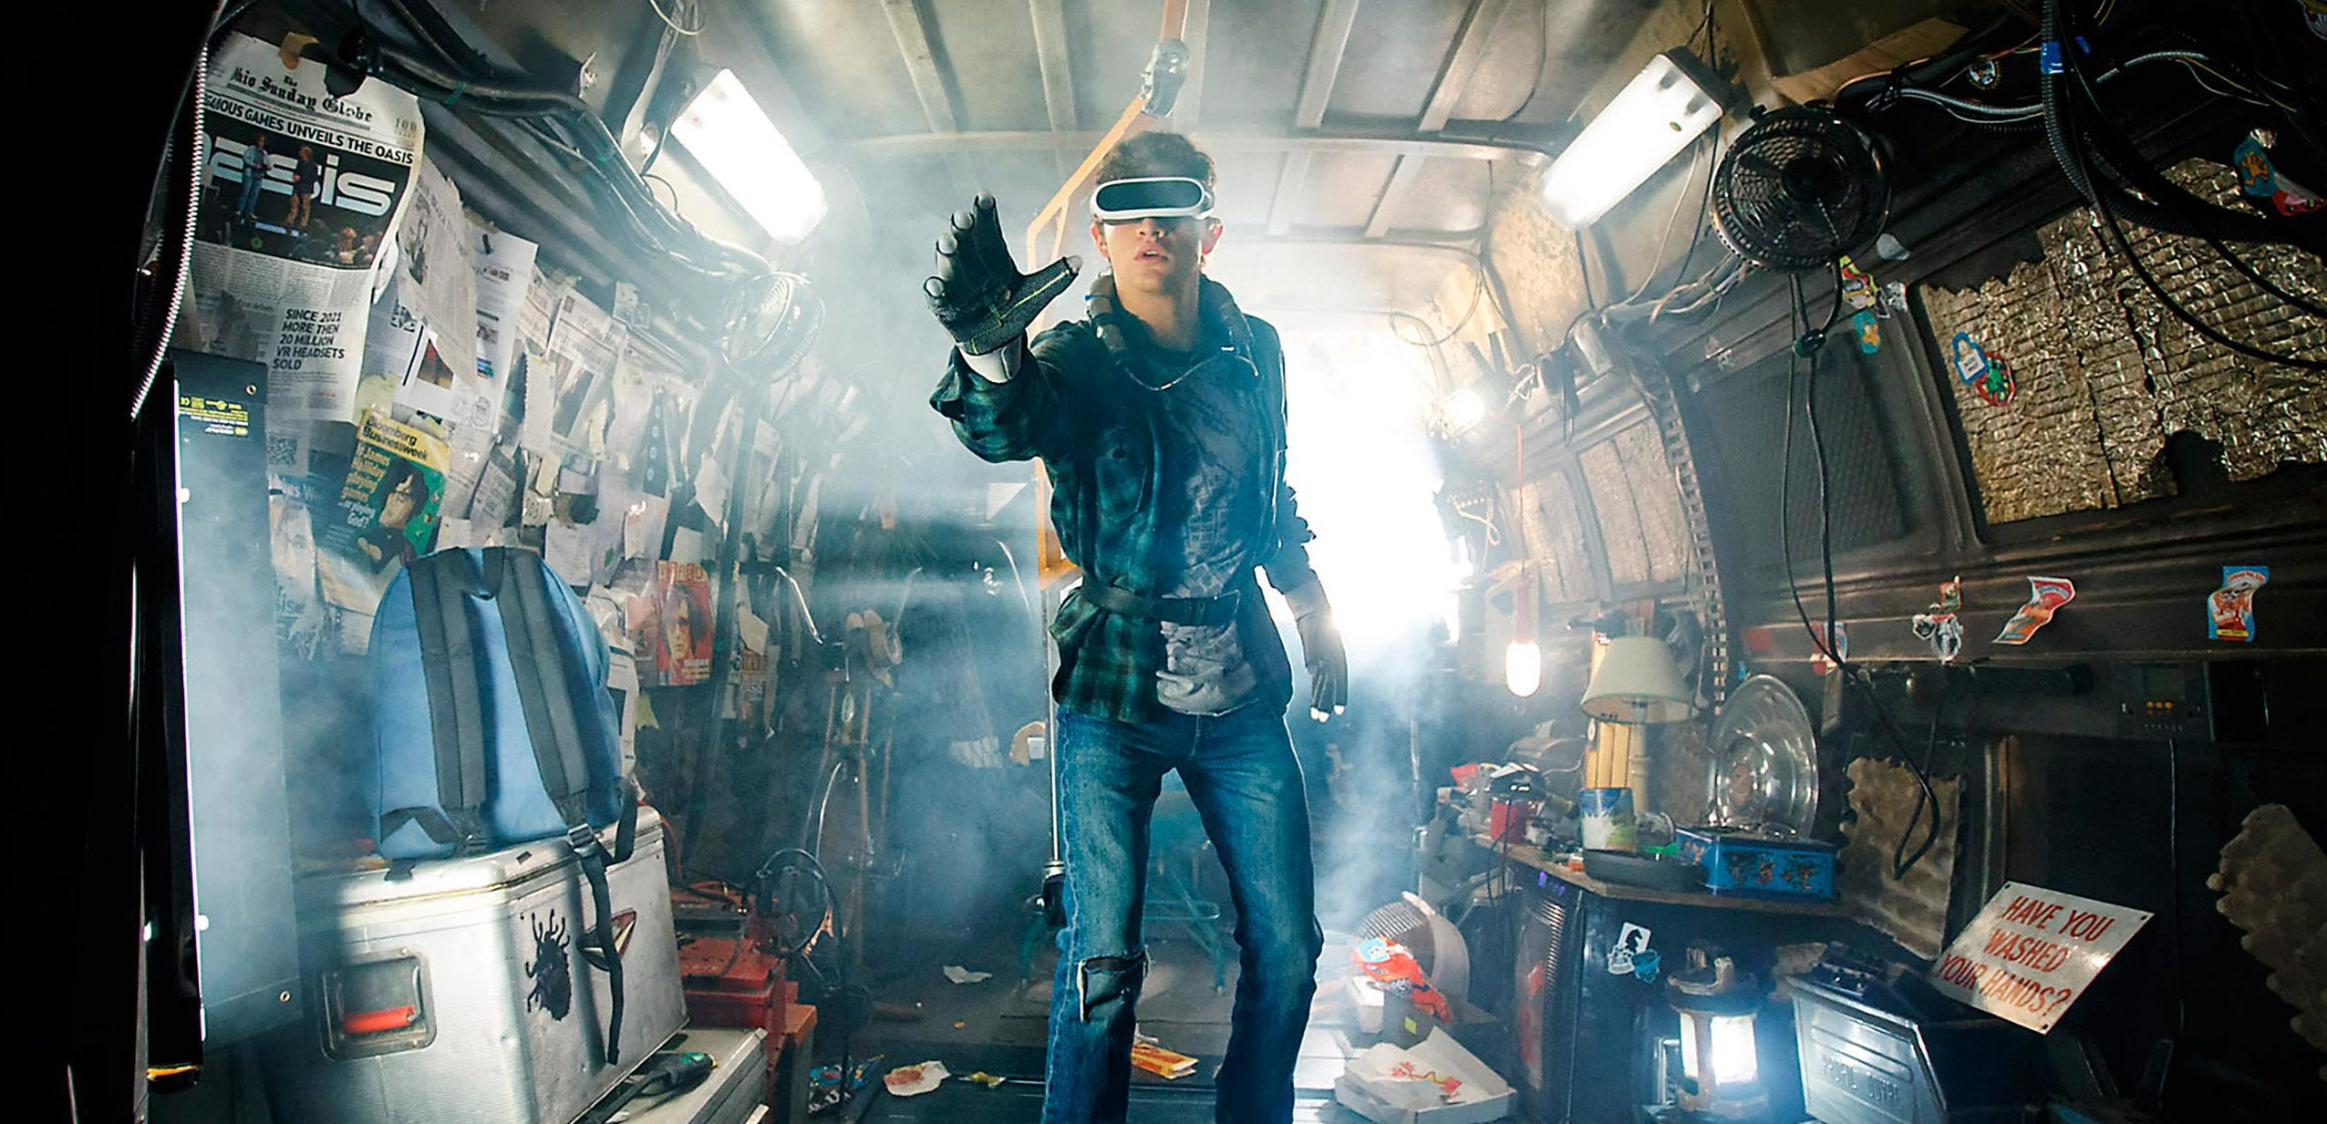
Stereo
A lot of slides from Noah Snavely + Shree Nayar’s YT series: First principals of Computer Vision
CS180: Intro to Computer Vision and Comp. Photo
Angjoo Kanazawa & Alexei Efros, UC Berkeley, Fall 2025

Slide 2
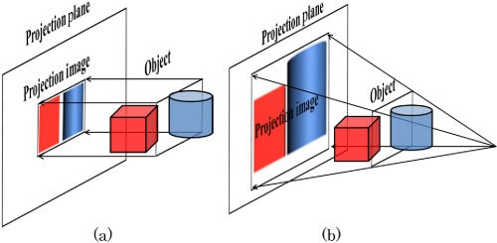

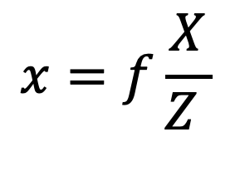
Orthographic Projection
Perspective Projection
Scaled Orthographic Projection
$$x=f\frac{X}{Z }$$
$$x=sX$$
- Approximates a very far away object or focal length, s ≅ f/z, with large enough z or f.
- Rays are parallel.
- Used for technical drawings, megical imaging, video games, simple approx in 3D vision

Slide 3
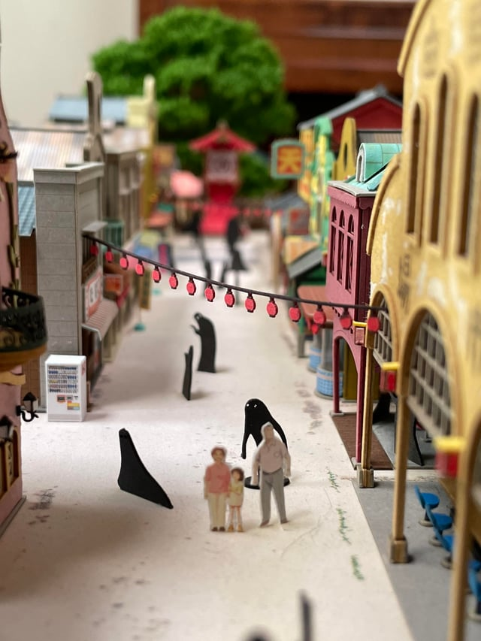
Scale ambiguity
Can you tell exactly how big this diorama is?
Even if you know the focal length? No, because two different scaled world produce identical images even with the same known focal length

Slide 4
We do not know the scale of things even if we know the focal length
Structure and depth are inherently ambiguous from single views.
P1
P2
P1’=P2’
Optical center
You have to know the depths and focal length in order to figure out the size
Notes:
But if you know the camera, you know one thing → which is?

Slide 5
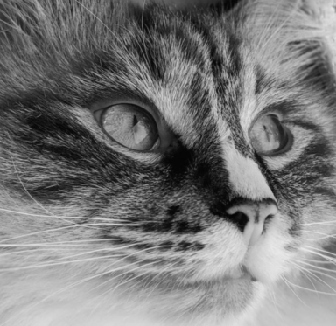
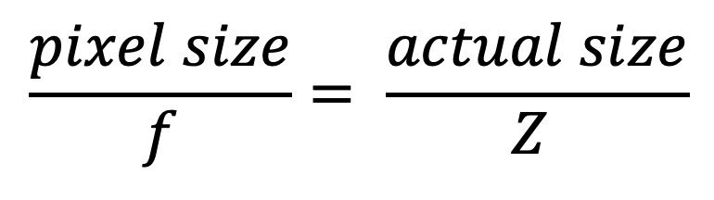
Image plane
50 cm
optical center
5 px
f = 10 mm
Z (depth)
$$\frac{pixel size}{f}= \frac{actual size}{Z }$$
✅
❓
❓
❓
You need to know 3 parameters to figure out the 4th ... This is why vision is hard!

Slide 6
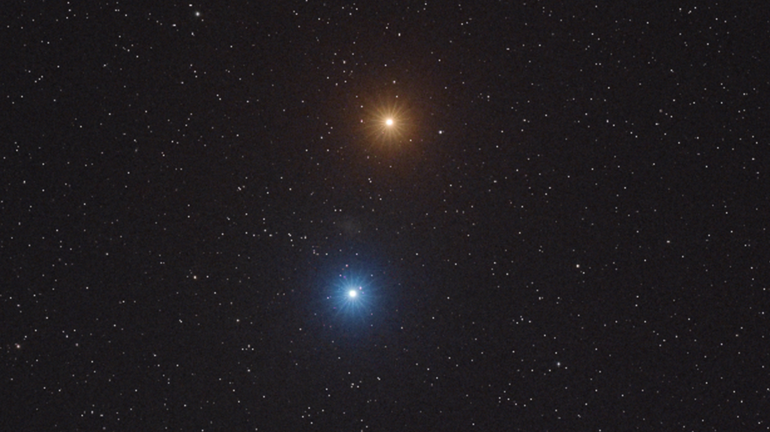
What does focal length give you?
What is the angle between these stars relative to you?

Slide 7
What does focal length give you?
What is the angle between these stars relative to you?
If focal length is very small =
wide angle camera
i.e. this could be covering the entire sky
Angle between the star is wide
Optical center

Slide 8
What does focal length give you?
What is the angle between these stars relative to you?
If focal length is very large =
Almost orthographic
Angle between the star is narrow
Optical center
Two very different interpretations! And you don’t know unless you know/guess the focal length

Slide 9
Big picture
We know the projective geometry now
Now lets use two cameras (stereo) to estimate the geometry!
Assume the projection matrix is known (K,R,T)
Goal: Compute depth of every point in each image

Slide 10
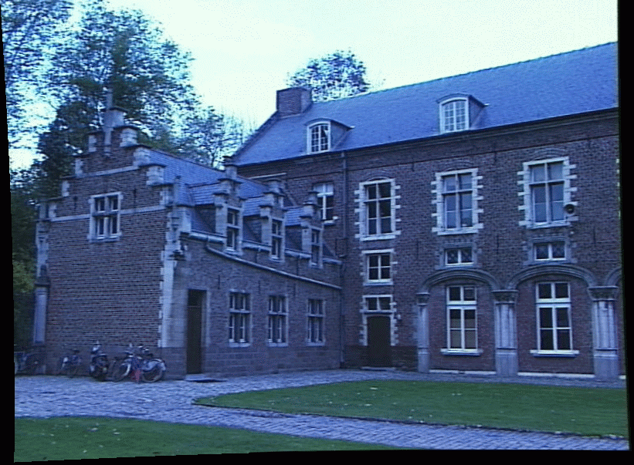
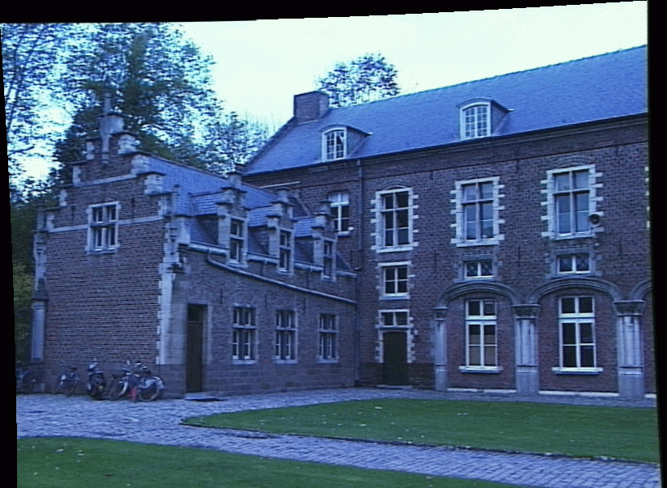
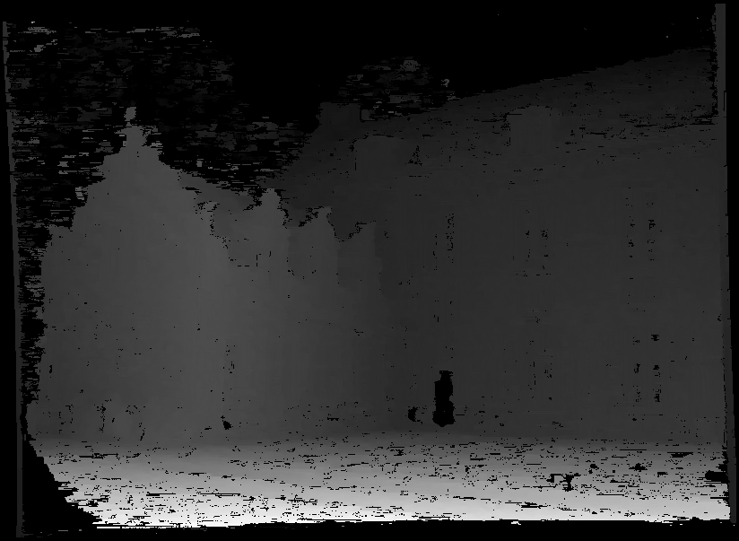
Stereo reconstruction: main steps
Calibrate cameras
Compute disparity
Estimate depth
disparity
Grauman

Slide 11
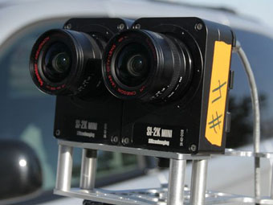
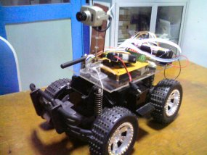
Stereo vision
Two cameras, simultaneous views
Single moving camera and static scene

Slide 12
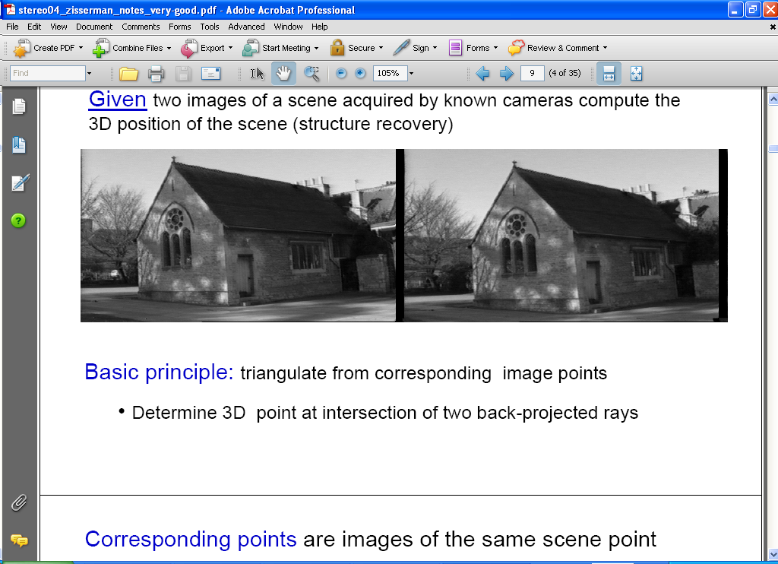
Estimating depth with stereo
Stereo: shape from “motion” between two views
We’ll need to consider:
1. Camera pose (“calibration”) – assume known for now
2. Image point correspondences
scene point
image plane
optical center
Notes:
12

Slide 13
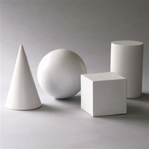
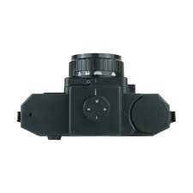
Simple Stereo Setup
Assume parallel optical axes
Two cameras are calibrated
Find relative depth
Key Idea: difference in corresponding points to understand shape
Slide credit: Noah Snavely

Slide 14
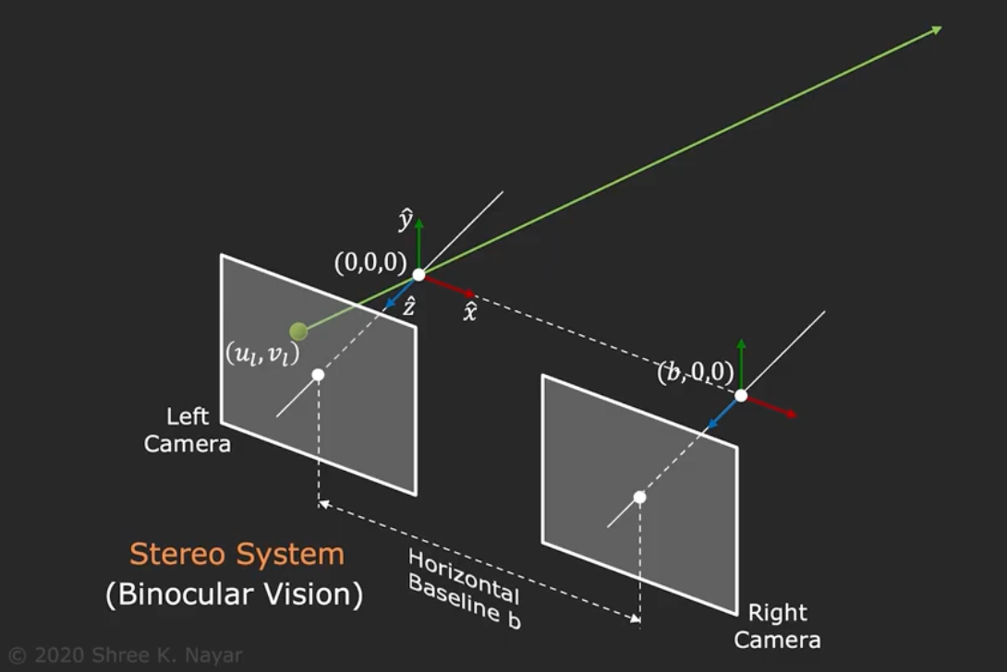
Triangulation using two cameras
Notes:
Left and right camera are identical

Slide 15
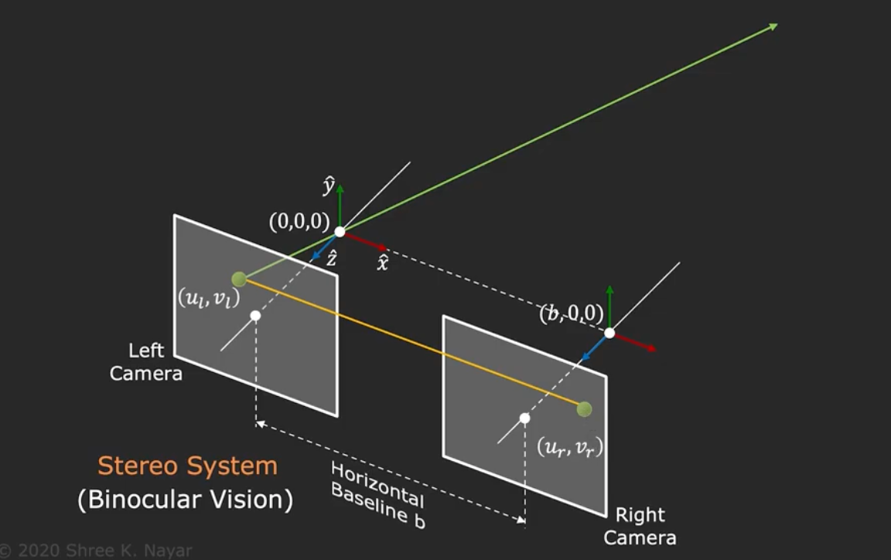
Triangulation using two cameras
Notes:
Left and right camera are identical

Slide 16
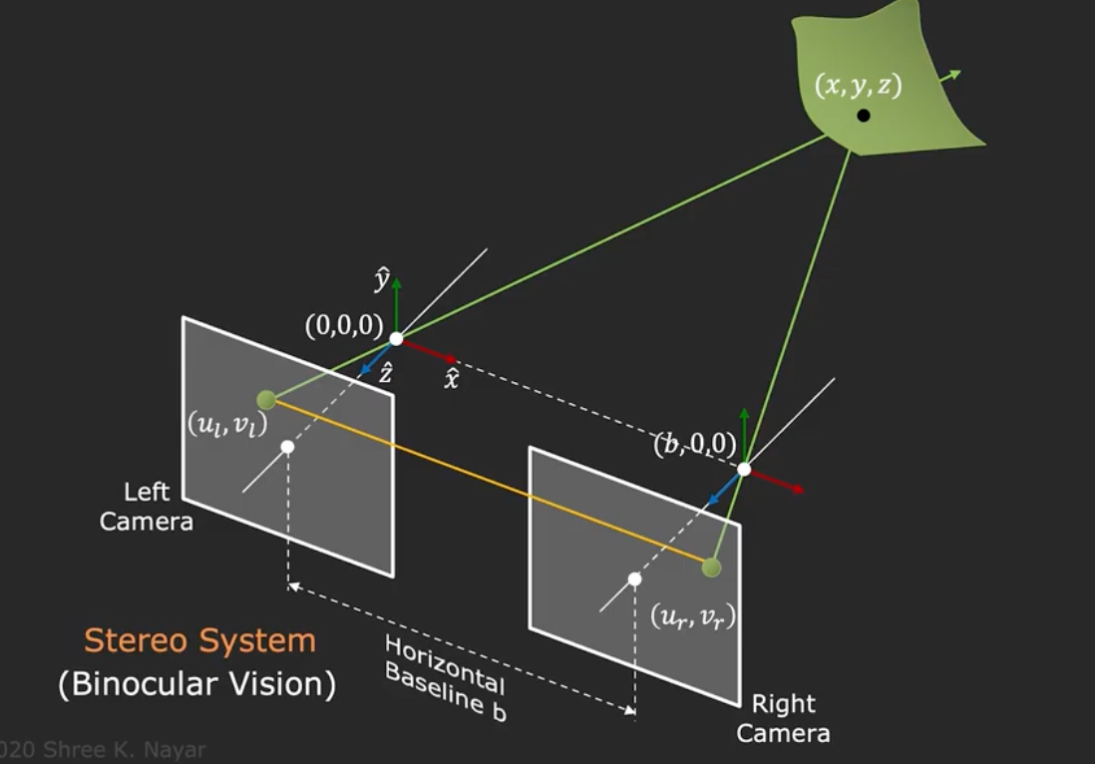
Triangulation using two cameras
Notes:
Left and right camera are identical

Slide 17
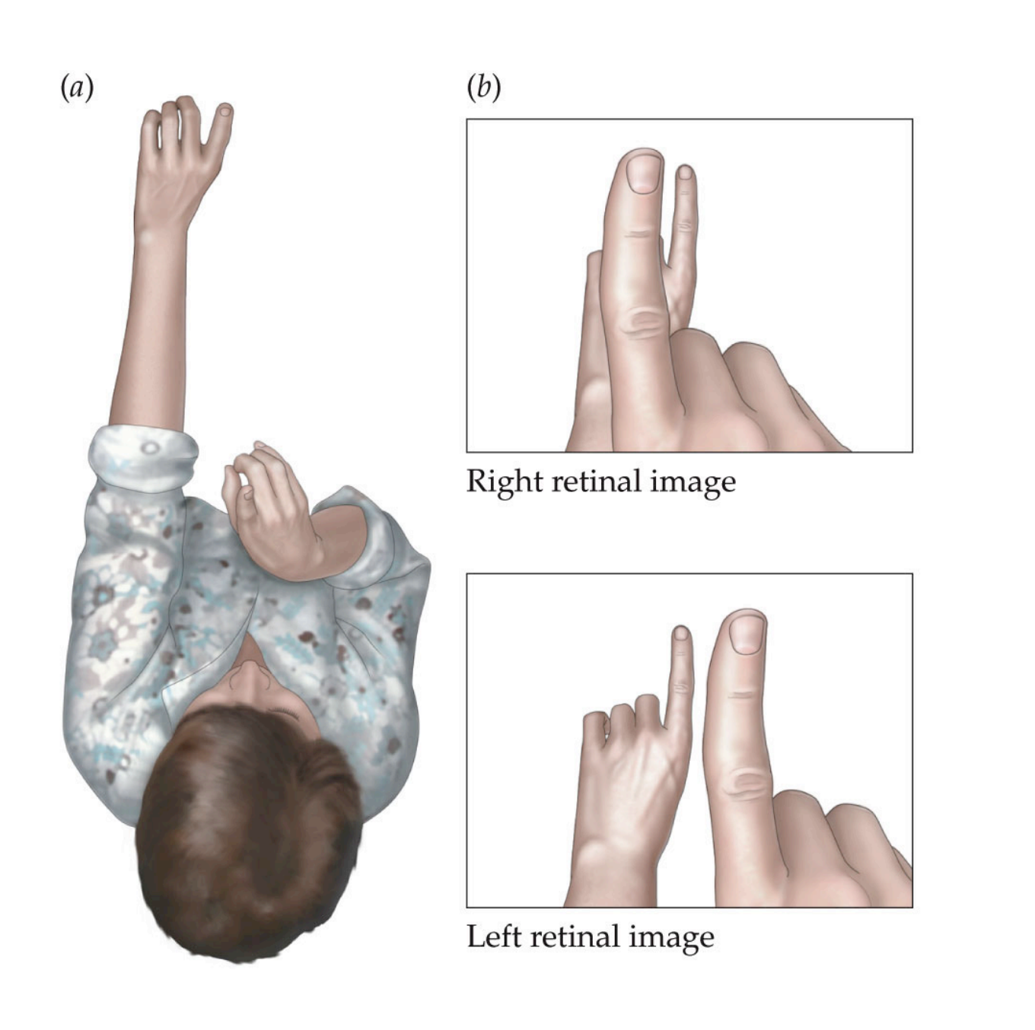
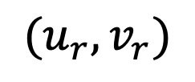
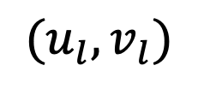
We are equipped with binocular vision. Let’s try!
$$(u_{r}, v_{r})$$
$$(u_{l}, v_{l})$$

Slide 18

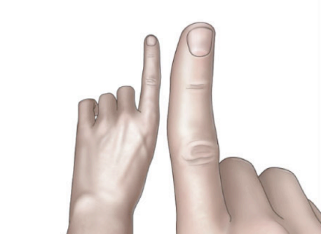
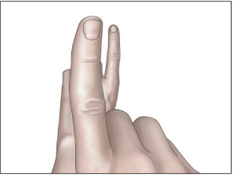
Solving for Depth in Simple Stereo
X
Do we have enough to know what is Z?
Yes, similar triangles!
u_{l}
z?
u_{r}
f
disparity
(how much corrsp. pixels move)
B
Base of :
in image coordinates:
Notes:
dx = B(x_l

Slide 19
Try with your hands!
Notes:
the finger further away moves less than the closer finger why?

Slide 20
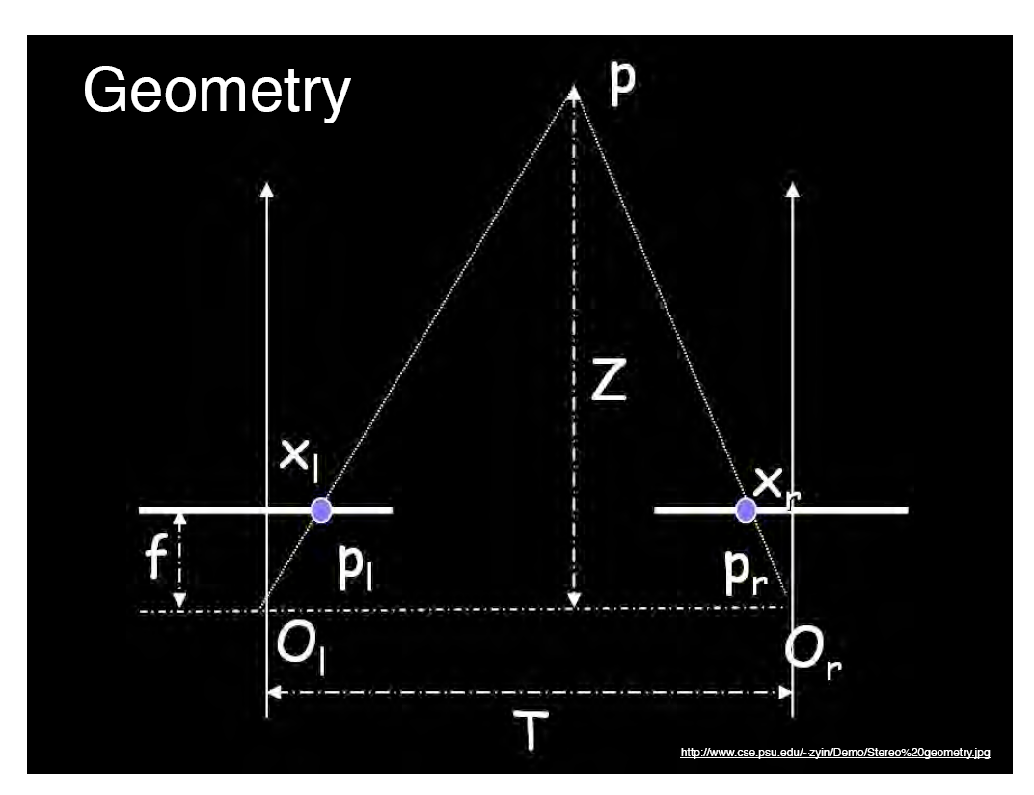
Geometry for a simple stereo system
Assume parallel optical axes, known camera parameters (i.e., calibrated cameras).
Use similar triangles (p_{l}, P, p_{r}) and (O_{l}, P, O_{r}):
want Z
disparity
Grauman
Notes:
20

Slide 21

Depth is inversely proportional to disparity
$$∞$$
0
disparity
depth
disparity
0
Max disparity
what is the disparity of the closer point?
what is the disparity of the far away point?
Disparity gives you the depth information!
Notes:
larger disparity = lower depth

Slide 22
Try again
Setup so your fingers are on the same line of sight from one eye
Now look in the other eye
They move!
Relative displacement is higher as the relative distance grows
== Parallax

Slide 23
A
C
B

Slide 24
50 cm
optical center
5 px
f = 10 mm

Slide 25

Parallax
parallax!
Parallax = from ancient Greek parállaxis
= Para (side by side) + allássō, (to alter)
= Change in position from different view point
Two eyes give you parallax, you can also move to see more parallax = “Motion Parallax”
Notes:
para = side by side
allassein (vary / change)

Slide 26
Why you need translation to see parallax i.e. relative depth

Slide 27
Why you need translation to see parallax i.e. relative depth
Notes:
Bottom line, the difference is important!!

Slide 28
Bottom line
Disparity (how much points move in two images ) gives depth
Parallax reveals relative depth difference
$$∞$$
0
disparity
depth
disparity
0
Max disparity

Slide 29
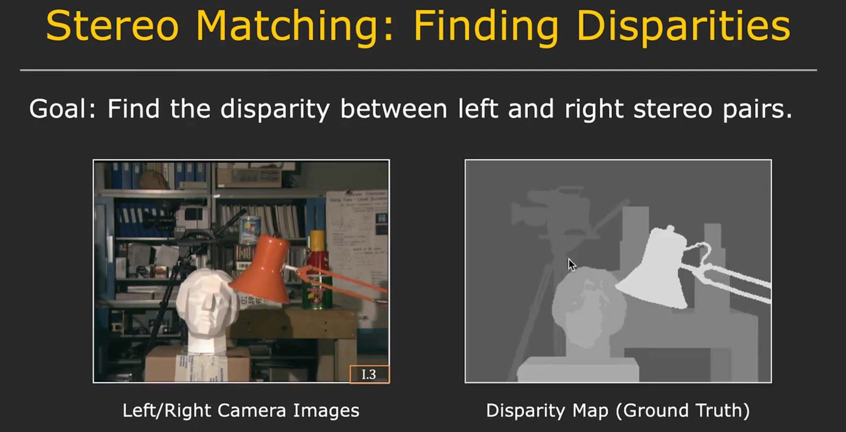

Slide 30
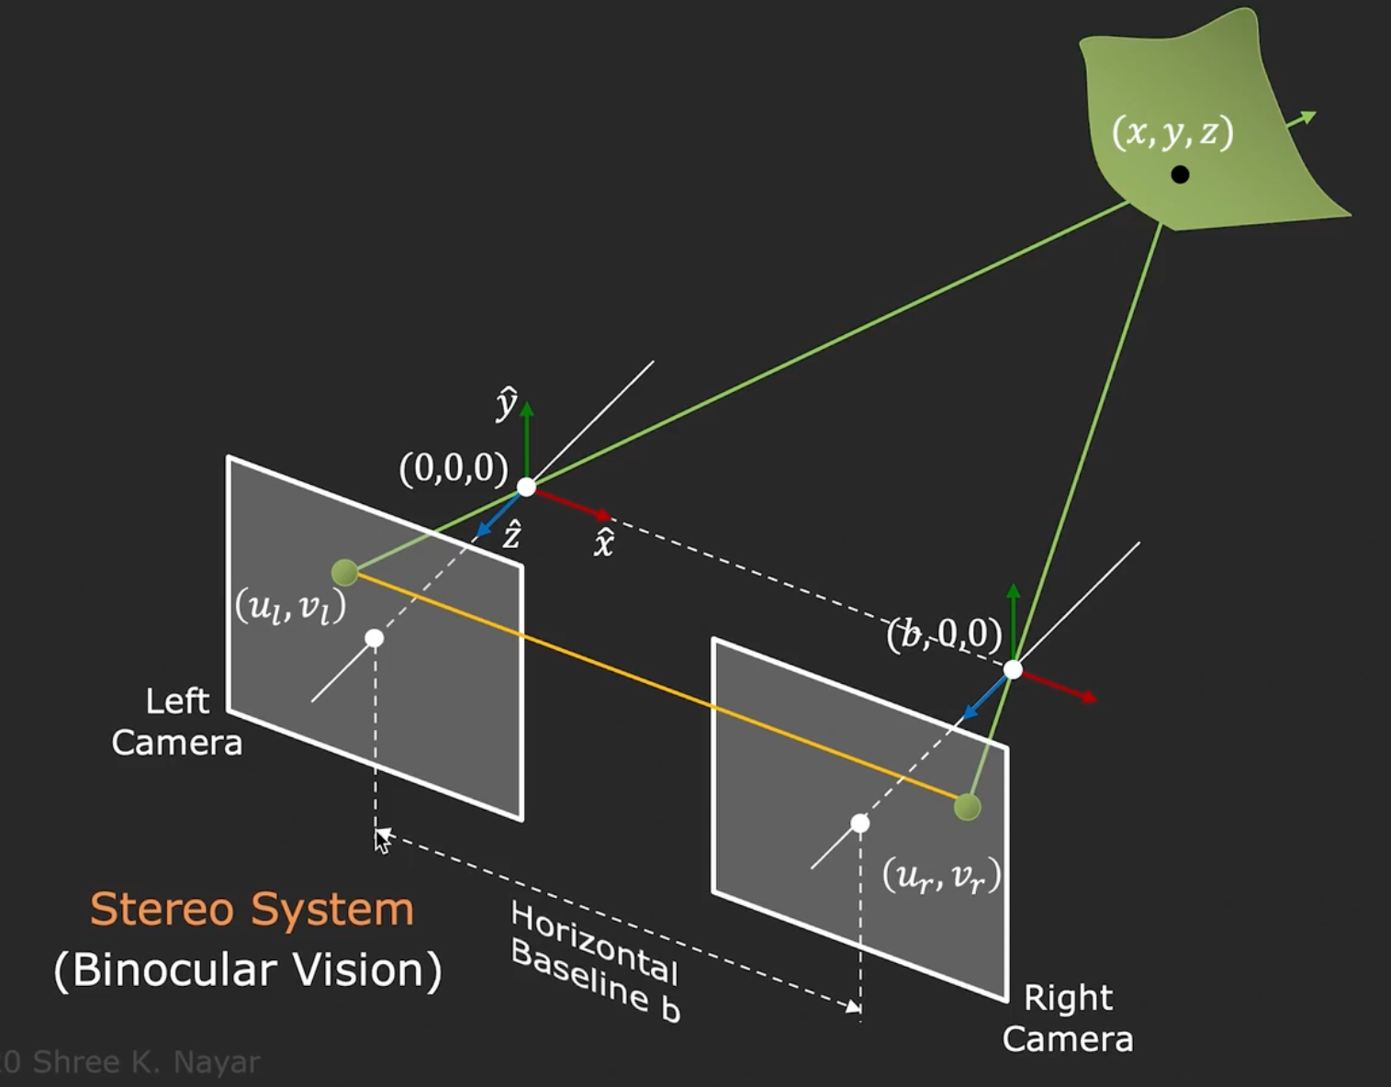
Where is the corresponding point going to be?
Hint

Slide 31
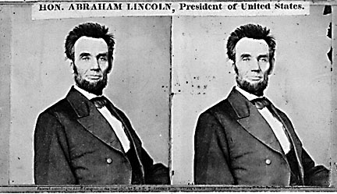
Epipolar Line
epipolar lines
(x₁, y₁)
(x₂, y₁)
Two images captured by a purely horizontal translating camera
(rectified stereo pair)
x₁ –x₂ = the disparity of pixel (x₁, y₁)

Slide 32
Your basic stereo algorithm
For every epipolar line:
For each pixel in the left image
compare with every pixel on same epipolar line in right image
pick pixel with minimum match cost
Improvement: match windows, + clearly lots of matching strategies
Slide credit: Noah Snavely

Slide 33
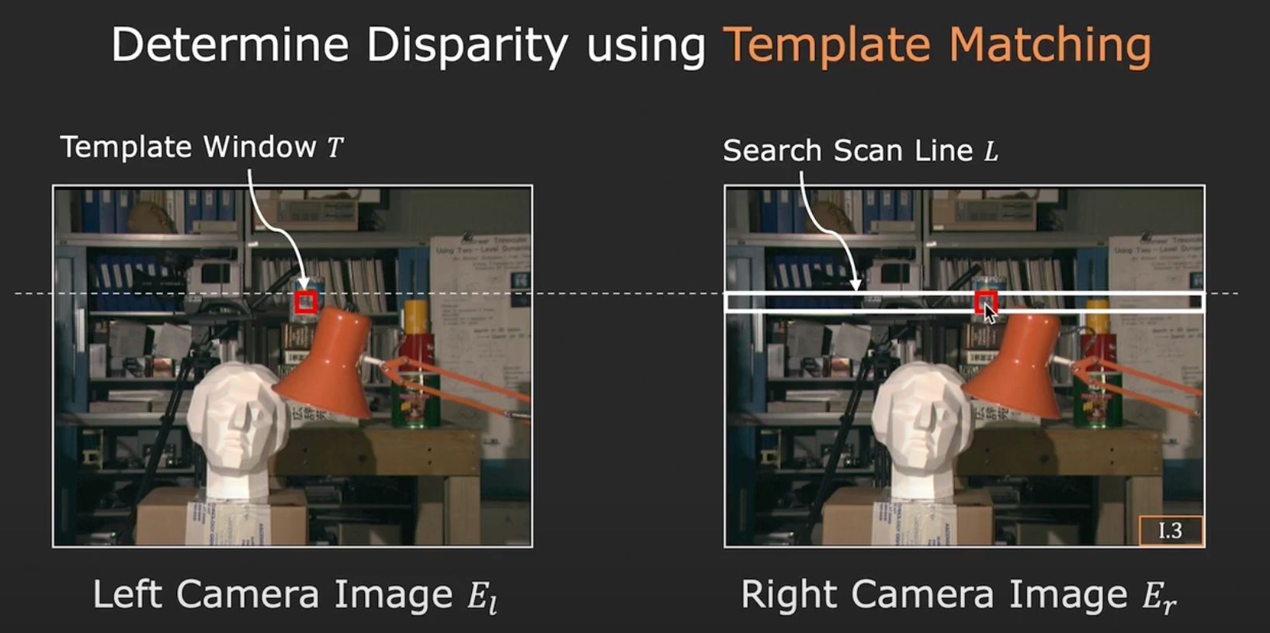
Your basic stereo algorithm

Slide 34
In simple stereo, corresp = 1/depth
Once you have correspondence, you know the disparity, so you also have the depth
$$∞$$
0
depth
disparity
disparity
0
Max disparity

Slide 35
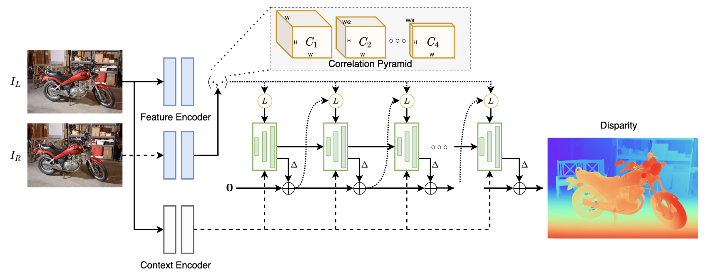
A modern learning example: RaftStereo (3DV ’21)
Use network to solve the correspondence along epipolar line

Slide 36

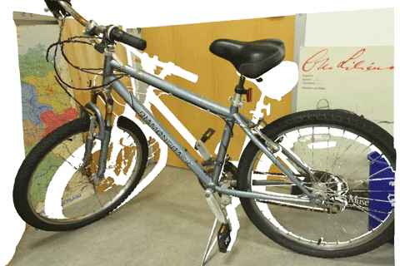
A modern learning example: RaftStereo
Just solving correspondence gives you nice –per-pixel depth for an image

Slide 37
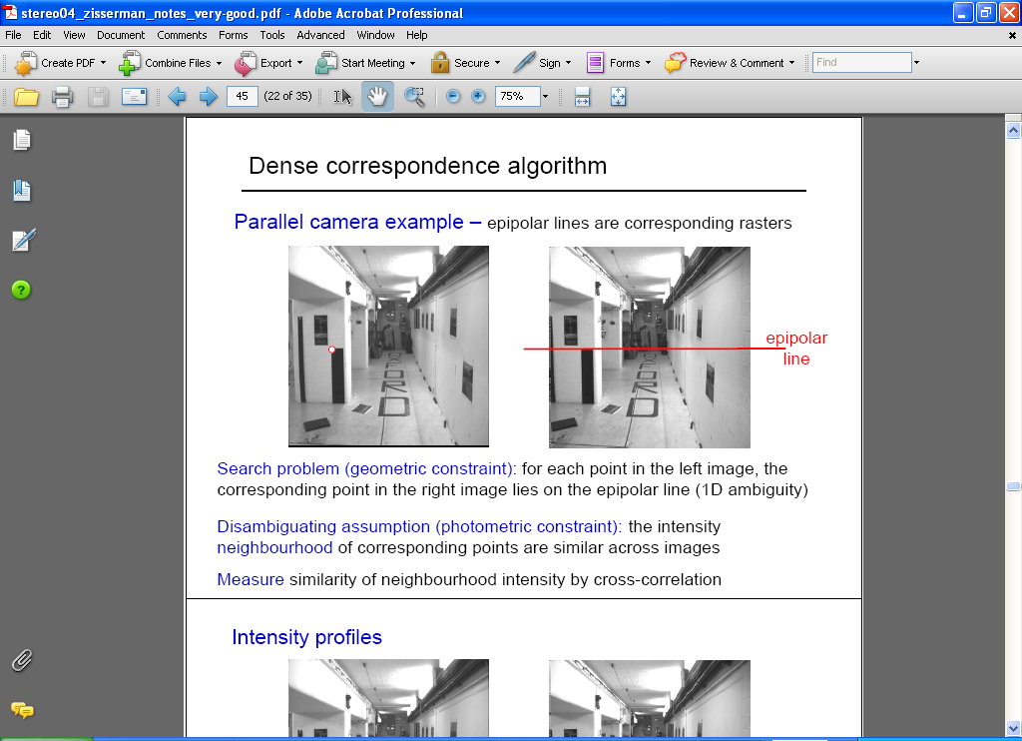
How to solve the Correspondence problem
Source: Andrew Zisserman

Slide 38
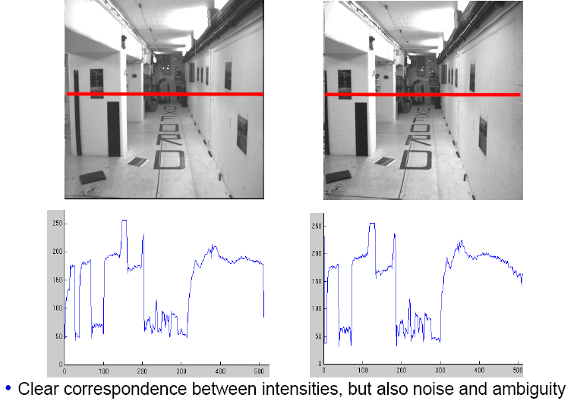
Intensity profiles
Source: Andrew Zisserman

Slide 39
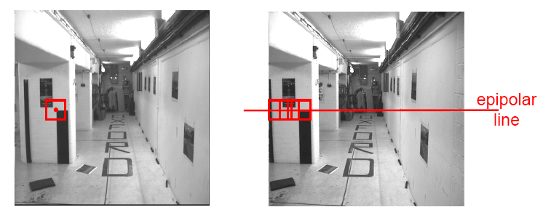
Correspondence problem
Neighborhood of corresponding points are similar in intensity patterns.
Source: Andrew Zisserman

Slide 40
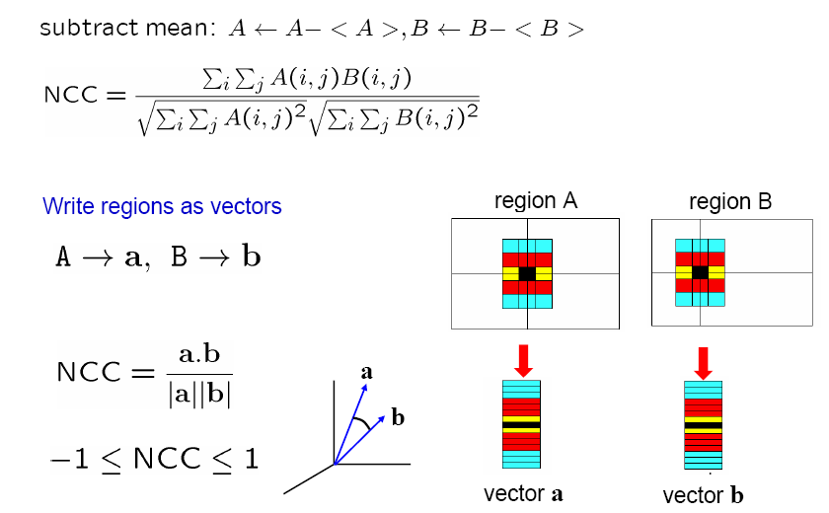
Normalized cross correlation
Source: Andrew Zisserman

Slide 41
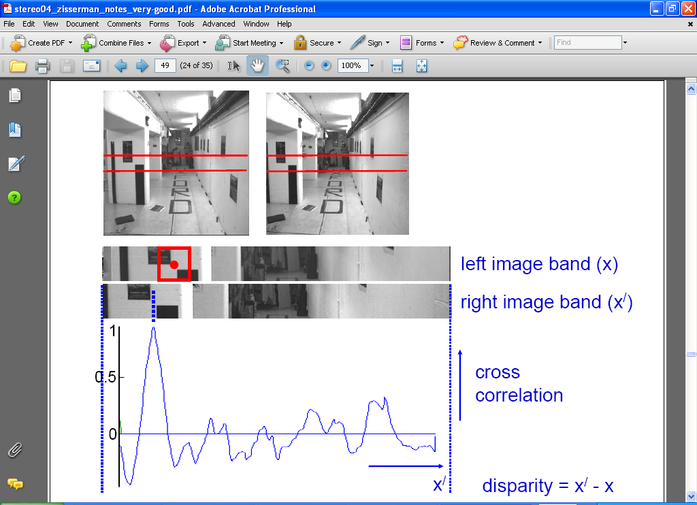
Correlation-based window matching
Source: Andrew Zisserman

Slide 42
Dense correspondence search
For each epipolar line
For each pixel / window in the left image
compare with every pixel / window on same epipolar line in right image
pick position with minimum match cost (e.g., SSD, correlation)
Adapted from Li Zhang
Grauman
Notes:
42

Slide 43
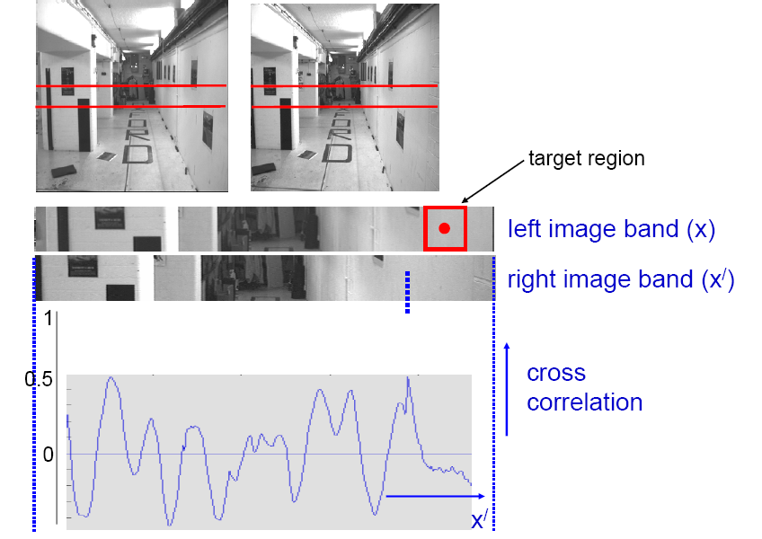
Textureless regions
Textureless regions are non-distinct; high ambiguity for matches.
Source: Andrew Zisserman
Grauman

Slide 44
Effect of window size
Source: Andrew Zisserman
Grauman
Notes:
Have to pick a window size, can’t do it at a pixel. But window ➔ area in the scene, projected area will be different from two views

Slide 45
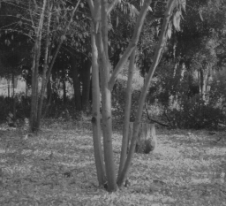
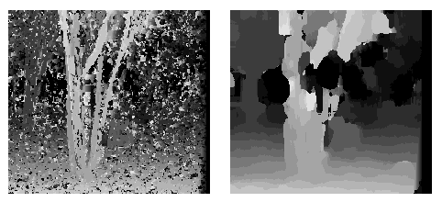
Effect of window size
W = 3
W = 20
Want window large enough to have sufficient intensity variation, yet small enough to contain only pixels with about the same disparity.
Figures from Li Zhang
Grauman

Slide 46


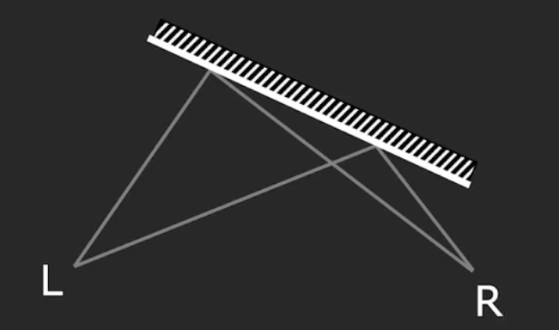
Issues with Stereo
Surface must have non-repetitive texture
Foreshortening effect makes matching a challenge
Slide Credit: Shree Nayar
Notes:
Projected area is smaller → causes distortion

Slide 47
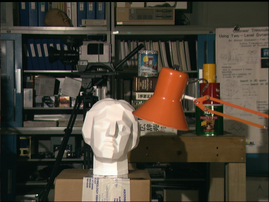

Stereo Results
Data from University of Tsukuba
Scene
Ground truth

Slide 48
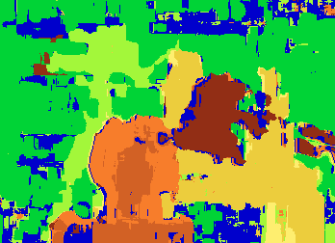

Results with Window Search
Window-based matching
(best window size)
Ground truth

Slide 49
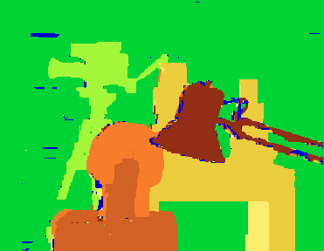
Better methods exist...
Energy Minimization
Boykov et al., Fast Approximate Energy Minimization via Graph Cuts,
International Conference on Computer Vision, September 1999.
Ground truth

Slide 50
Summary
With a simple stereo system, how much pixels move, or “disparity” give information about the depth
Correspondences to measure the pixel disparity

Slide 51
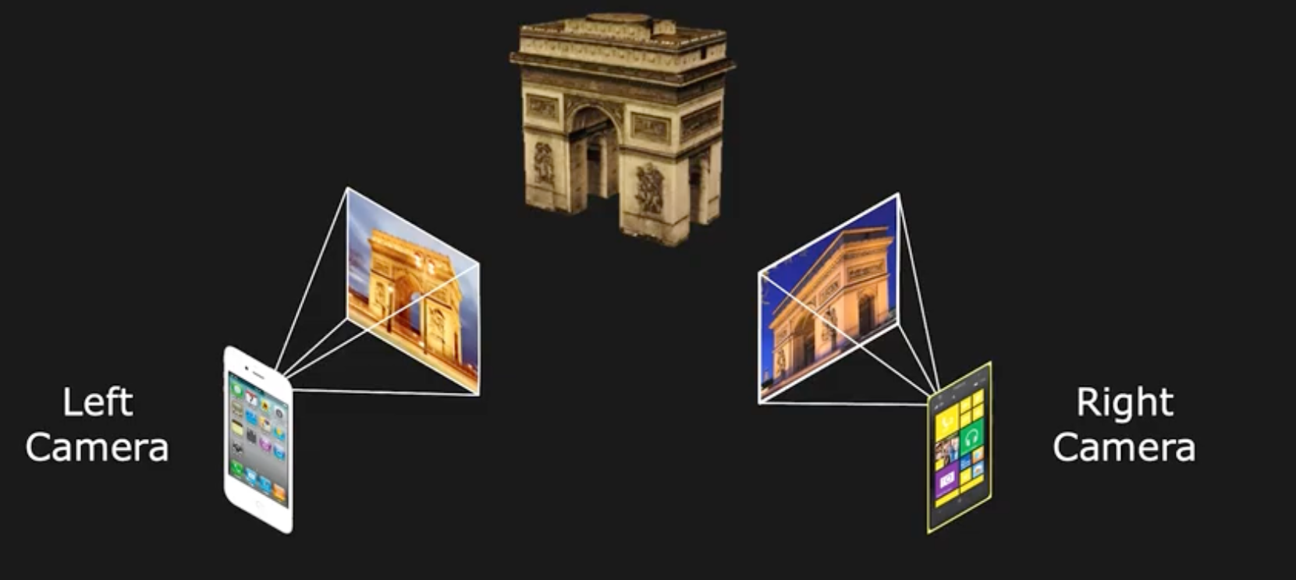
Next: Uncalibrated Stereo
From two arbitrary views
Assume intrinsics are known (fx, fy, ox, oy)
Slide Credit: Shree Nayar

Slide 52
General case, with calibrated cameras
The two cameras need not have parallel optical axes.

Slide 53
Option 1: Rectify via homography
reproject image planes onto a common plane
plane parallel to the line between optical centers
pixel motion is horizontal after this transformation
two homographies, one for each input image reprojection
C. Loop and Z. Zhang. Computing Rectifying Homographies for Stereo Vision. CVPR 1999.
Slide courtesy of Noah Snavely

Slide 54
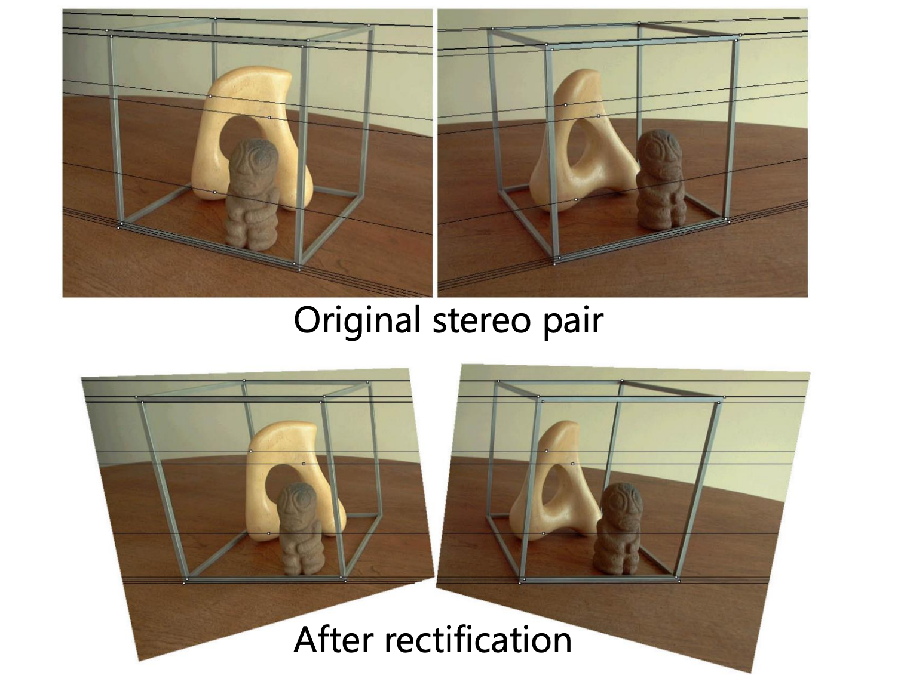
Option 1: Rectify via homography
Slide courtesy of Noah Snavely

Slide 55
Option 2
Solve for correspondences
Estimate camera
Triangulate

Slide 56
Option 2
Solve for correspondences
Estimate camera
What is the relationship between the camera + correspondences?
Triangulate

Slide 57
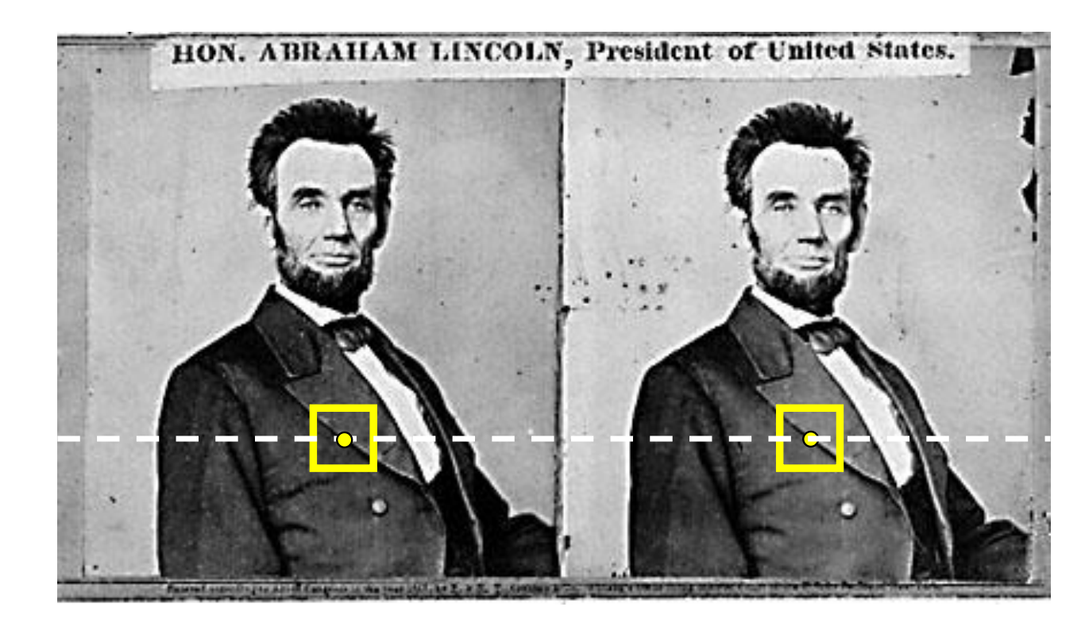
Where do epipolar lines come from?
Slide courtesy of Noah Snavely
Notes:
57

Slide 58
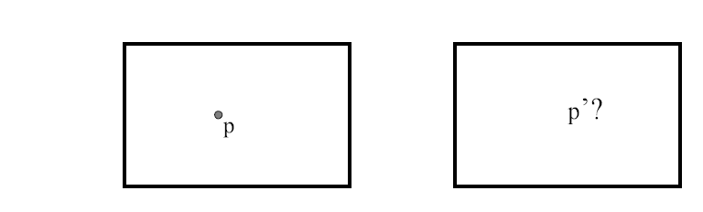
Stereo correspondence constraints
Given p in left image, where can corresponding point p’ be?

Slide 59
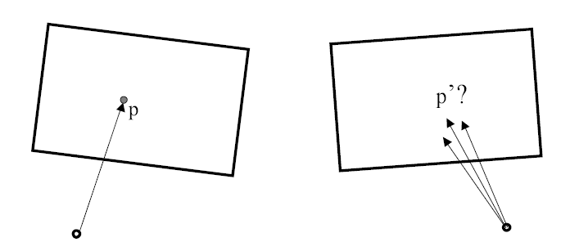
Stereo correspondence constraints
Given p in left image, where can corresponding point p’ be?

Slide 60
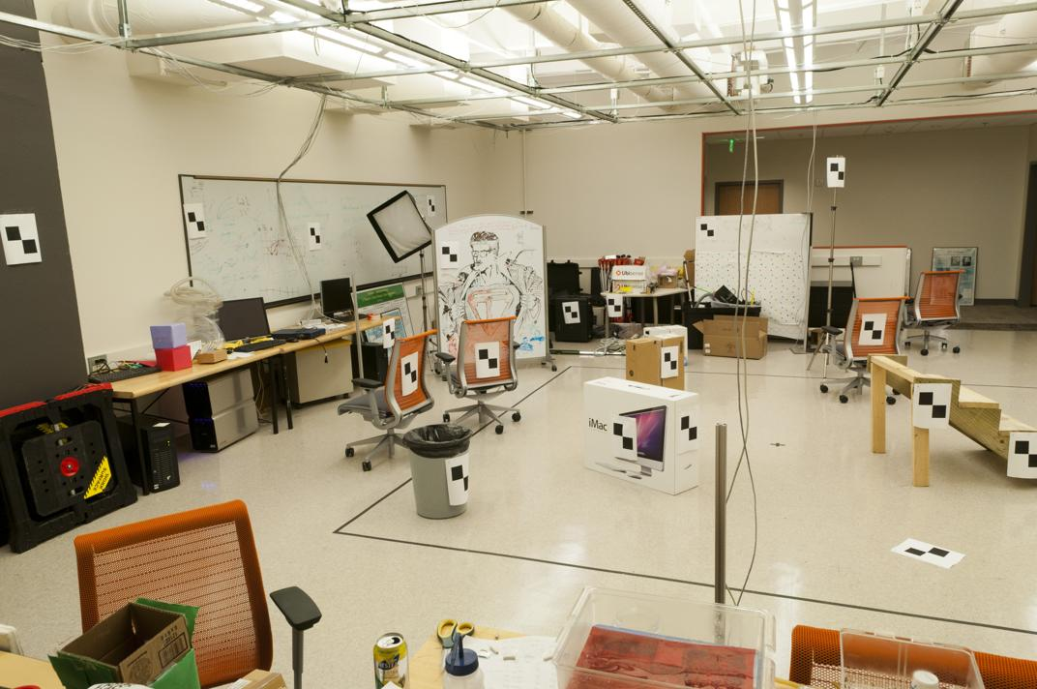
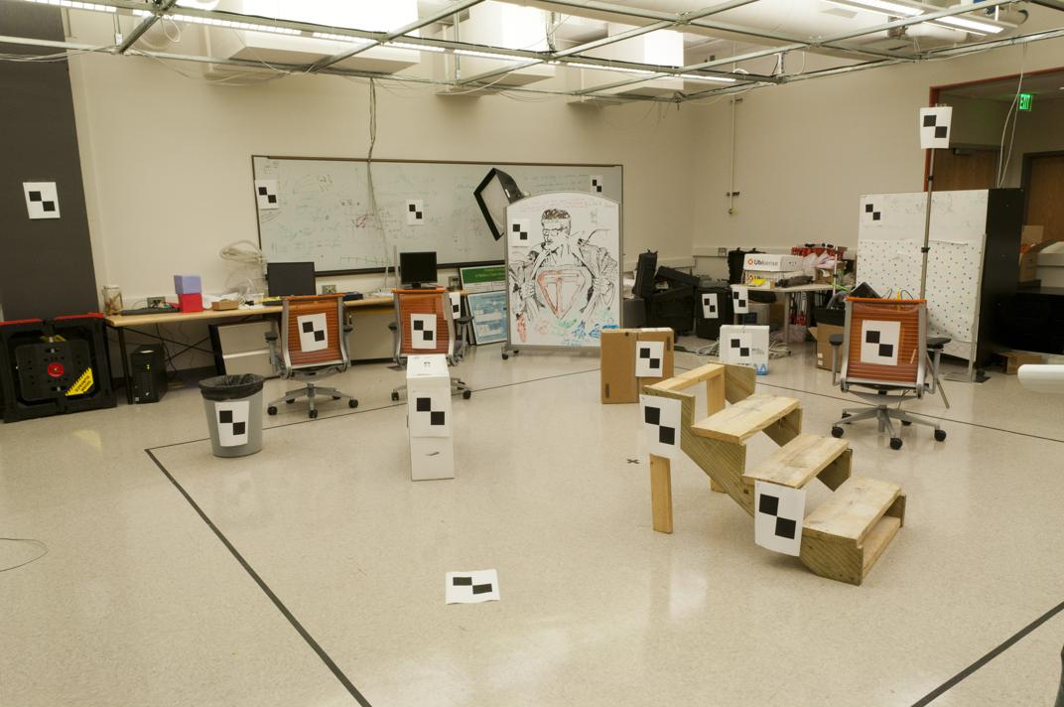
Where do we need to search?
Slide by James Hays

Slide 61
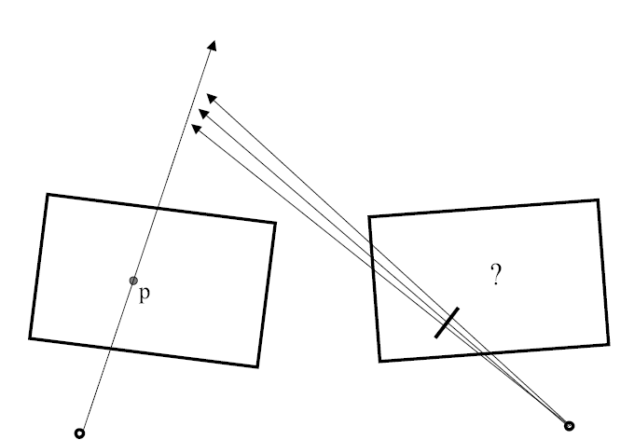
Stereo correspondence constraints

Slide 62

Epipolar Geometry
Figures by Carlos Hernandez

Slide 63


Slide 64
Stereo correspondence constraints
Geometry of two views allows us to constrain where the corresponding pixel for some image point in the first view must occur in the second view.
epipolar line
epipolar line
epipolar plane
Epipolar constraint: Why is this useful?
Reduces correspondence problem to 1D search along conjugate epipolar lines
http://www.ai.sri.com/~luong/research/Meta3DViewer/EpipolarGeo.html
Adapted from Steve Seitz

Slide 65

Epipolar geometry
X
x
x’
Baseline – line connecting the two camera centers
Epipolar Plane – plane containing baseline (1D family)
Epipoles
= intersections of baseline with image planes
= projections of the other camera center
= vanishing points of the motion direction

Slide 66

The Epipole
Photo by Frank Dellaert
Notes:
Where the students are pointing is the epipole!!! (there’s the other camera)

Slide 67
Epipolar geometry: terms
Baseline: line joining the camera centers
Epipole: point of intersection of baseline with the image plane
Epipolar plane: plane containing baseline and world point
Epipolar line: intersection of epipolar plane with the image plane
All epipolar lines intersect at the epipole
An epipolar plane intersects the left and right image planes in epipolar lines
Grauman

Slide 68

Epipolar constraint
Potential matches for p have to lie on the corresponding
epipolar line l’.
Potential matches for p’ have to lie on the corresponding
epipolar line l.
Source: M. Pollefeys
Notes:
68

Slide 69

Example

Slide 70



Example: converging cameras
As position of 3d point varies, epipolar lines “rotate” about the baseline
Figure from Hartley & Zisserman
Notes:
70

Slide 71



Example: motion parallel with image plane
Figure from Hartley & Zisserman
Notes:
71

Slide 72


Example: forward motion
e’
e
Epipole has same coordinates in both images.
Points move along lines radiating from e: “Focus of expansion”
Figure from Hartley & Zisserman
Notes:
72

Slide 73
For a given stereo rig, how do we express the epipolar constraints algebraically?
For calibrated cameras, with Essential Matrix
For uncalibrated cameras, with Fundamental Matrix

Slide 74

X
x
x’
Slide Credit: Shree Nayar
Notes:
T: is position of the right camera in left camera’s frame
R:orientation of left camera in right camera’s frame.
Then, expand x_l = R*x_r + t

Slide 75
Epipolar constraint: Calibrated case
X
= (x,1)^{T}
x
x’ = Rx+t
t
R
The vectors Rx, t, and x’ are coplanar
Notes:
X’ is X in the second camera’s coordinate system
We can identify the non-homogeneous 3D vectors X and X’ with the homogeneous coordinate vectors x and x’ of the projections of the two points into the two respective images

Slide 76
Epipolar constraint: Calibrated case
X
x
x’
Intrinsic and extrinsic parameters of the cameras are known, world coordinate system is set to that of the first camera
Then the projection matrices are given by K[I | 0] and K’[R | t]
We can multiply the projection matrices (and the image points) by the inverse of the calibration matrices to get normalized image coordinates:
Notes:
T: is position of the right camera in left camera’s frame
R:orientation of left camera in right camera’s frame.
Then, expand x_l = R*x_r + t

Slide 77
Epipolar constraint: Calibrated case
X
x
x’ = Rx+t
Recall:
The vectors Rx, t, and x’ are coplanar

Slide 78
Epipolar constraint: Calibrated case
X
x
x’ = Rx+t
Essential Matrix
(Longuet-Higgins, 1981)
The vectors Rx, t, and x’ are coplanar
Notes:
x
T is green, Rx + t is the point on the right
X’ (t_x Rx + t_x*t) = x’[t_xRx] = 0

Slide 79
Epipolar constraint: Calibrated case
X
x
x’
E x is the epipolar line associated with x (l' = E x)
Recall: a line is given by ax + by + c = 0 or

Slide 80

Essential matrix can be decomposed
E = T_{x}R
If we know E, we can recover t and R

Slide 81

Finding E: But we know the image coord
z’s are still unknown! (they are > 0 and !=0)
But this whole equation goes to 0 so we can skip it

Slide 82
Epipolar constraint: Calibrated case
X
x
x’
E x is the epipolar line associated with x (l' = E x)
E^{T}x' is the epipolar line associated with x' (l = E^{T}x')
E e = 0 and E^{T}e' = 0
E is singular (rank two)
E has five degrees of freedom
Notes:
why 5? R + T = > 6 DoF, with the projective scale ambiguity -> 5
Rank 2 → 2D plane gets mapped to a single line in the other image. (Also skew symm is rank2)

Slide 83
Epipolar constraint: Uncalibrated case
X
x
x’
The calibration matrices K and K’ of the two cameras are unknown
We can write the epipolar constraint in terms of unknown normalized coordinates:

Slide 84

Epipolar constraint: Uncalibrated case
X
x
x’
Fundamental Matrix
(Faugeras and Luong, 1992)
Notes:
F is 3 x 3 = 9 total, but 8 bc of ambiguity, -1 because rank 2..

Slide 85
Epipolar constraint: Uncalibrated case
X
x
x’
F x is the epipolar line associated with x (l' = F x)
F^{T}x' is the epipolar line associated with x' (l = F^{T}x')
F e = 0 and F^{T}e' = 0
F is singular (rank two)
F has seven degrees of freedom
Notes:
F is 3 x 3 = 9 total, but 8 bc of ambiguity, -1 because rank 2..

Slide 86
Recall the homography
Homography Matrix: 3x3
Fundamental Matrix is also 3x3.
Homography is a special case of the Fundamental matrix, for planar scenes

Slide 87

How do we find E or F?
But we know the image coordinates!
z’s are still unknown, but they are > 0 and !=0

Slide 88

Estimating the fundamental matrix

Slide 89

The eight-point algorithm
Solve homogeneous linear system using eight or more matches
Enforce rank-2 constraint (take SVD of F and throw out the smallest singular value)

Slide 90
Problem with eight-point algorithm

Slide 91

Problem with eight-point algorithm
Poor numerical conditioning
Can be fixed by rescaling the data

Slide 92
The normalized eight-point algorithm
(Hartley, 1995)
Center the image data at the origin, and scale it so the mean squared distance between the origin and the data points is 2 pixels
Use the eight-point algorithm to compute F from the normalized points
Enforce the rank-2 constraint (for example, take SVD of F and throw out the smallest singular value)
Transform fundamental matrix back to original units: if T and T’ are the normalizing transformations in the two images, than the fundamental matrix in original coordinates is T’^{T} F T

Slide 93

The Bible by Hartley & Zisserman

Slide 94

The Fundamental Matrix Song
http://danielwedge.com/fmatrix/
https://www.youtube.com/watch?time_continue=8&v=DgGV3l82NTk&feature=emb_title

Slide 95
Option 2: Depth from arbitrary two cameras
Solve for correspondences
Estimate camera
What is the relationship between the camera + correspondences? → Epipolar geometry!
Triangulate

Slide 96

Finally: computing depth by triangulation
Now we know about the camera, K₁, K₂ and [R t]:
Substitute in terms of
Then solve for with least squares!
Notes:
In general you solve for the 3D point all together, because although the only thing you should need is the depth of a single point, in practice due to noise it may not exactly lie on the ray

Slide 97
The Bible by Hartley & Zisserman

Slide 98
What we just did for stereo
Rectified stereo → use similar triangles to solve for per-pixel disparity, which gives you depth
Difference between calibrated + uncalibrated case?
General Stereo: First calibrate cameras from correspondences
by solving for Essential or Fundamental matrices
Then triangulate corresponding points to get the depth.

Slide 99
What about more than two views?
The geometry of three views is described by a 3 x 3 x 3 tensor called the trifocal tensor
The geometry of four views is described by a 3 x 3 x 3 x 3 tensor called the quadrifocal tensor
After this it starts to get complicated…
Slide courtesy of Noah Snavely

Slide 100

Large-scale structure from motion
Dubrovnik, Croatia. 4,619 images (out of an initial 57,845).
Total reconstruction time: 23 hours
Number of cores: 352
Building Rome in a Day, Agarwal et al. ICCV 2009
Slide courtesy of Noah Snavely

Slide 101
Large-scale structure from motion
Result using COLMAP: Schönberger et al. CVPR ’16

