Slide 1
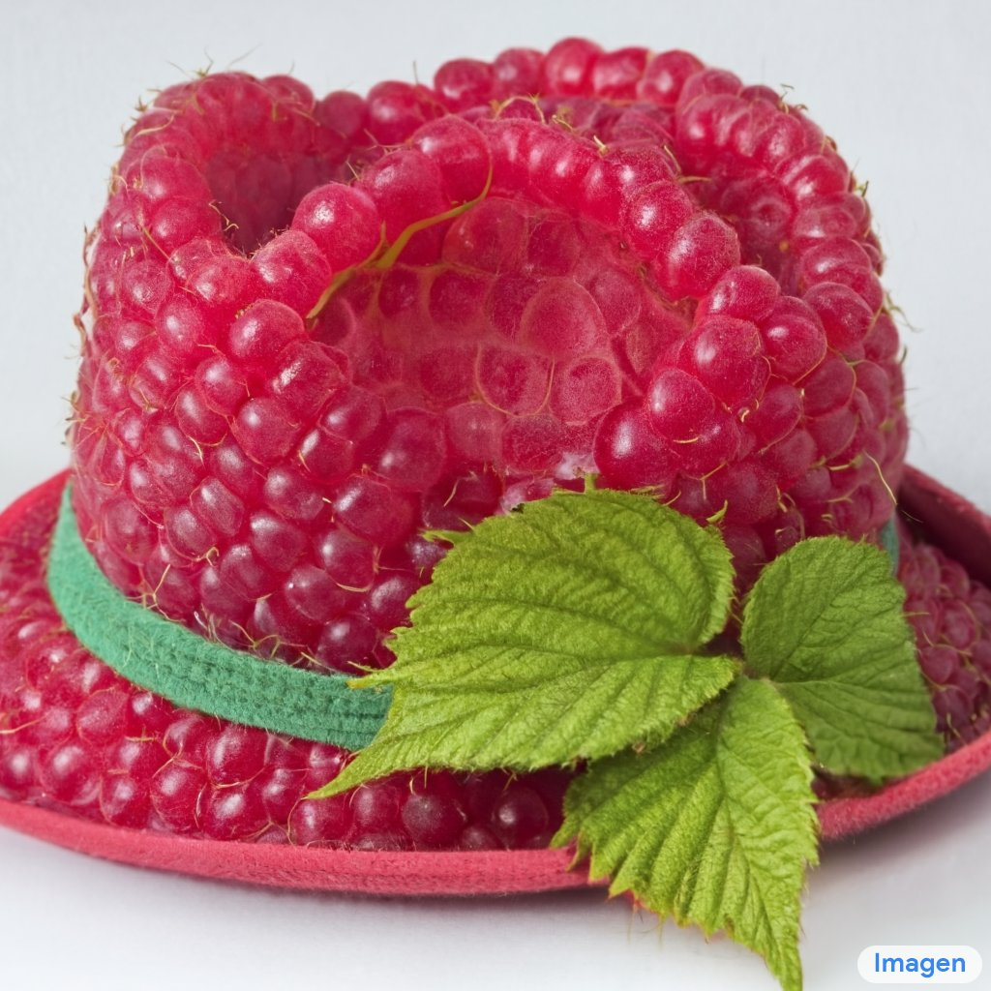
Flow Models
CS180: Intro to Comp. Vision and Comp. Photo
Efros & Ng, UC Berkeley, Fall 2026
with slides by Angjoo Kanazawa

Slide 2

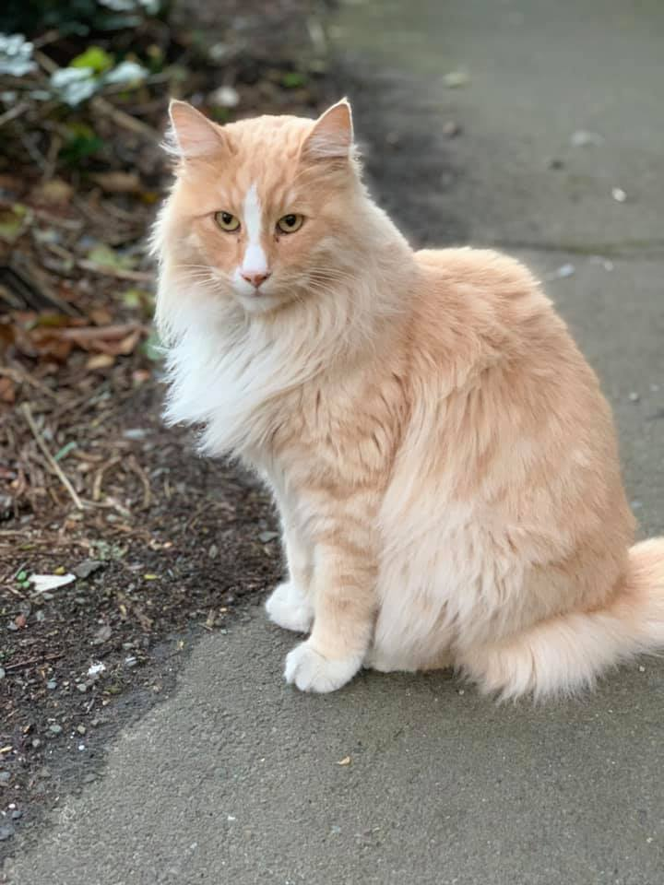
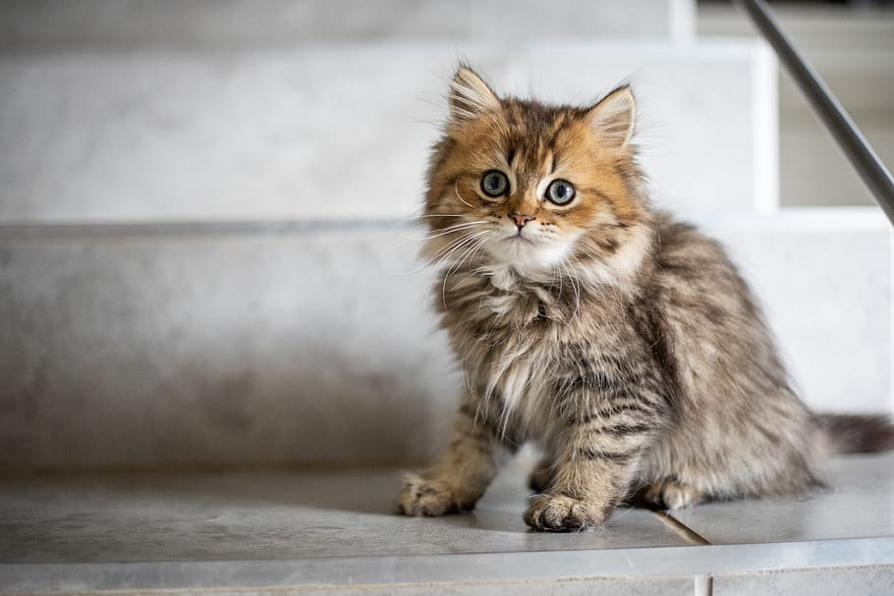
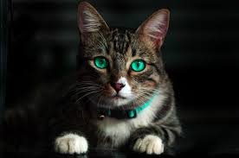
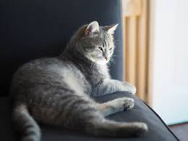
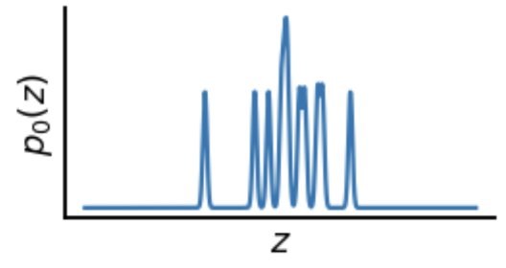
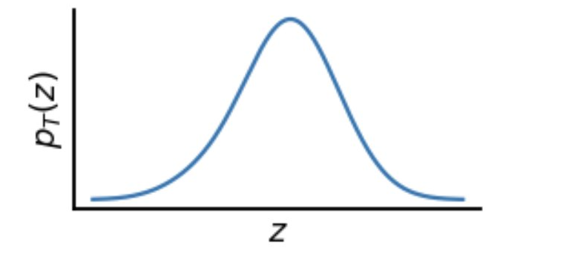
Generating Images from Noise
Random images
cat images
Noise to Images
Slide source: Steve Seitz

Slide 3
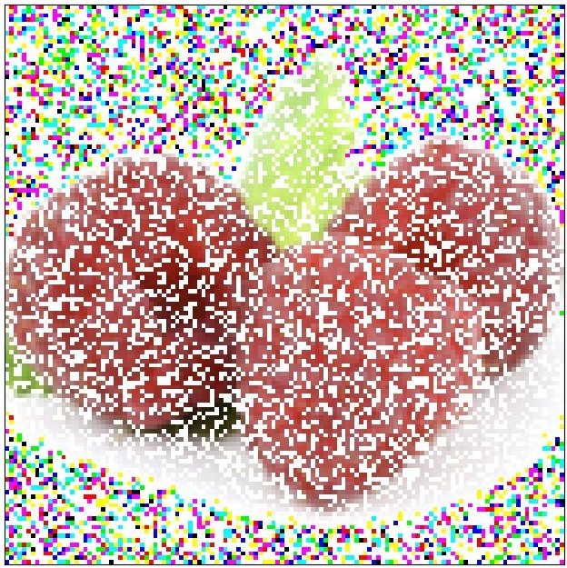
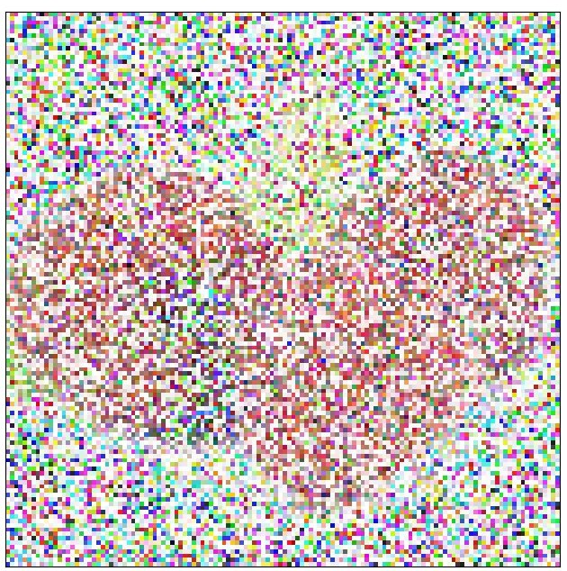
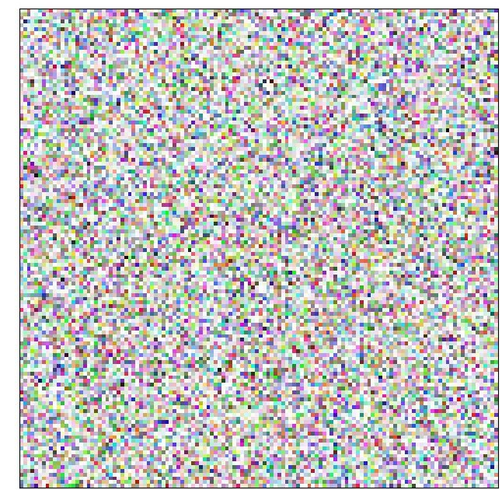

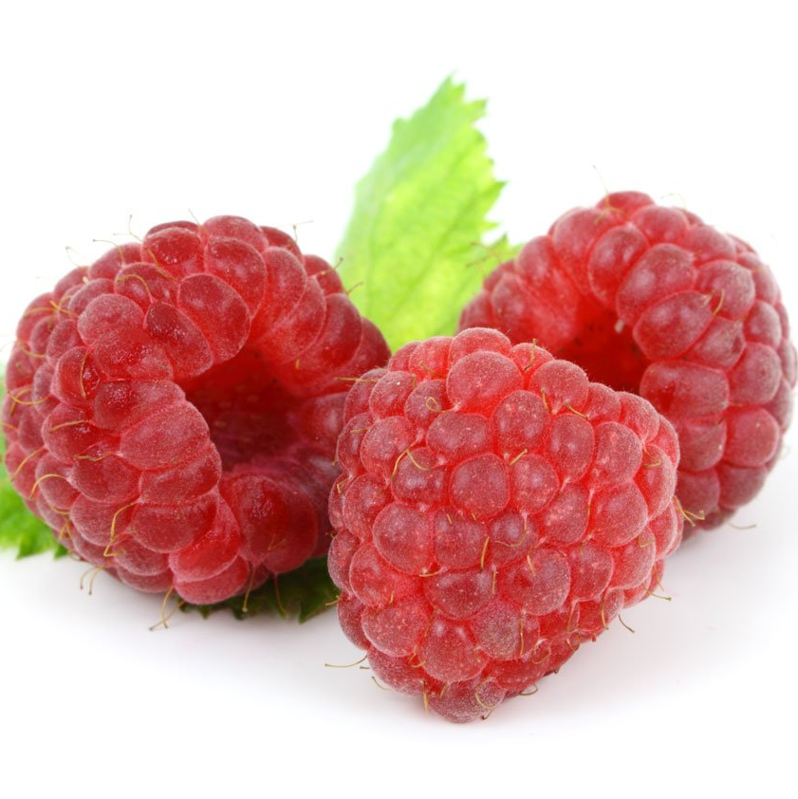
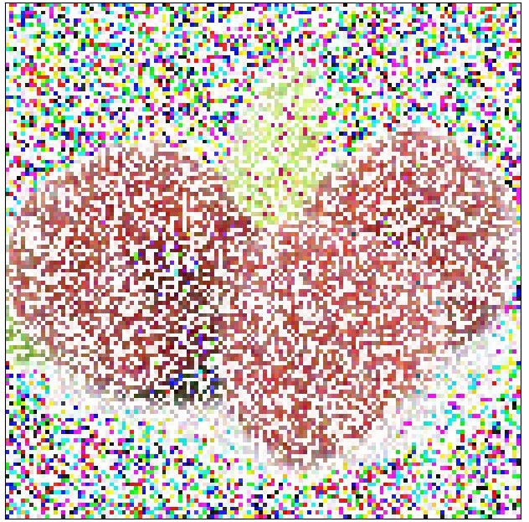
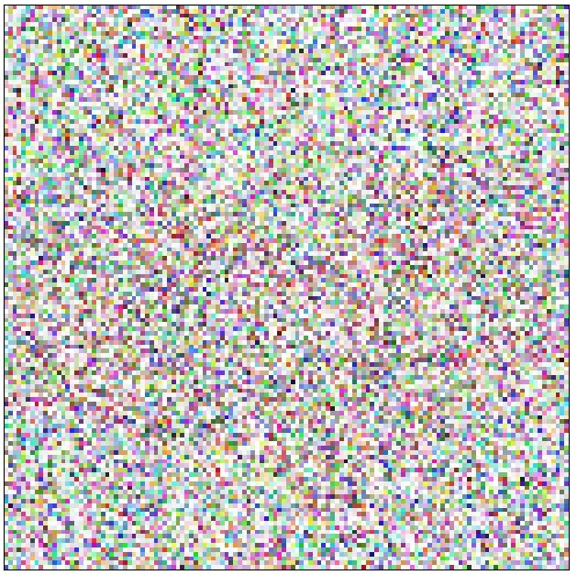
Recap
Take real data, corrupt it to left distribution somehow
Learn the velocity that undoes the process! (Denoise / Reverse)
raspberry
images
random
images
Figure from Steve Seitz’s video
Notes:
You can think of the animation I just showed as a path through the space of images
where each frame is a single step towards more randomness

Slide 4

$$$ question, how to pick the intermediate path?
How to generate this Green path?
raspberry
images
random
images
Figure from Steve Seitz’s video
Notes:
You can think of the animation I just showed as a path through the space of images
where each frame is a single step towards more randomness

Slide 5
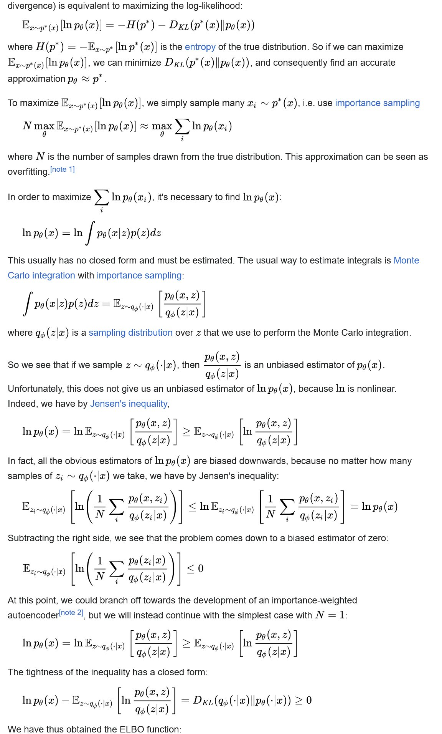

Slide 6
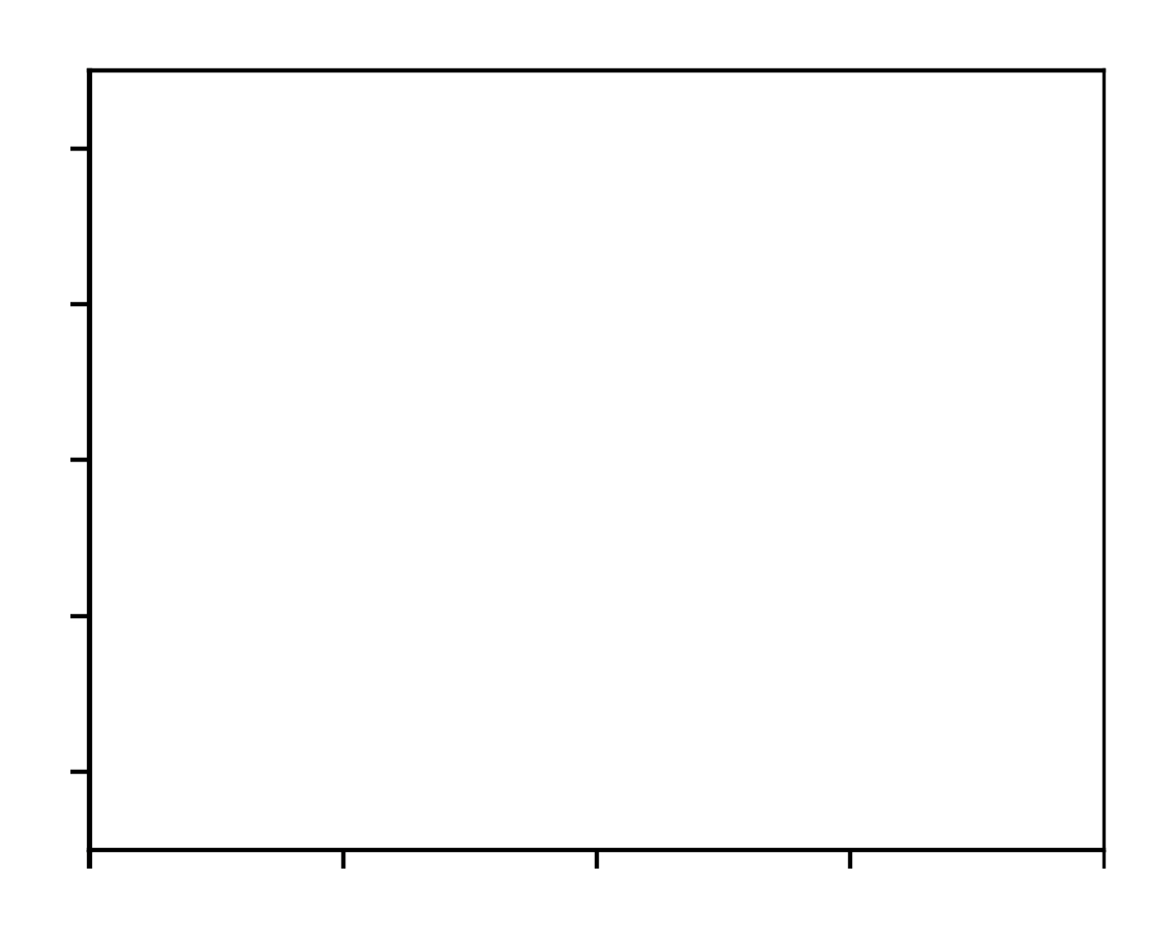
x
Data distribution
pixel values
Data lives in high dimensional space of pixel values
We’ll visualize in 1D
t = 0 (noise)
t = 1 (clean)

Slide 7
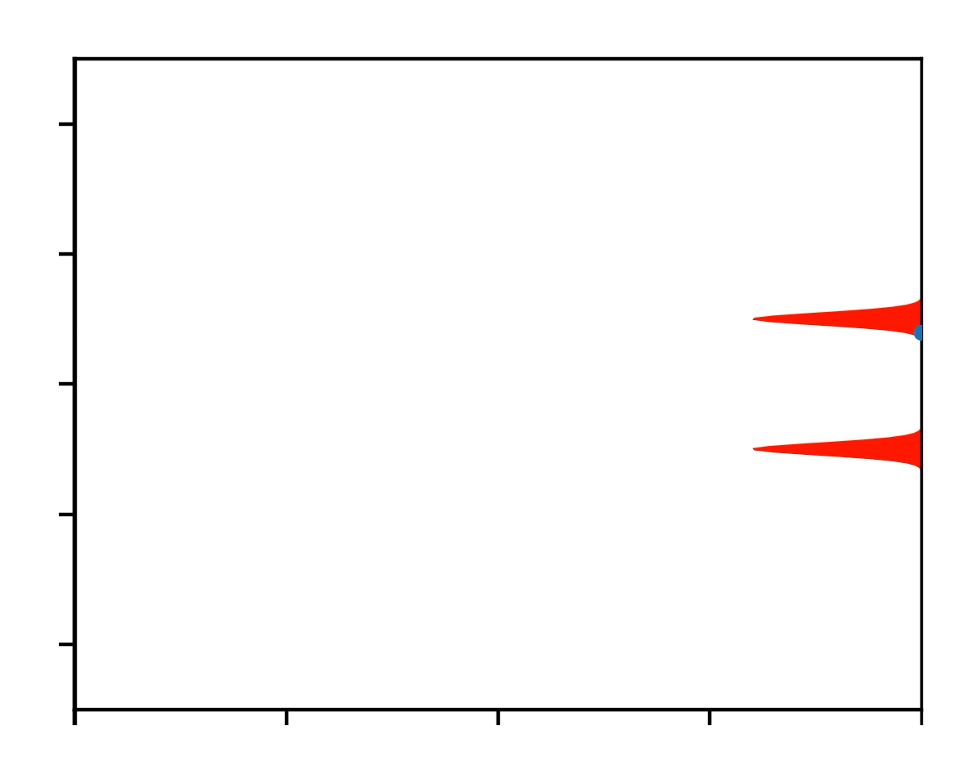
x
Data distribution
pixel values
Draw a sample
Data lives in high dimensional space of pixel values
Let’s visualize in 1D
increasing noise level
t = 0 (noise)
t = 1 (clean)

Slide 8
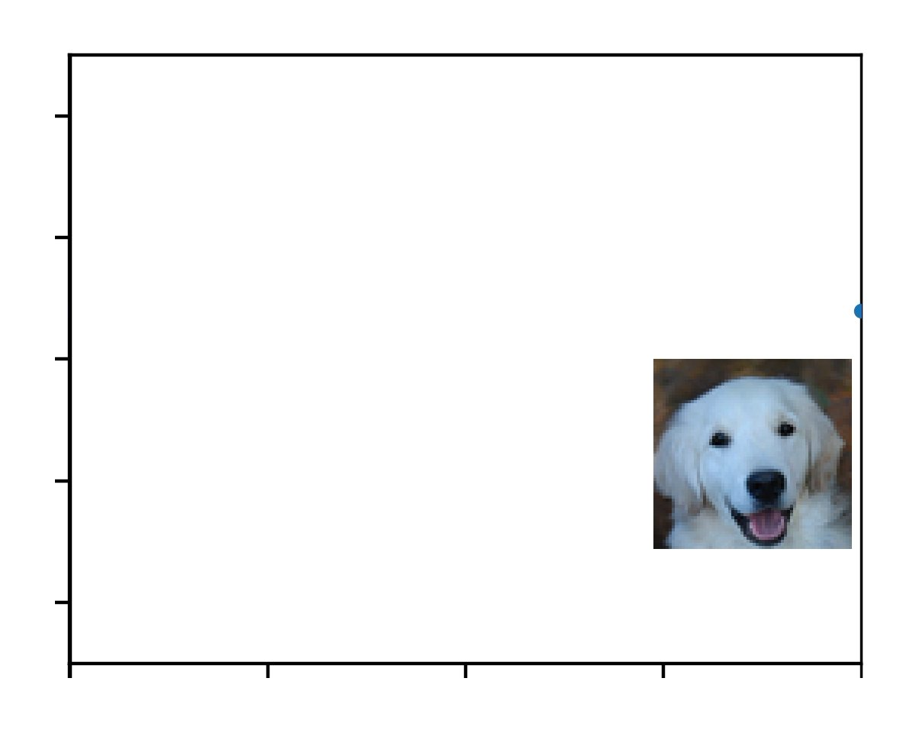
x
Data distribution
pixel values
increasing noise level
t = 0 (noise)
t = 1 (clean)

Slide 9
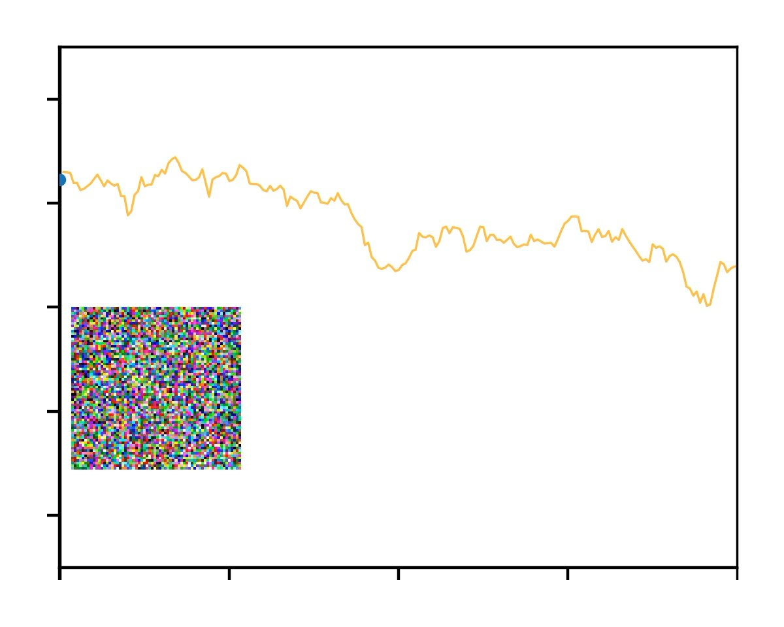
x
Gradually add noise to destroy the image
t = 0 (noise)
t = 1 (clean)

Slide 10
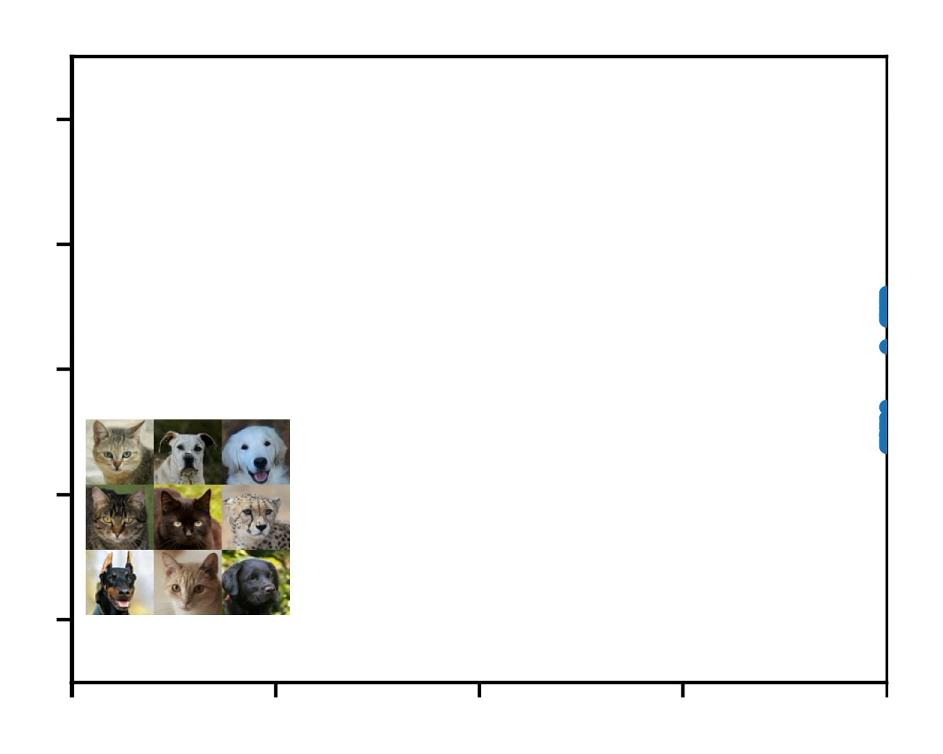
x
Gradually add noise to destroy the image
t = 0 (noise)
t = 1 (clean)

Slide 11
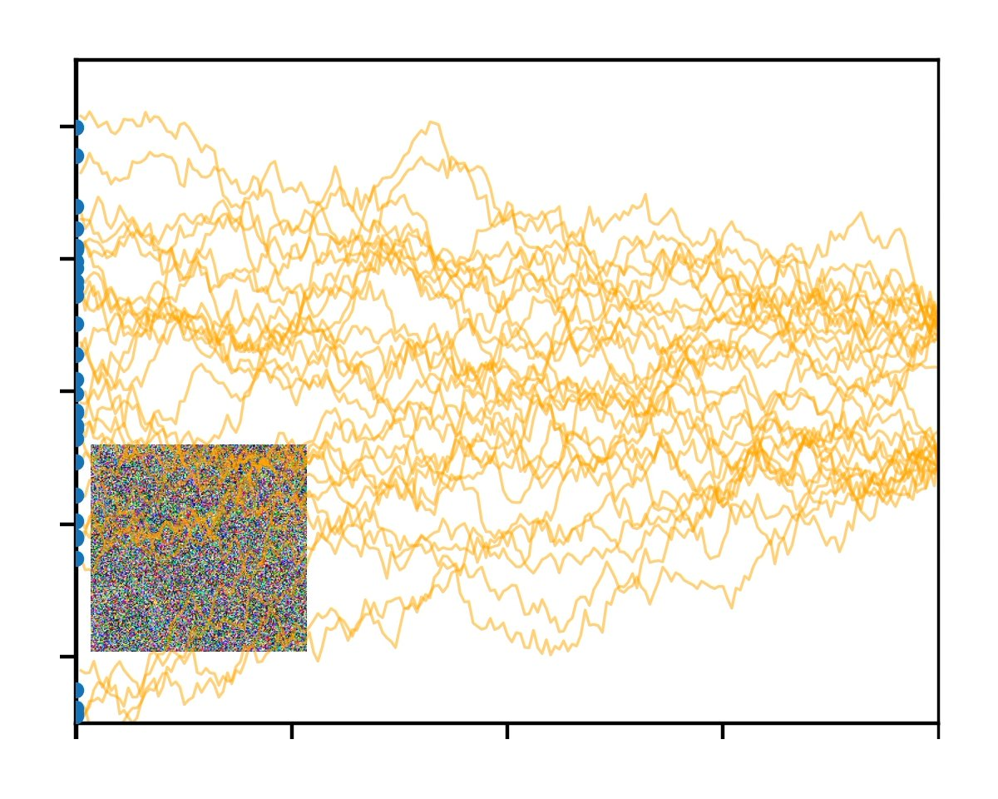
x
Data density is diffused as t decreases
t = 0 (noise)
t = 1 (clean)

Slide 12
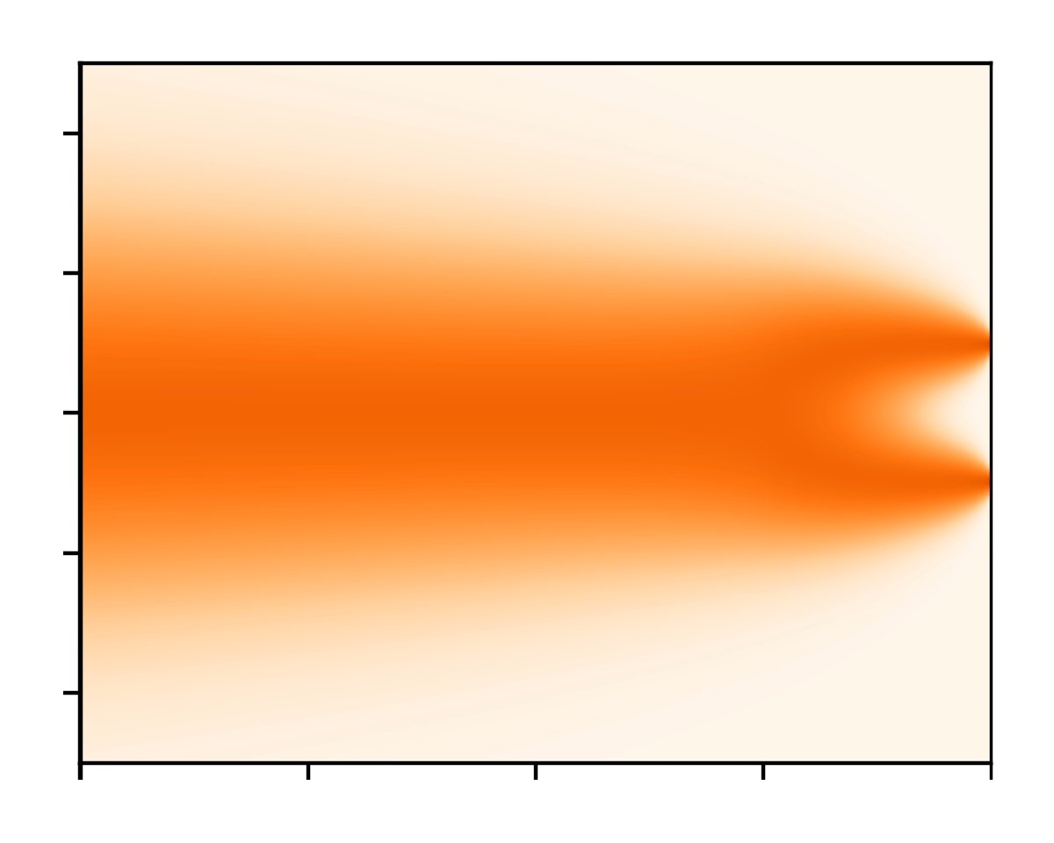
x
Data density is diffused as t decreases
All data ends up normally distributed
t = 0 (noise)
t = 1 (clean)

Slide 13
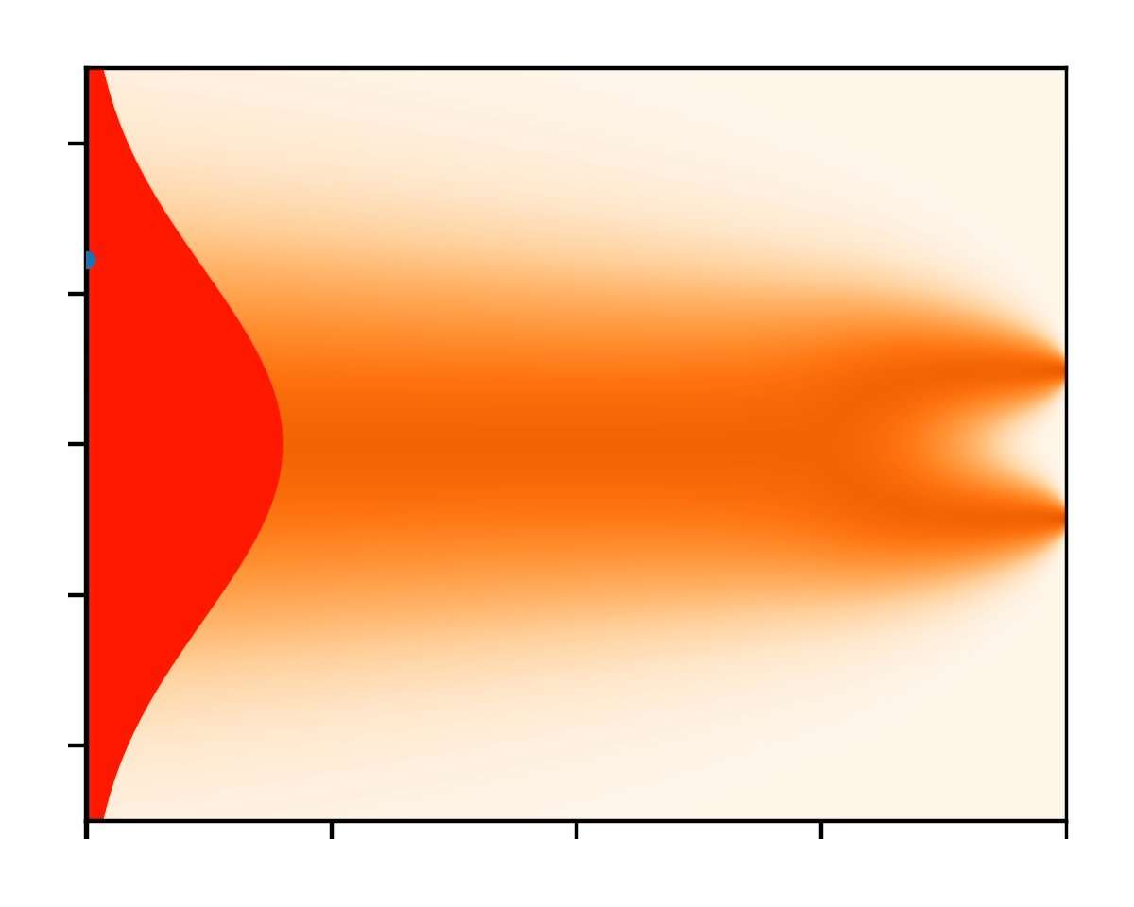
x
Data density is diffused as t decreases
All data ends up normally distributed
Let’s draw a sample…
t = 0 (noise)
t = 1 (clean)

Slide 14
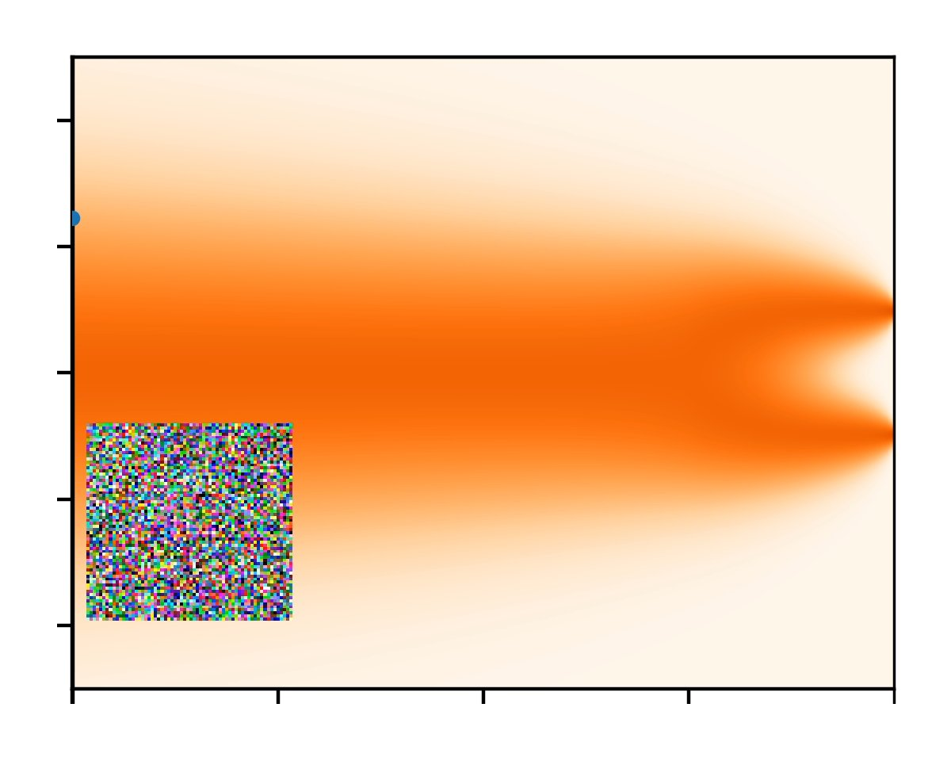
x
We can reverse the trajectory by gradual denoising
Endpoint is a random sample from data distribution!
t = 0 (noise)
t = 1 (clean)
Notes:
\mathrm{d}\mathbf{x} = \mathrm{d}\omega_{\mathbf{x}}
\mathrm{d}\mathbf{x} = -\nabla_{\mathbf{x}} \text{log} ~ p_t(\mathbf{x}) \mathrm{d}t + \mathrm{d}\omega_{\mathbf{x}}

Slide 15
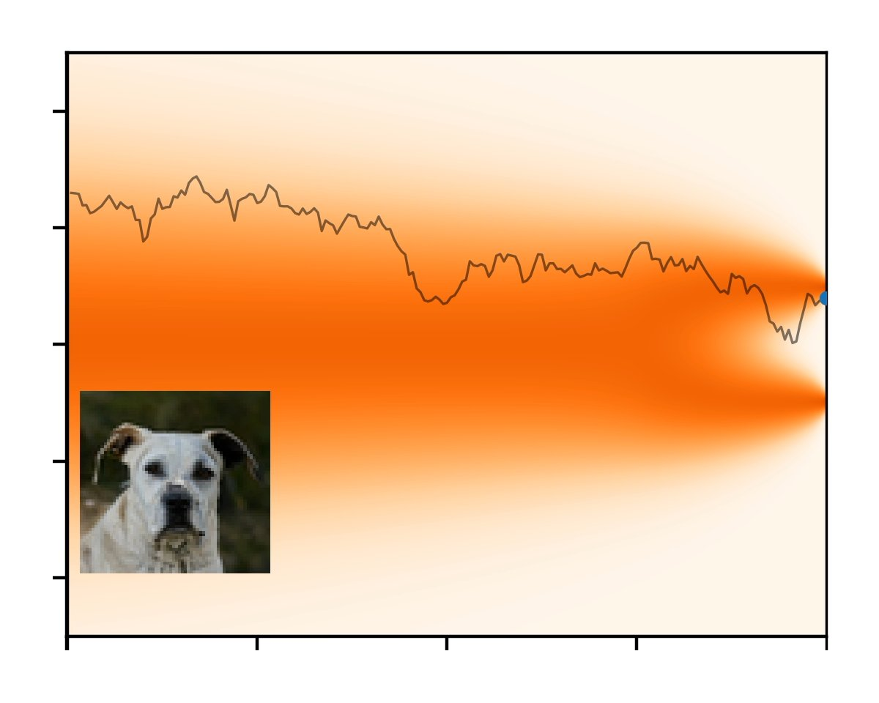
x
We can reverse the trajectory by gradual denoising
Endpoint is a random sample from data distribution!
t = 0 (noise)
t = 1 (clean)
Notes:
\mathrm{d}\mathbf{x} = \mathrm{d}\omega_{\mathbf{x}}
\mathrm{d}\mathbf{x} = -\nabla_{\mathbf{x}} \text{log} ~ p_t(\mathbf{x}) \mathrm{d}t + \mathrm{d}\omega_{\mathbf{x}}

Slide 16
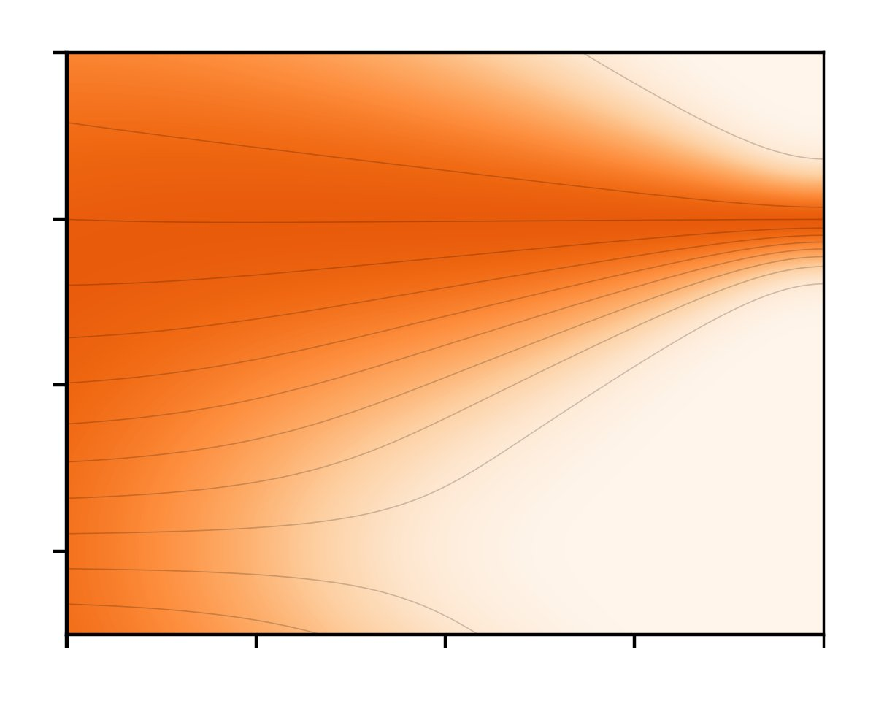
x
Why wiggles?
  Take one step to reduce noise
  Add a bit of fresh noise back
t = 0 (noise)
t = 1 (clean)

Slide 17
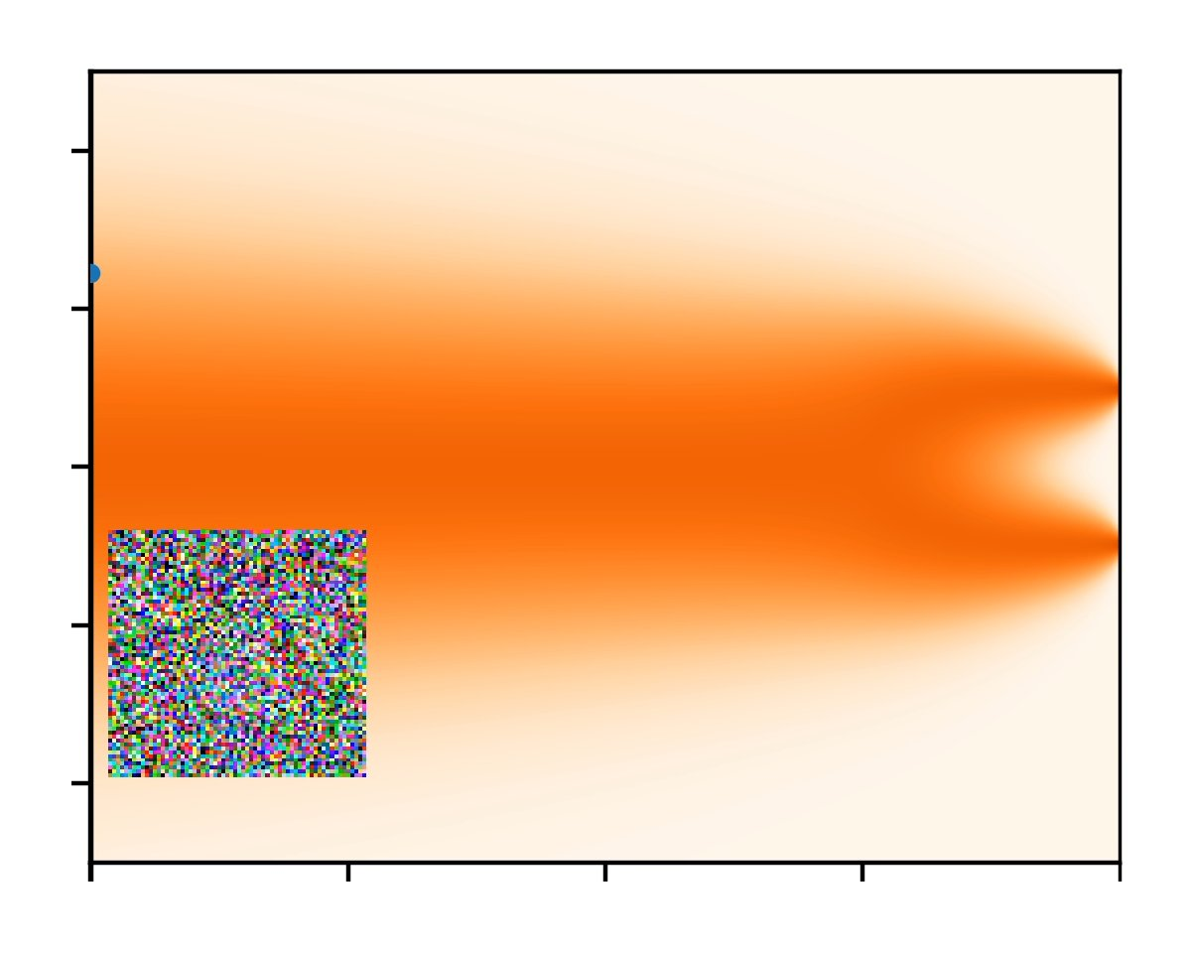

x
Flow Models
Deterministic
t = 0 (noise)
t = 1 (clean)
Notes:
\mathrm{d}\mathbf{x} = - \frac{1}{2} \nabla_{\mathbf{x}} \text{log} ~ p_t(\mathbf{x}) \mathrm{d}t

Slide 18
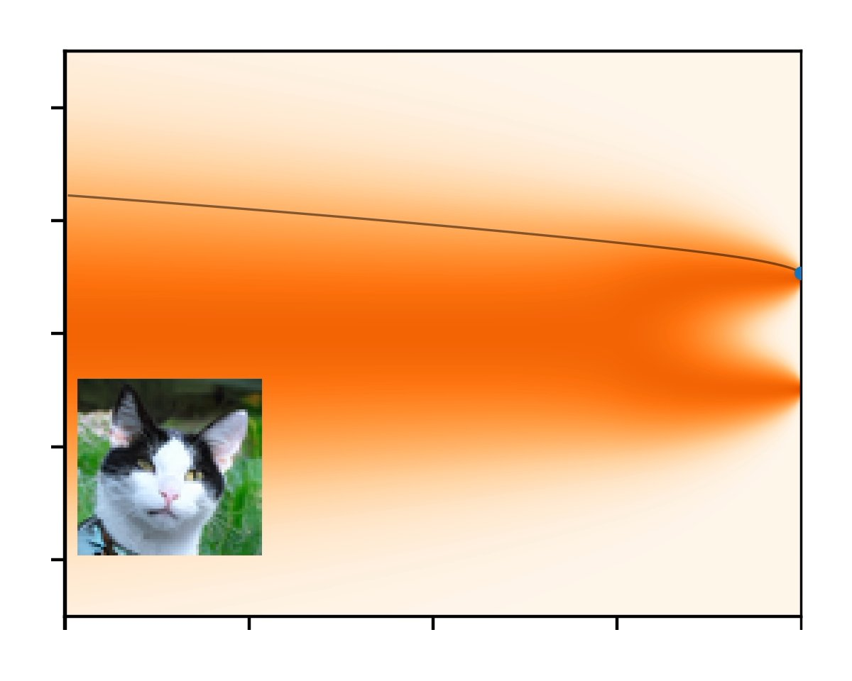
x
Deterministic ODE
t = 0 (noise)
t = 1 (clean)
Notes:
\mathrm{d}\mathbf{x} = - \frac{1}{2} \nabla_{\mathbf{x}} \text{log} ~ p_t(\mathbf{x}) \mathrm{d}t

Slide 19
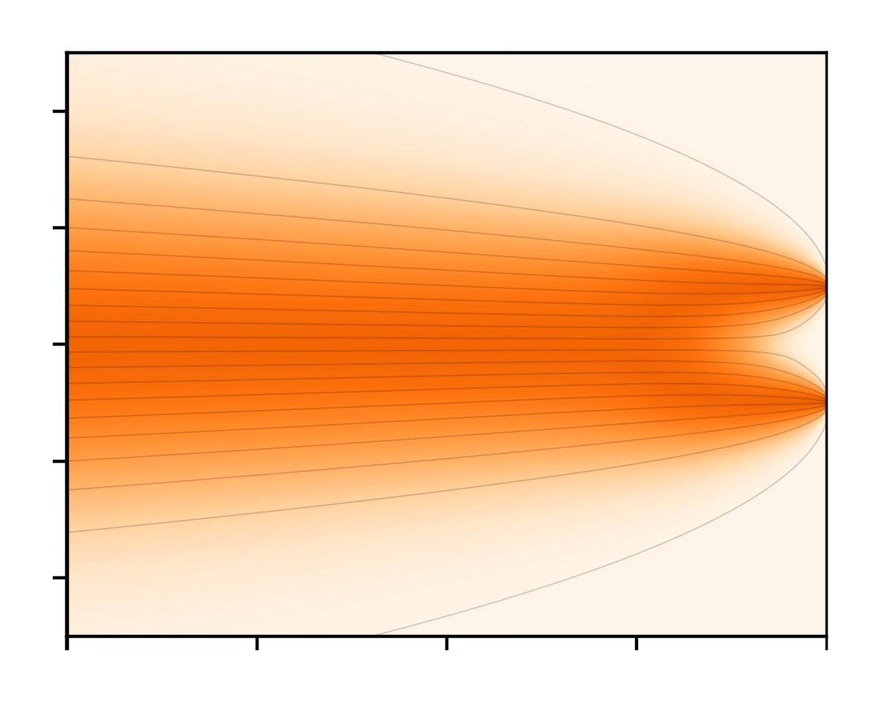
x
Solution by discretization
t = 0 (noise)
t = 1 (clean)
Notes:
\mathrm{d}\mathbf{x} = - \frac{1}{2} \nabla_{\mathbf{x}} \text{log} ~ p_t(\mathbf{x}) \mathrm{d}t

Slide 20
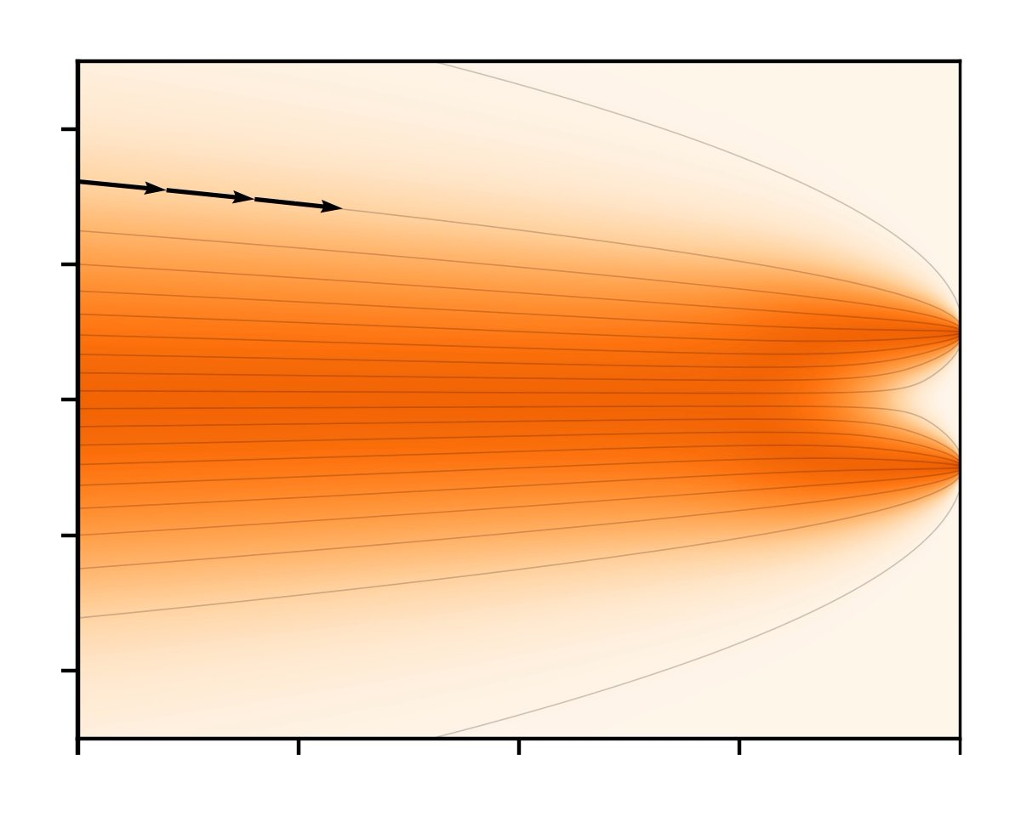
x
Solution by discretization
t = 0 (noise)
t = 1 (clean)
Notes:
\mathrm{d}\mathbf{x} = - \frac{1}{2} \nabla_{\mathbf{x}} \text{log} ~ p_t(\mathbf{x}) \mathrm{d}t

Slide 21
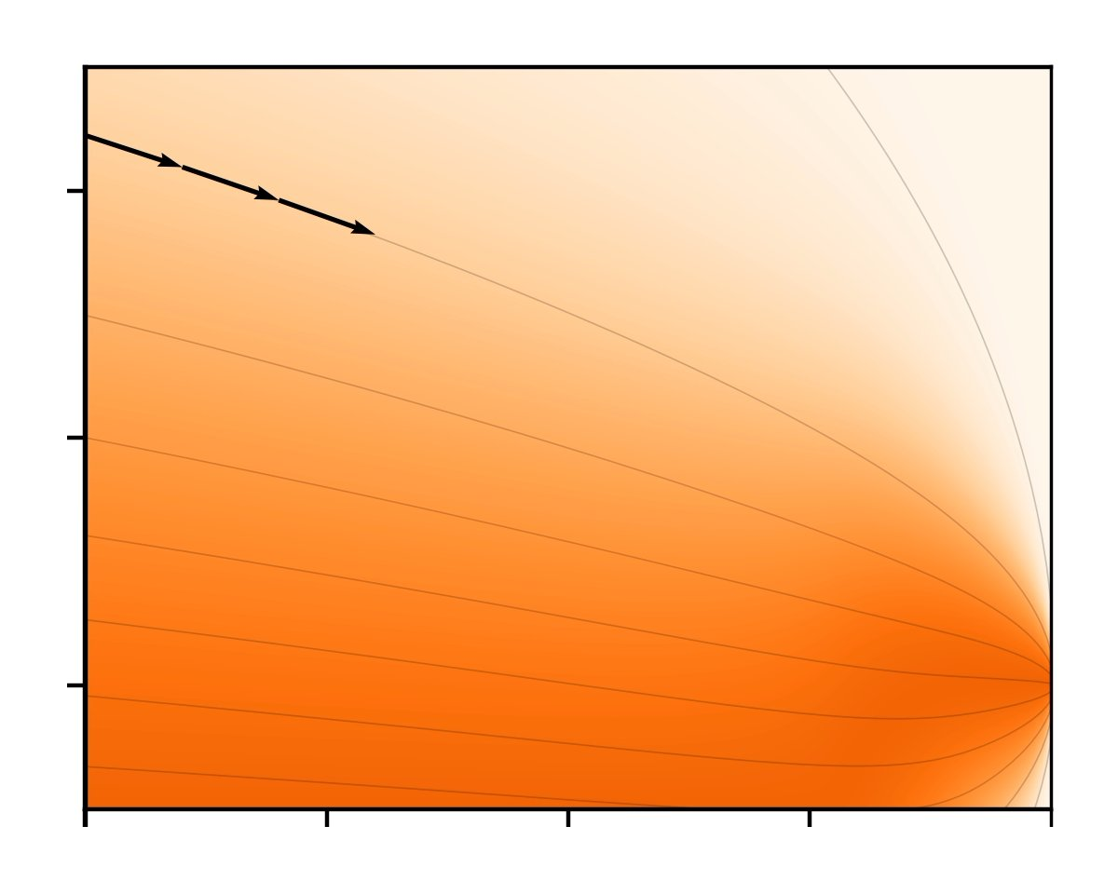
x
Solution by discretization
for a given change in time t
… the image x changes by this amount to push to be more probable (real)
t = 0 (noise)
t = 1 (clean)
Notes:
\mathrm{d}\mathbf{x} = - \frac{1}{2} \nabla_{\mathbf{x}} \text{log} ~ p_t(\mathbf{x}) \mathrm{d}t

Slide 22
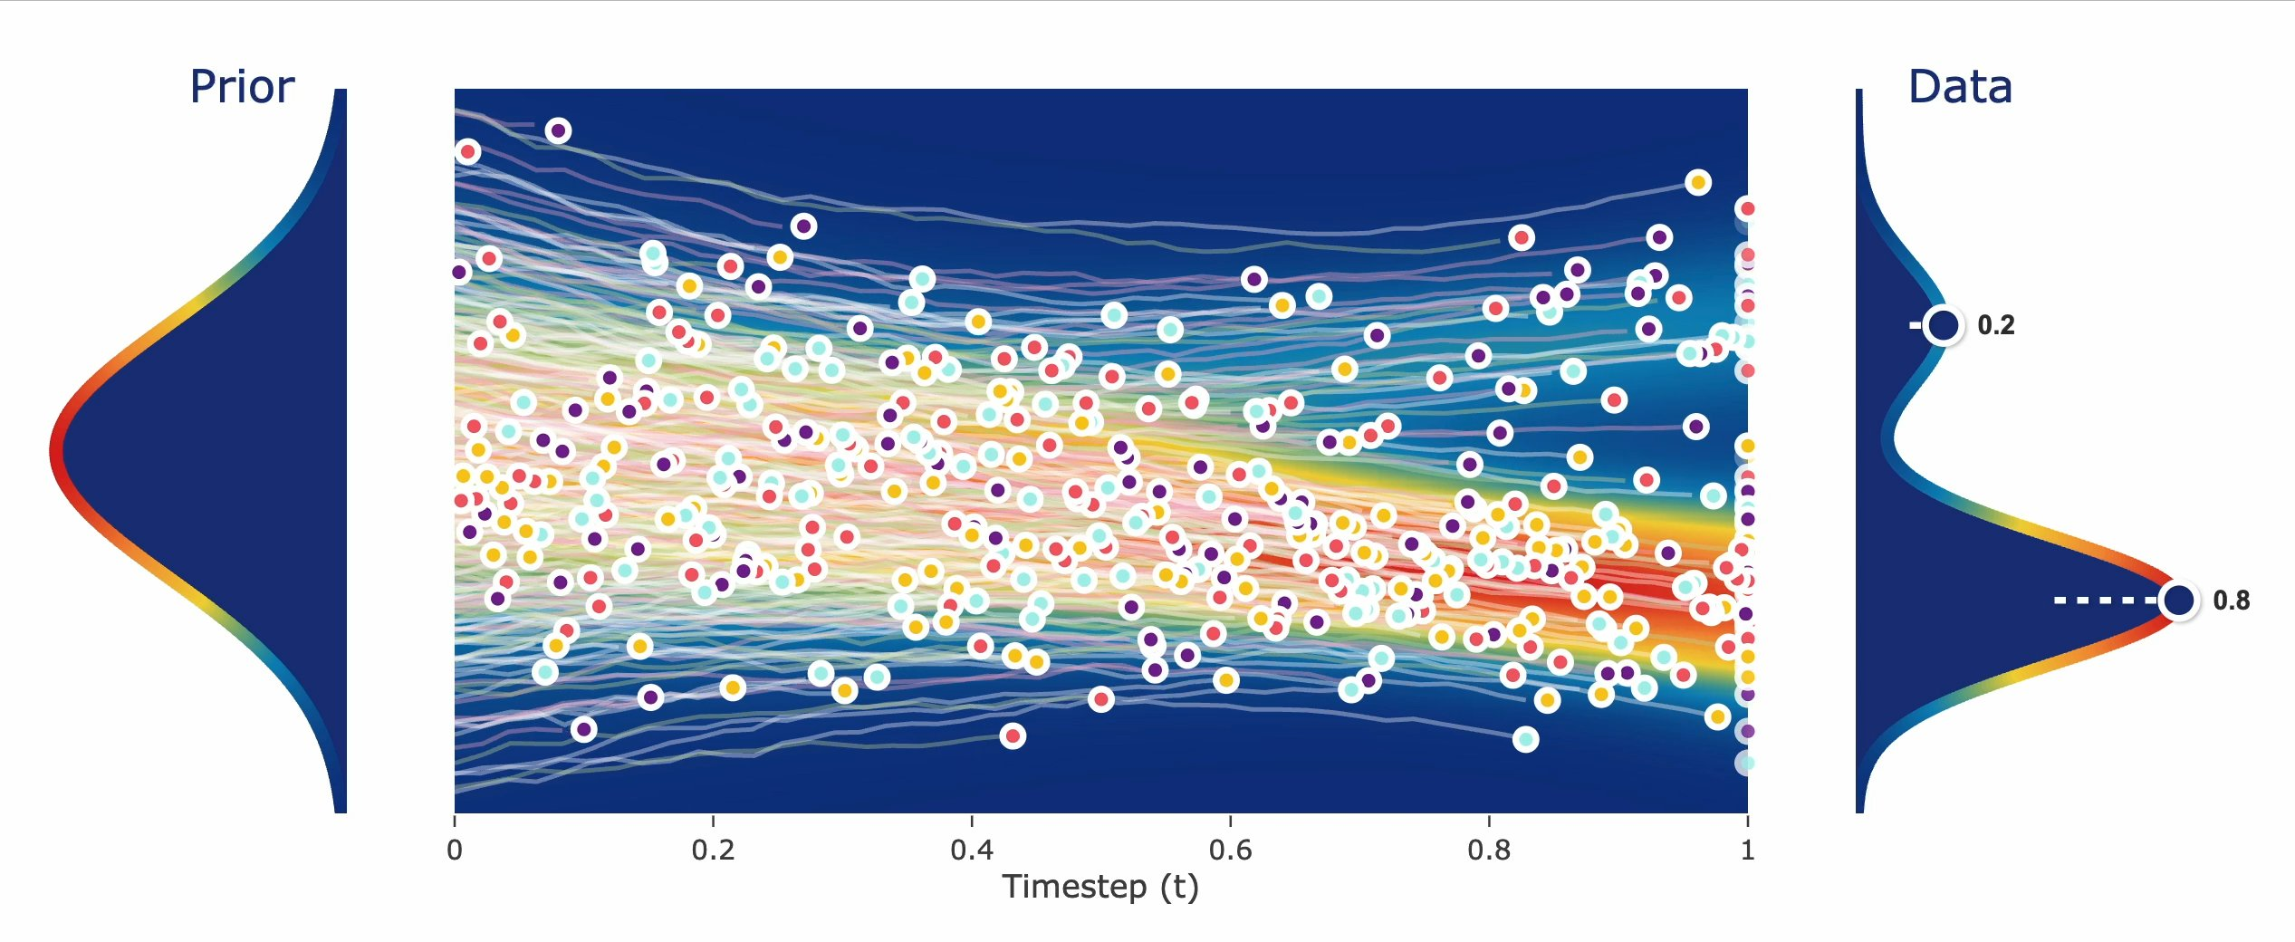
Continuous Flows
Transport Map from Noise to Data
Notes:
Idea is to have an intuitive idea of what the flow matching model optimizes, it is doing this

Slide 23
What about…
DDPM
DDIM
VP/VE-ODE
Flow matching
EDM
...?
Different choices of timesteps, image scaling, etc.
Some better than others, but fundamentally all the same

Slide 24
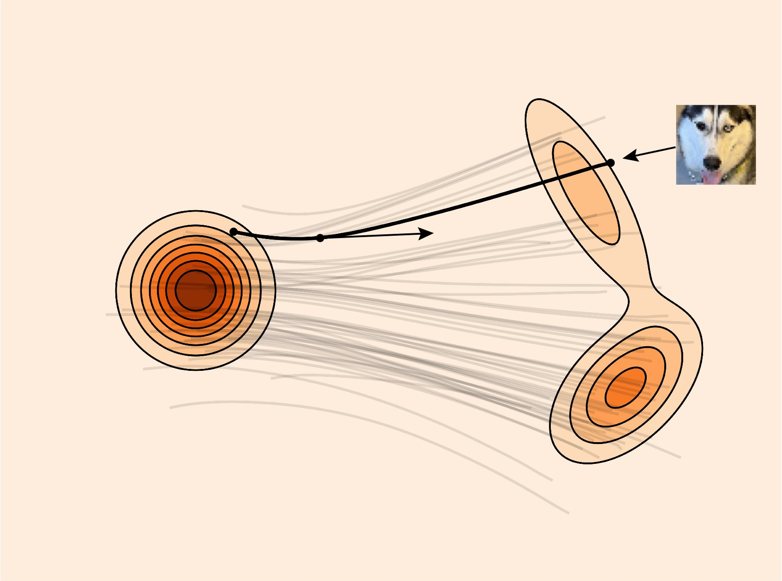
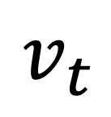
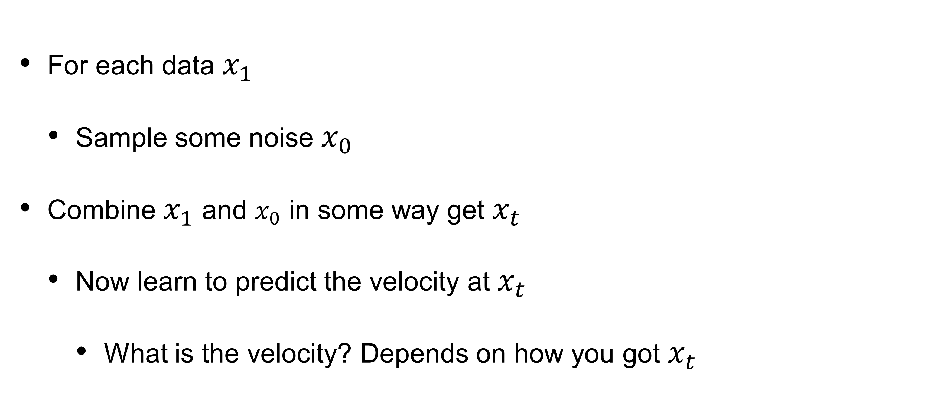
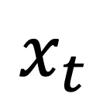
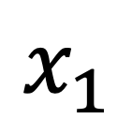
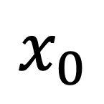
  Flow training
For each data $x_{1}$
  Sample some noise $x_{0}$
Combine $x_{1}$ and $x_{0}$ in some way get $x_{t}$
  Now learn to predict the velocity at $x_{t}$
    What is the velocity? Depends on how you got $x_{t}$
$$x_{1}$$
$$x_{0}$$
$$x_{t}$$
$$v_{t}$$

Slide 25
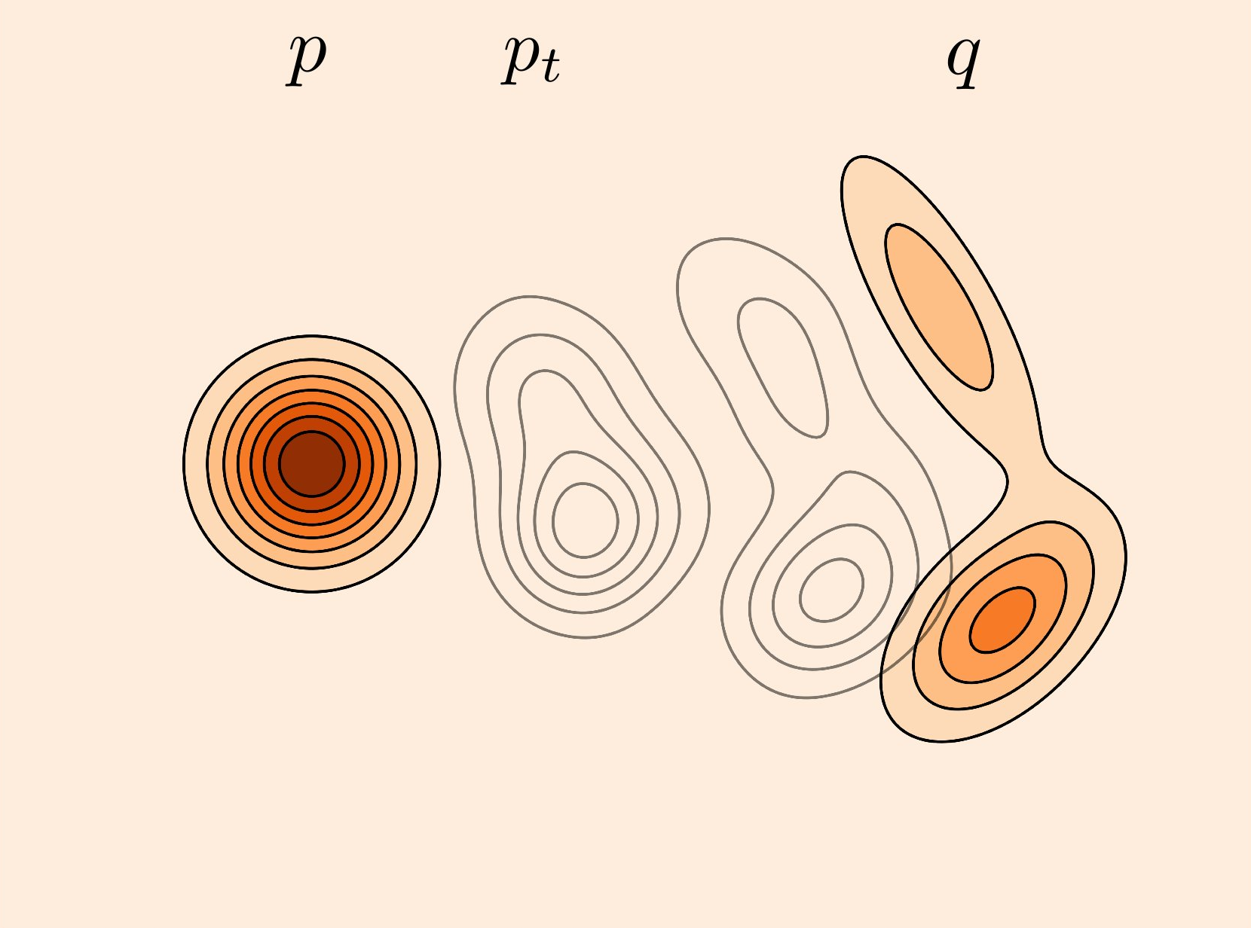
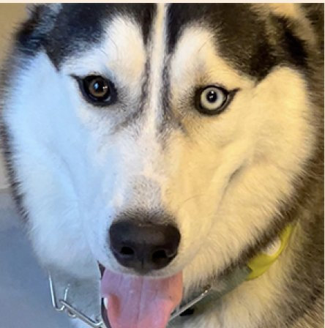
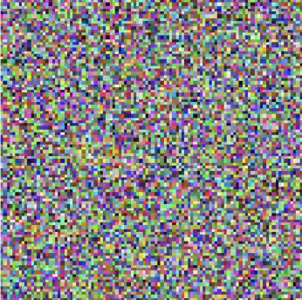
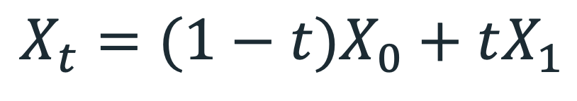
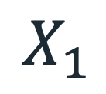
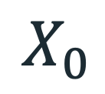
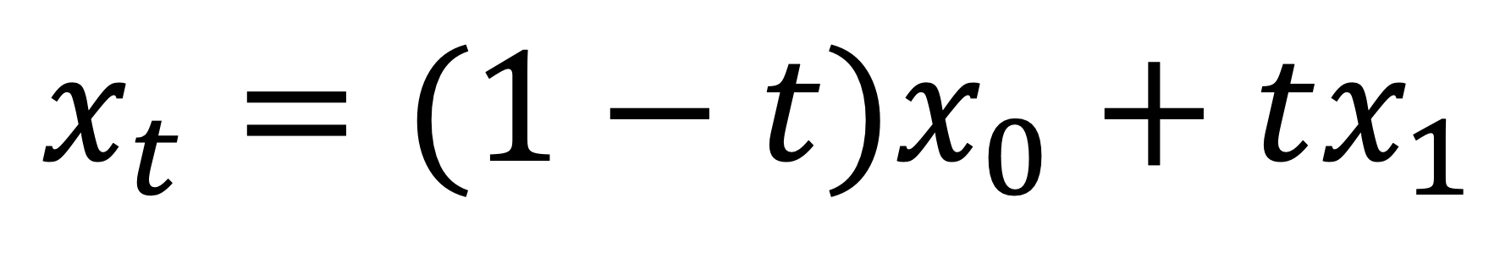
A Very Simple Way
Linear interpolation!
$$X_{t}=(1−t)X_{0}+tX_{1}$$
$$X_{1}$$
$$X_{0}$$
$$x_{t}=(1−t)x_{0}+tx_{1}$$

Slide 26
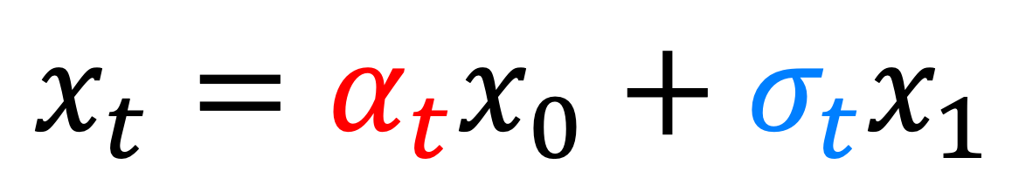
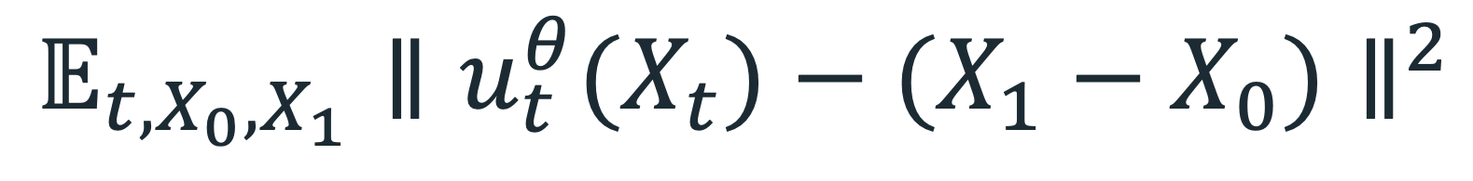
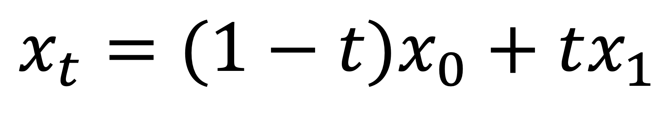
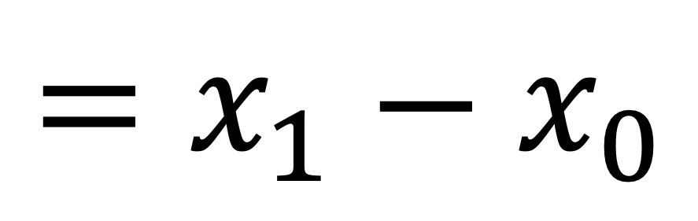
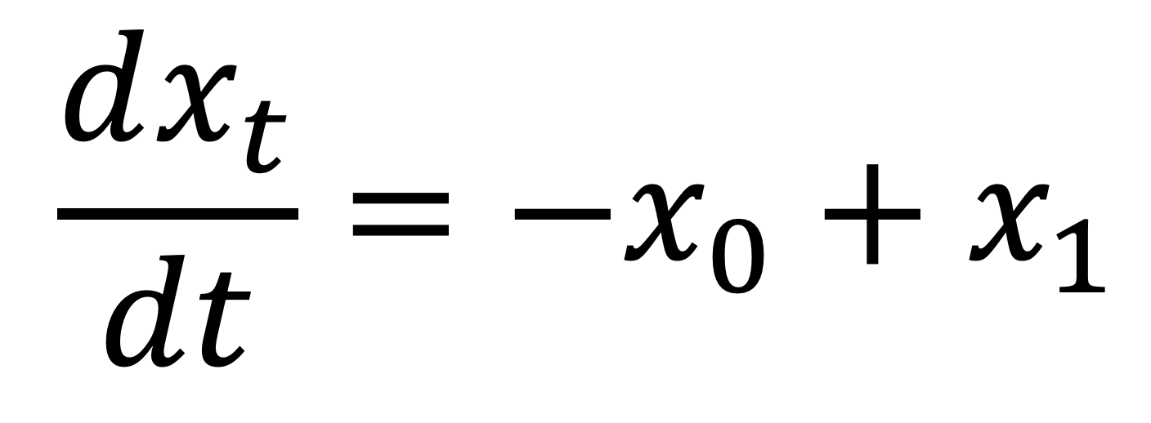
What is the velocity supervision?
$$x_{t}=α_{t}x_{0}+σ_{t}x_{1}$$
$$𝔼_{t,X_{0},X_{1}}∥u_{t}^{θ}(X_{t})−(X_{1}−X_{0})∥^{2}$$
$$x_{t}=(1−t)x_{0}+tx_{1}$$
$$X_{t}=(1−t)X_{0}+tX_{1}$$
$$\frac{dx_{t}}{dt}=−x_{0}+x_{1}$$
$$X_{1}$$
$$X_{0}$$
$$=x_{1}−x_{0}$$
*Conditioned on a single sample

Slide 27
Inside a Training Loop
Flow Matching
x = next(dataset)
t = torch.rand(1) # Sample timestep (0,1)
noise = torch.randn_like(x) # Sample noise
x_t = (1-t) * noise + (t) * x # Get noisy x_t
flow_pred = model(x_t, t) # Predict noise in x_t
flow_gt = x - noise # ground truth flow (w/ linear sched)
loss = F.mse_loss(flow_pred, flow_gt) # Update model
loss.backward()
optimizer.step()

Slide 28
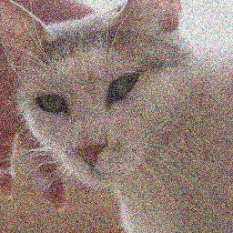












Training U-Net Denoiser
$$x_{t}$$
$$\overset{ˆ}{v}$$
Loss:
$${\left\|v−\overset{ˆ}{v}\right\|}^{2}$$
$$v=\frac{x_{clean}−x_{t}}{\left(1−t\right)}$$
+
Velocity:
$$v=x_{clean}−ε$$
$$x_{clean}$$
$$ε$$
-
Flow Matching
$$x_{clean}$$
$$ε$$

Slide 29



Test-time sampling
Just take a small step in the velocity
Use any ODE Solver, i.e. integration you like, like Euler integration:
$$u_{t}^{θ}$$
Sample
from $X_{0}∼p$
Notes:
More next lecture

Slide 30
Inside Sampling Loop
steps = 100
dt = 1.0 / steps
for i in range(steps):
  velocity = model(x_t, t) # Predict velocity at x_t
  x_t = x_t + dt * velocity # Step in velocity
Notes:
x_t = (1-t)*x0 + t*x1 ; Linear flow choice, where x0 is the noise, x1 is data
You predict x0, now to compute the velocity, you have to compute x1_pred from x0_pred
x1_pred= (x_t - (1-t)*x0_pred) / (t)
#X0 = x_t - noise_pred
Velocity = x_t - x1_pred

Slide 31
U-Net Denoiser at inference
$$x_{t}$$
$$\overset{ˆ}{v}$$
Flow Matching

Slide 32

















Training Time:
Inference Time:
denoise
blend

Slide 33
Curius Property #1
In ML, you want to always train the same data you test on
But in Diffusion/Flow Models, they are different:
Not great, but seems to still work, somewhat
Training Time:
Inference Time:

Slide 34


Other options lead to prior works
Other choices:
  Preserve variance (VP-ODE) - DDPM
  Exploding variance (VE-ODE) - Score Matching/DDIM
  Linear interpolation (Flow Matching, Rectified Flow)
$$x_{t}=α_{t}x_{0}+σ_{t}x_{1}$$

Slide 35
Why does Flow Matching work?
FM —> predict the velocity conditioned on a single sample

Slide 36

Marginal vs. Conditional Flow
What we want is the flow (velocity field) that takes samples from $p_{0}$ to $p_{1}$when integrated (called Marginal Flow)
  e.g. Find the best noise that would flow to each training image
But what we did was to train flow for each sample (Conditional Flow)

Slide 37


Turns out Gradient is the same!
  Flow Matching loss:
  Conditional Flow Matching loss:
$$ℒ_{FM}(θ)=𝔼_{t,X_{t}}∥u_{t}^{θ}(X_{t})−u_{t}(X_{t})∥^{2}$$
We can’t do this bc we don’t know what ground truth flow is
$$ℒ_{CFM}(θ)=𝔼_{t,X_{1},X_{t}}∥u_{t}^{θ}(X_{t})−u_{t}(X_{t}|X_{1})∥^{2}$$
Theorem: Gradient of the losses are equivalent,
$$∇_{θ}ℒ_{FM}(θ)=∇_{θ}ℒ_{CFM}(θ)$$

Slide 38




Why does this work?
High level: You can average conditional flow (marginalization)
$$u_{t}(x)=𝔼[u_{t}(X_{t}|X_{1})|X_{t}=x]$$
Marginal flow
(what we want)
Conditional flow
(easy to obtain from each sample)
$$=∫u_{t}(x|x_{1})p(x_{1}|X_{t}=x)dx_{1}$$
$$u_{t}(x)=∫u_{t}(x|x_{1})\frac{p_{t}(x|x_{1})q(x_{1})}{p_{t}(x)}dx_{1}$$
Bayes rule with notation:
$$p(x_{1})=q(x_{1})$$

Slide 39




It’s all just weighted average
$$u_{t}(x)=∫u_{t}(x|x_{1})\frac{p_{t}(x|x_{1})q(x_{1})}{p_{t}(x)}dx_{1}$$
$$u_{t}(x_{t})=∑u_{t}(x_{t}|x_{1})\frac{p_{t}(x_{t}|x_{1})}{p_{t}(x)}q(x_{1})$$
Weight of sample x0 = 1
Marginal flow
Path from $x_{1}$ to $x_{t}$
Path weight (how relevant $x_{1}$ is to $x_{t}$)
Just a weighted average of the flow to each data sample!!!!!
You can actually do this non-parametrically.

Slide 40
On the board

Slide 41






x
Illustration of the analytic solution
pixel values
Path weight
$$\frac{p_{t}(x_{t}|x_{1})}{p_{t}(x)}$$
Conditional flow: $u_{t}(x_{t}|x_{1})$
Averaged velocity (marginal flow)
Current noisy image $x_{t}$
Data samples
t

Slide 42
Now we can explain why x_t start out so flurry?
denoise
blend

Slide 43






Our old friend L2 is the problem!
Notes:
Suppose there is an equal chance that the actual color is red or blue. Then the solution that minimizes the L2 norm is to output average of red and blue, which gives a grayish result.

Slide 44


Image Composites
Multiple Individuals
Sir Francis
Galton
1822-1911
Composite
[Galton, “Composite Portraits”, Nature, 1878]

Slide 45

“100 Special Moments” by Jason Salavon
Why
blurry?

Slide 46

Sum-population means

Slide 47

The full intuition!
Donghoon Ahn’s visualization: https://sunovivid.github.io/blog/2026/flow-matching/

Slide 48
Important Caveat
One can minimize the diffusion objective (marginal flow) non-parametrically and perfectly minimize the loss.
But there is no learning! No ability to generate new images!
i.e. Exactly minimizing this objective does not guarantee interpolation/compositionally, learning of the image manifold!
Parametrizing it with neural networks results in magic smoothing to generate new images and interpolate between them. Exactly what makes this possible still active area of research

Slide 49
Curious property #2
We are training the model to reconstruct the training set
  But it fails!
  Instead, it generate novel images
  Which is what makes it great
Perhaps the network models images as textures
  Keeping important statistics and throwing away the rest
  But we don’t know the “model space” of these textures

Slide 50
Diffusion/Flow Models tend to model important correlations

Slide 51


Slide 52

“Person holding a laptop”

Slide 53

“Person holding birthday cake”

Slide 54

“Person offering tea”

Slide 55

“Person holding a watermelon”

Slide 56

“Person holding a self-portrait”

Slide 57

“Person holding a painting of himself”

Slide 58
Practical Inference Tricks

Slide 59

Great! Let’s collect a billion images, train, and generate…
An old man in a colorful smock splattering paint alongside a young man in an oversized t-shirt and goggles.
… oh.
What went wrong?

Slide 60

Guiding a Diffusion Model with a Bad Version of Itself, Karras et al 2024

Slide 61


A photo of a raccoon wearing an astronaut helmet
guidance off
guidance on
Notes:
But these methods don’t actually work too well out of the box. If we simply run the plain diffusion sampling process with a state of the art model, we get a result like this. I mean, you can kinda see a raccoon in there, but it’s not having a very good day.
Now, let’s enable a widely used, and slightly oddly named magic trick called classifier-free guidance, or CFG. Quite the improvement, right?

Slide 62
Two Approaches
Original
Current
Classifier Guidance
Classifier-Free Guidance
Guide with a pretrained classifier.
Guide a diffusion model with itself.

Slide 63



Diffusion Guidance
Push Toward a Conditional Mode
Raspberry Beret Distribution
Guided Prediction
Guidance
$x_{t}$
Noise Image
Single-Step Prediction
Natural Image Distribution

Slide 64



Classifier Guidance
Using a Pretrained Classifier
Raspberry Beret Distribution
Guided Prediction
$x_{t}$
Guidance
Noise Image
Single-Step Prediction
${\overset{̂}{x}}_{1}$
Image Prediction
Natural Image Distribution

Slide 65



Classifier Guidance
Raspberry Beret Distribution
Using a Pretrained Classifier
$∇_{}logp({\overset{̂}{x}}_{0}|c)$
Gradient from Classifier
Diffusion Model
$x_{t}$
Noise Image
${\overset{̂}{x}}_{1}$
Image Prediction
Natural Image Distribution

Slide 66

Sampling ODE View
Guide
Guide
Guide
Step
Step
Step
Step
Guide
Step

Slide 67



Classify These Images!

Slide 68



Classifier Guidance Pathologies
Intermediate Diffusion Steps are O.O.D. for Classifier
ImageNet Training Data
$x_{t}$
${\overset{̂}{x}}_{1}$
Noise Image
Image Prediction

Slide 69

Two Approaches
Original
Current
Classifier Guidance
Classifier-Free Guidance
Guide with a pretrained classifier.
Guide a diffusion model with itself.

Slide 70

Model is trained to output both
$ε_{φ}(x_{t};c)$
$ε_{φ}(x_{t};∅)$

Slide 71
Conditional Diffusion
Model Knows Unconditional, Text-Conditioned Distributions
Raspberry Beret Distribution
Conditional Prediction
$x_{t}$
Noise Image
Difference
Unconditional Prediction
Natural Image Distribution

Slide 72





Classifier-Free Guidance
Model Knows Unconditional, Text-Conditioned Distributions
Raspberry Beret Distribution
Conditional Prediction
$x_{t}$
Difference
Noise Image
Unconditional Prediction
$$ε_{CFG}=s⋅\left(ε_{φ}(x_{t};c)−ε_{φ}(x_{t};∅)\right)+ε_{φ}(x_{t};∅)$$
$$ε_{φ}$$
Predicted Noise
$$∅$$
Null Prompt
Natural Image Distribution
$$c$$
Target Prompt
$$s$$
CFG Scale

Slide 73





Classifier-Free Guidance
TLDR: Amplify Delta Between Conditional, Unconditional Predictions
$$ε_{φ,CFG}=s⋅\left(ε_{φ}(x_{t};c)−ε_{φ}(x_{t};∅)\right)+ε_{φ}(x_{θ};∅)$$
$$ε_{φ}$$
Predicted Noise
$$∅$$
Null Prompt
$$c$$
Target Prompt
$$s$$
CFG Scale
Figure from Perturbed-Attention Guidance (ECCV 2024)

Slide 74

Classifier-Free Guidance
Drives Generations Toward Conditional Mode
s = 1 (Conditional Generation)
s = 3 (Conditional Generation)
"Classifier-Free Diffusion Guidance" Ho et al. (2022)

Slide 75
Variety of ways to use Flow Models

Slide 76




Visual Anagrams: Generating Multi-View Optical Illusions with Diffusion Models
Daniel Geng
Aaron Park
Andrew Owens
University of Michigan
CVPR 2024
https://dangeng.github.io/visual_anagrams/

Slide 77


Slide 78


Slide 79


Slide 80








Diffusion Models
“a photo of a puffin”

Slide 81










Method
“an oil painting of people around a campfire”
“an oil painting of an old man”

Slide 82







Method

Slide 83

$$p(x|c)$$
Guidance Lets Us Sample a Conditional Distribution

Slide 84
$$p(x|c)$$
Guidance Lets Us Sample a Conditional Distribution
What if we’re creative about the conditioning?

Slide 85

Condition on the First frame and Audio, Generate the Video
OmniHuman-1: Rethinking the Scaling-Up of One-Stage Conditioned Human Animation Models. Lin et al. (2025)

Slide 86

Condition on Video Pixels, Generate Depth Map
"Generating Consistent Long Depth Sequences for Open-world Videos" Hu et al. (2025)

Slide 87




Conditioning
Samples
Condition on Start and End Frame, Generate Intermediate Frames
"Explorative Inbetweening of Time and Space" Feng et al. (2024)

Slide 88

Condition on Image + Camera, Generate Novel Views
"CAT3D: Create Anything in 3D with Multi-View Diffusion Models" Gao et al. (2024)

Slide 89

Cat3D

Slide 90

Condition on Image + Camera, Generate Novel Views
Stable Virtual Camera: Generative View Synthesis with Diffusion Models (Zhou*, Gao* et al.)

