Slide 1
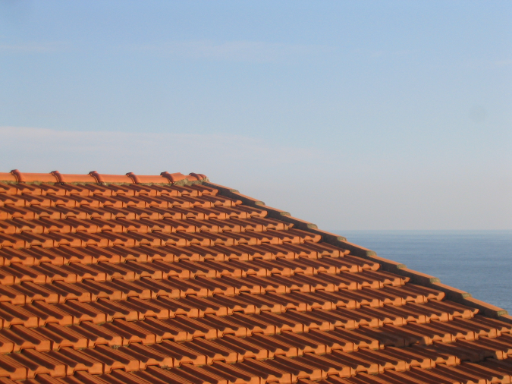
The Frequency Domain, without tears
Many slides borrowed
from Steve Seitz
Somewhere in Cinque Terre, May 2005
CS180: Intro to Computer Vision and Comp. Photo
Alexei Efros and Ren Ng, UC Berkeley, Fall 2026
Notes:
fourier transform – understand what does it mean to think in frequency domain, not the technical derivation

Slide 2
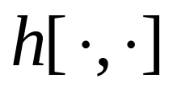
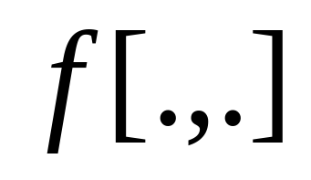
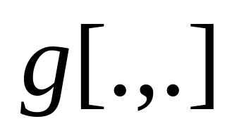
Recap: Image filtering
1
1
1
1
1
1
1
1
1
0 | 0 | 0 | 0 | 0 | 0 | 0 | 0 | 0 | 0
0 | 0 | 0 | 0 | 0 | 0 | 0 | 0 | 0 | 0
0 | 0 | 0 | 90 | 90 | 90 | 90 | 90 | 0 | 0
0 | 0 | 0 | 90 | 90 | 90 | 90 | 90 | 0 | 0
0 | 0 | 0 | 90 | 90 | 90 | 90 | 90 | 0 | 0
0 | 0 | 0 | 90 | 0 | 90 | 90 | 90 | 0 | 0
0 | 0 | 0 | 90 | 90 | 90 | 90 | 90 | 0 | 0
0 | 0 | 0 | 0 | 0 | 0 | 0 | 0 | 0 | 0
0 | 0 | 90 | 0 | 0 | 0 | 0 | 0 | 0 | 0
0 | 0 | 0 | 0 | 0 | 0 | 0 | 0 | 0 | 0
 | 0 | 10 | 20 | 30 | 30 | 30 | 20 | 10
 | 0 | 20 | 40 | 60 | 60 | 60 | 40 | 20
 | 0 | 30 | 60 | 90 | 90 | 90 | 60 | 30
 | 0 | 30 | 50 | 80 | 80 | 90 | 60 | 30
 | 0 | 30 | 50 | 80 | 80 | 90 | 60 | 30
 | 0 | 20 | 30 | 50 | 50 | 60 | 40 | 20
 | 10 | 20 | 30 | 30 | 30 | 30 | 20 | 10
 | 10 | 10 | 10 | 0 | 0 | 0 | 0 | 0
Credit: S. Seitz

Slide 3
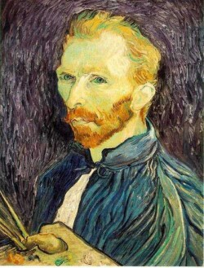
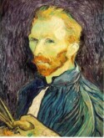

Filtering for antialiasing (low pass)
G 1/16
G 1/4
Gaussian 1/2
Solution: filter the image, then subsample
  Filter size should double for each ½ size reduction. Why?
Slide by Steve Seitz

Slide 4
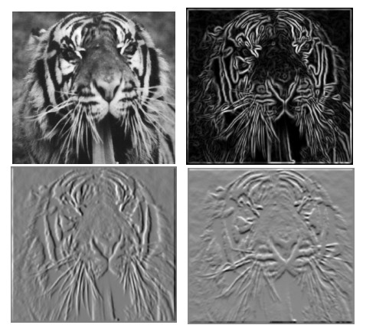
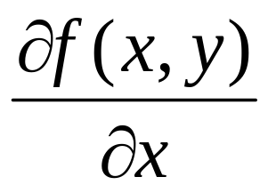
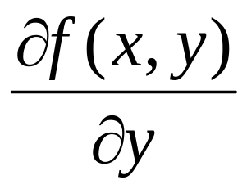
Filtering to compute image derivatives
-1 1
1 -1
-1 1
or
Which shows changes with respect to x?
Notes:
why 2 derivatives and not 1? when we’re on the hill… what if you’re a bird?

Slide 5
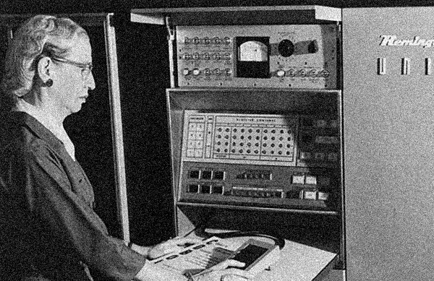
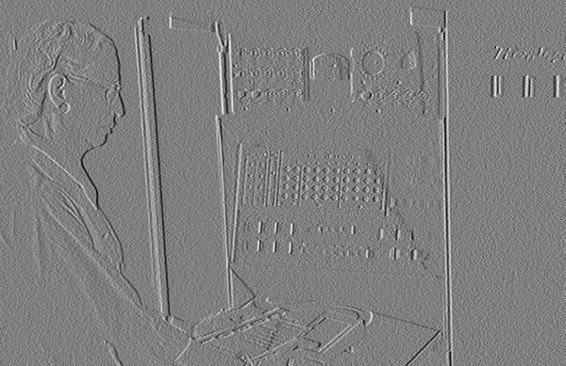
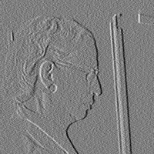

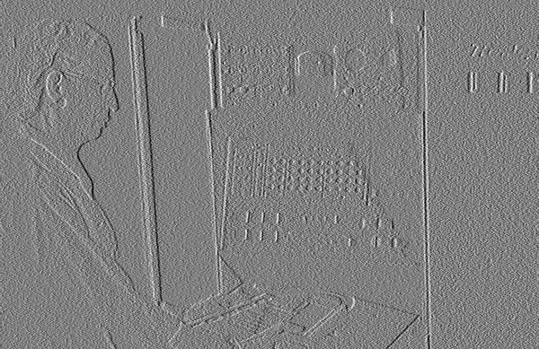
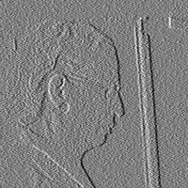
Filtering to denoise
Noisy Input
dx via [-1,01]
Zoom
Source: D. Fouhey

Slide 6

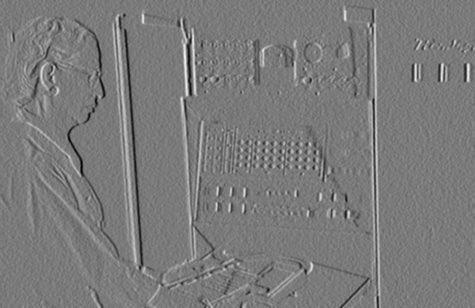
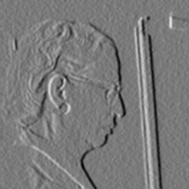



Filtering to denoise
Smoothed Input
dx via [-1,01]
Zoom
Source: D. Fouhey

Slide 7
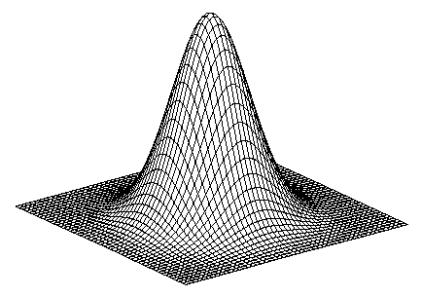
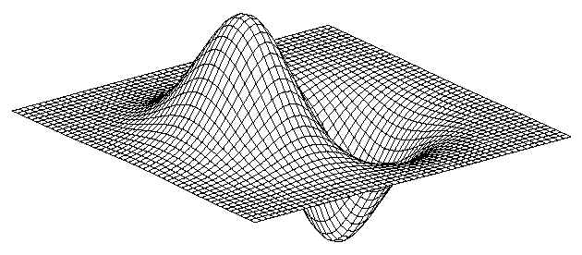
Derivative of Gaussian filter
* [-1 0 1] =

Slide 8
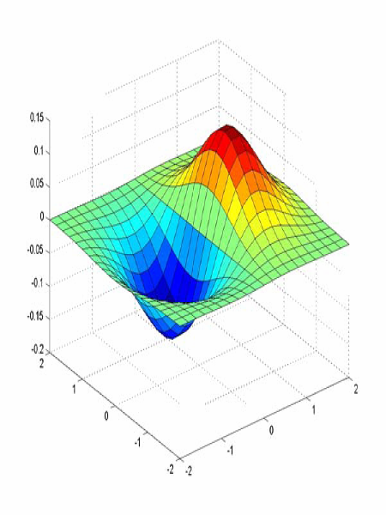
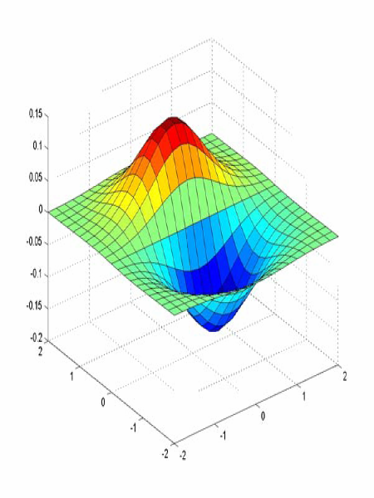
Derivative of Gaussian filter
x-direction
y-direction
Which one finds horizontal/vertical edges?

Slide 9


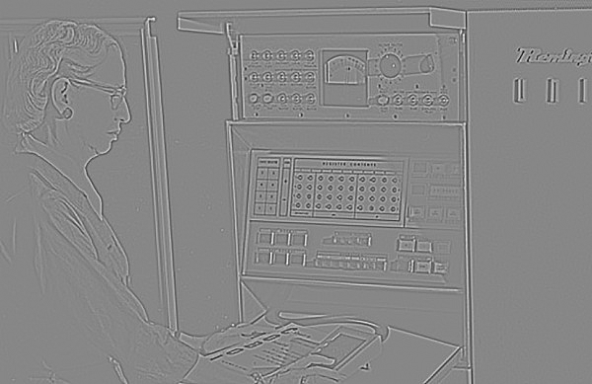
Low Pass vs. High Pass filtering
Image
Smoothed
–
Details
=
Notes:
What kind of frequency is this

Slide 10
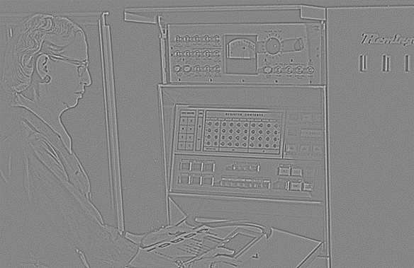

Filtering – Sharpening
Image
Details
+α
“Sharpened” α=1
=

Slide 11

Filtering – Sharpening
Image
Details
+α
“Sharpened” α=0
=

Slide 12

Filtering – Sharpening
Image
Details
+α
“Sharpened” α=2
=

Slide 13
Filtering – Sharpening
Image
Details
+α
“Sharpened” α=0
=

Slide 14

Filtering – Extreme Sharpening
Image
Details
+α
“Sharpened” α=10
=

Slide 15
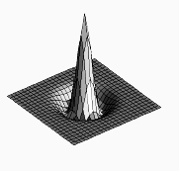

Unsharp mask filter (= sharpening filter)
image
blurred
image
unit impulse
(identity)
unit impulse
Gaussian
Laplacian of Gaussian
Notes:
f + a(f - f * g) = (1+a)f-af*g = f*((1+a)e-g)
Name is confusing.. “unsharp mask” → the mask is made by unsharped image..
High-pass filter!

Slide 16
Filtering: practical matters
What is the size of the output?
(MATLAB) filter2(g, f, shape) or conv2(g,f,shape)
  shape = ‘full’: output size is sum of sizes of f and g
  shape = ‘same’: output size is same as f
  shape = ‘valid’: output size is difference of sizes of f and g
Pytorch conv2d ‘valid’ or ‘same’
full
same
valid
g
g
g
g
f
f
f
g
g
g
g
g
g
g
g
Source: S. Lazebnik
Notes:
16

Slide 17
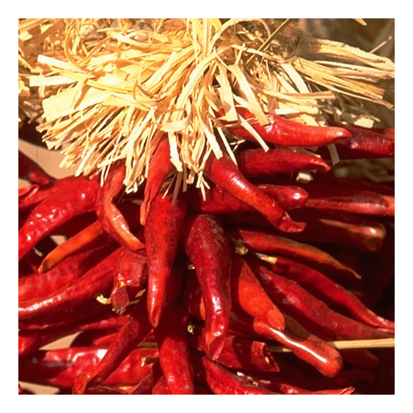
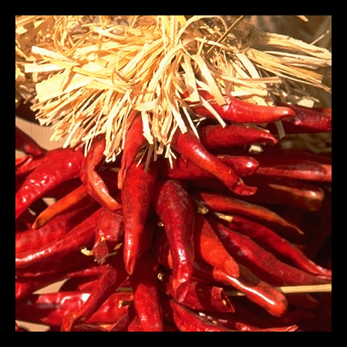


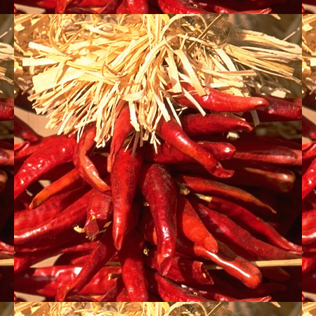

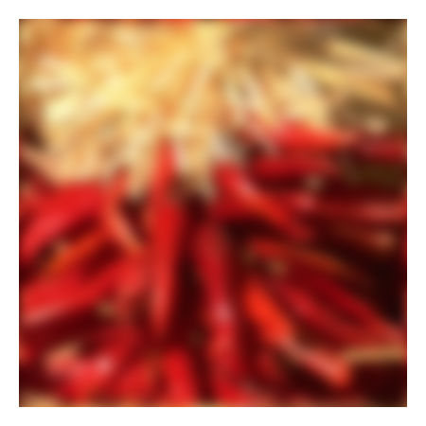
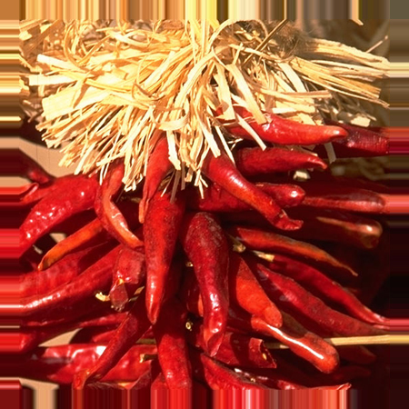


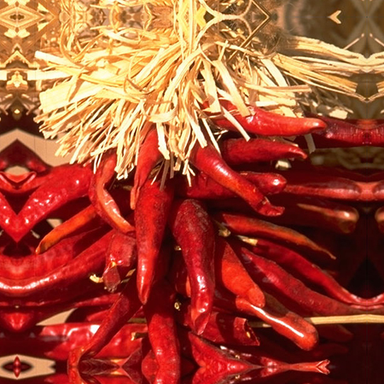


Filtering: practical matters
What about near the edge?
  the filter window falls off the edge of the image
  need to extrapolate
  methods:
    clip filter (black)
    wrap around (circular)
    copy edge
    reflect across edge
Source: S. Marschner
Notes:
17

Slide 18
The Frequency Domain, without tears
Many slides borrowed
from Steve Seitz
Somewhere in Cinque Terre, May 2005
CS180: Intro to Computer Vision and Comp. Photo
Alexei Efros and Ren Ng, UC Berkeley, Fall 2026
Notes:
fourier transform – understand what does it mean to think in frequency domain, not the technical derivation

Slide 19
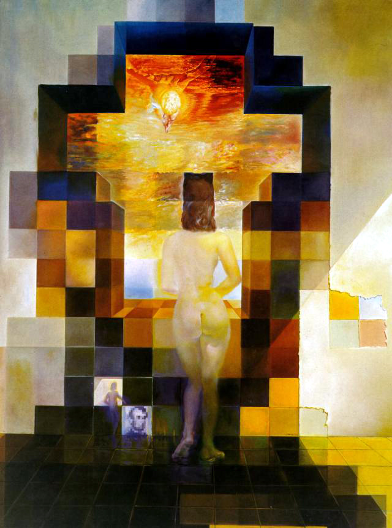
Salvador Dali
“Gala Contemplating the Mediterranean Sea,
which at 30 meters becomes the portrait
of Abraham Lincoln”, 1976
Notes:
psychophysics test. Backrow / frontrow
Gala => wife of Dali, in Dalí Museum, St. Petersburg, FL, as you walk towards it you see different things
what’s going on?
what to do if we want first row to see lincon?

Slide 20
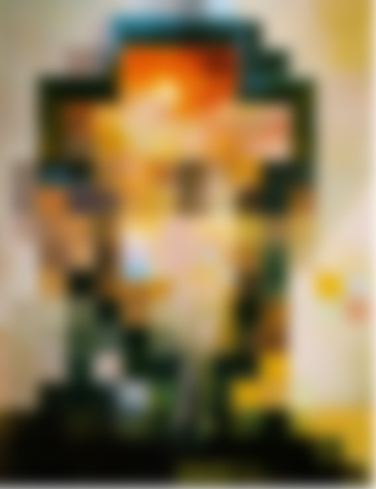
Notes:
Instead of showing two paintings side by side, or .. Dali put two paintings in two different.. spatial frequencies
how do we see the other image? High-pass.. how? -

Slide 21
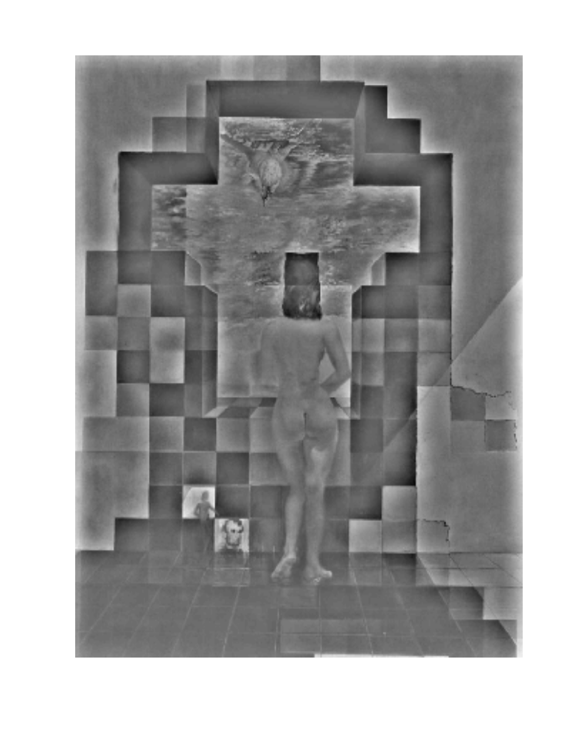
Notes:
how can we decomposte this image?

Slide 22

Spatial Frequencies and Perception
Campbell-Robson contrast sensitivity curve
Notes:
22
This particular curve, which you may not see.. but you actually see.
Visualize the frontier when sine wave stops and gray starts? what’s the shape? -> this curve captures the sensitivity to a particular brightness change as a function of frequence

Slide 23


Slide 24
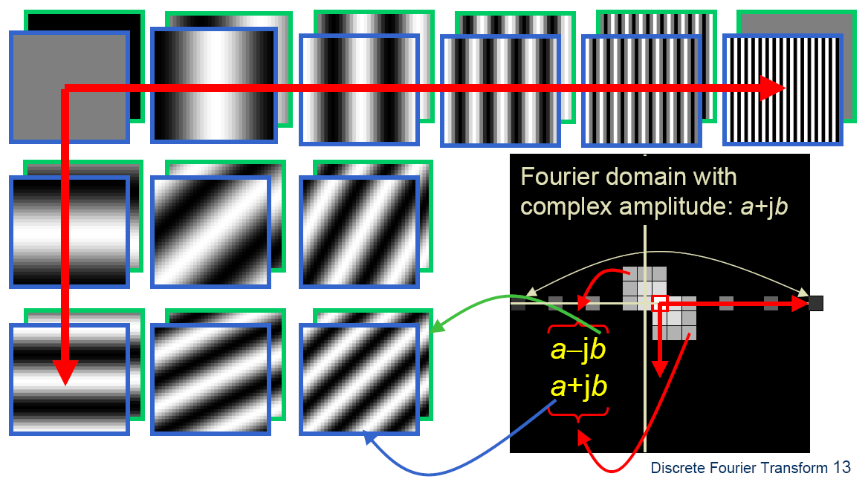

A Nice Basis for 2D Image Functions
Teases away fast vs. slow changes in the image.
This change of basis has a special name…
Notes:
20 min til here. Draw on board: Image as cartesian coordinates and write as coeff & basis → remind yourself linear algebra! What is the length of this array?

Slide 25
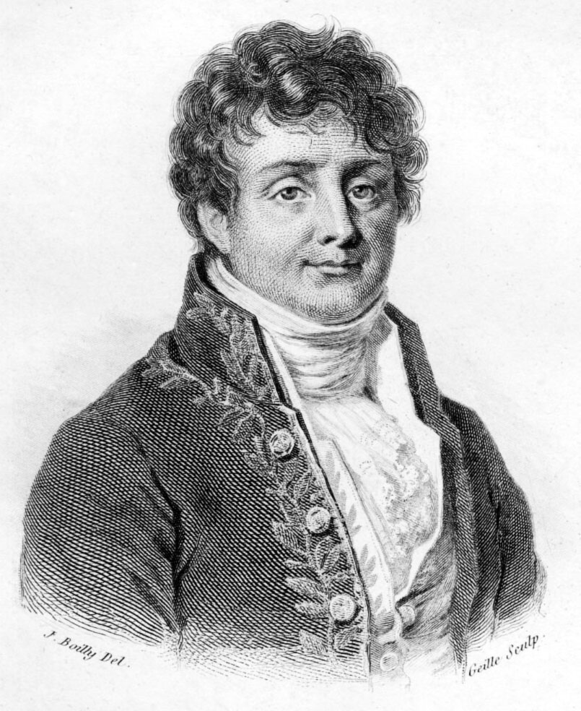
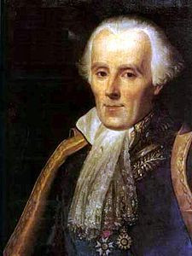
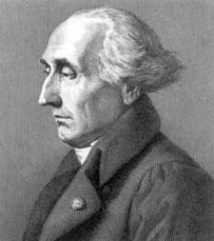
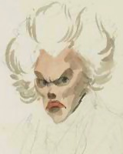
Jean Baptiste Joseph Fourier (1768-1830)
...the manner in which the author arrives at these equations is not exempt of difficulties and... his analysis to integrate them still leaves something to be desired on the score of generality and even rigour.
had crazy idea (1807):
Any univariate function can be rewritten as a weighted sum of sines and cosines of different frequencies.
Don’t believe it?
  Neither did Lagrange, Laplace, Poisson and other big wigs
  Not translated into English until 1878!
But it’s (mostly) true!
  called Fourier Series
Laplace
Legendre
Lagrange

Slide 26
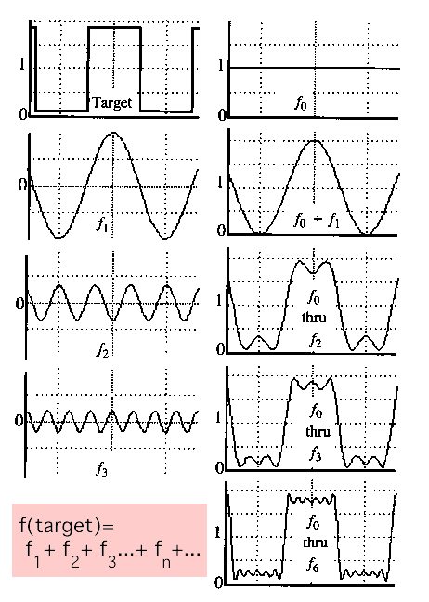
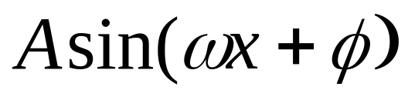
A sum of sines
Our building block:
Add enough of them to get any signal f(x) you want!
How many degrees of freedom?
What does each control?
Which one encodes the coarse vs. fine structure of the signal?
Notes:
technically this needs infinite, but computeres are finite,
What are A, omega, phi?
Omega is what we’re sensitive to and we’ll focus

Slide 27
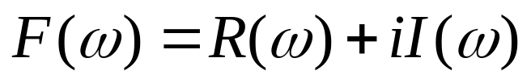
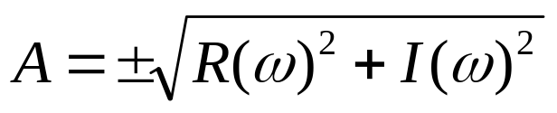
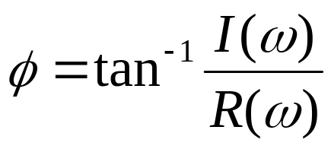
Fourier Transform
We want to understand the frequency ω of our signal. So, let’s reparametrize the signal by ω instead of x:
f(x)
Fourier
Transform
F(ω)
For every ω from 0 to inf, F(ω) holds the amplitude A and phase φ of the corresponding sine
  How does F hold both?
We can always go back:
F(ω)
Inverse Fourier
Transform
f(x)
Notes:
Just a change of basis!
This choice of holding F is technical / math proof reasons

Slide 28
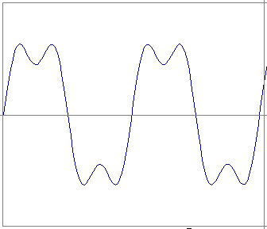
Time and Frequency
example : g(t) = sin(2πf t) + (1/3)sin(2π (3f) t)

Slide 29
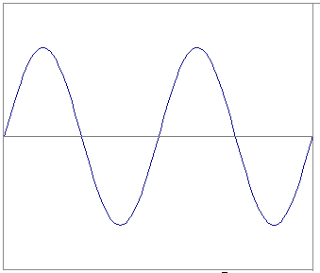
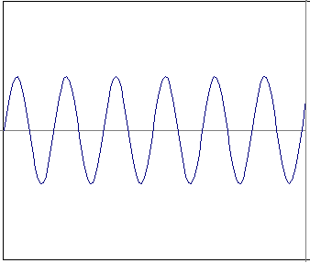
Time and Frequency
example : g(t) = sin(2πf t) + (1/3)sin(2π (3f) t)
=
+

Slide 30
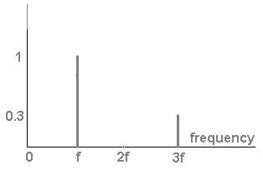
Frequency Spectrum
example : g(t) = sin(2πf t) + (1/3)sin(2π (3f) t)
=
+

Slide 31
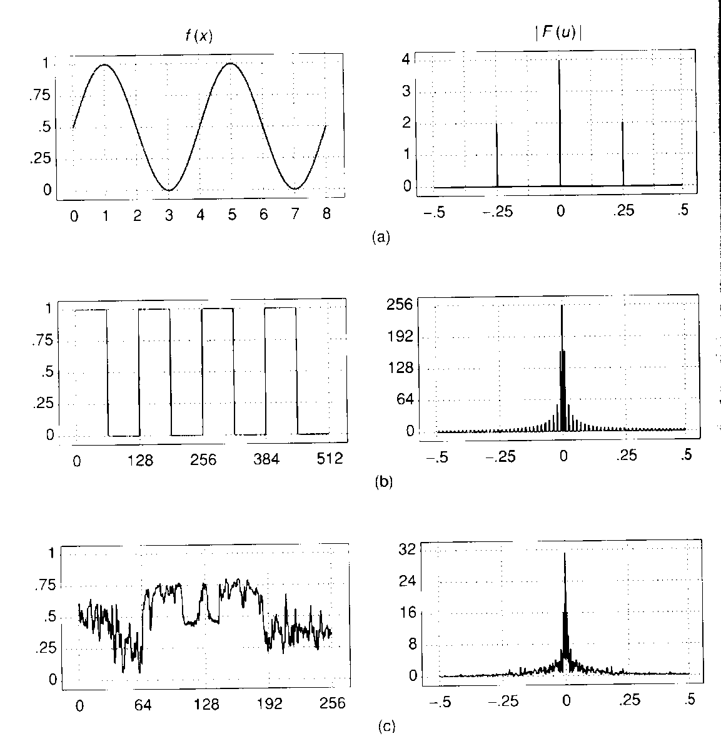
Various Frequency Spectra

Slide 32

Frequency Spectra
Usually, frequency is more interesting than the phase

Slide 33
Frequency Spectra
=
+
=

Slide 34
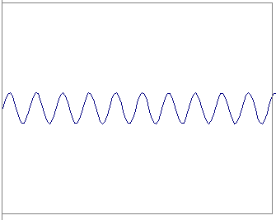
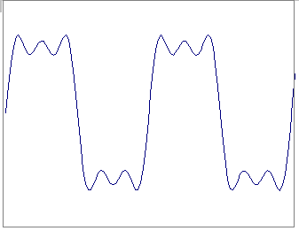
Frequency Spectra
=
+
=

Slide 35
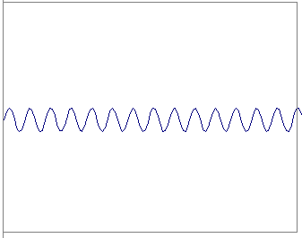

Frequency Spectra
=
+
=

Slide 36



Frequency Spectra
=
+
=

Slide 37


Frequency Spectra
=
+
=

Slide 38


Frequency Spectra
=
Notes:
straight edge is super high freq (highest it could) and you need infinite basis

Slide 39

Signal and its Furrier Transform
f(x)
signal
|F(𝟂)|
Fourier transform of signal

Slide 40


FT: Just a change of basis
M * f(x) = F(ω)
*
=
.
.
.
F x N
N x 1
F x 1

Slide 41

IFT: Just a change of basis
M⁻¹ * F(ω) = f(x)
*
=
.
.
.
N x F
F x 1
N x 1

Slide 42

Finally: Scary Math

Slide 43



Finally: Scary Math
…not really scary:
is hiding our old friend:
So it’s just our signal f(x) times sine at frequency ω
phase can be encoded
by sin/cos pair

Slide 44

Extension to 2D

Slide 45

Extension to 2D
=
Image as a sum of basis images

Slide 46


Slide 47


Slide 48


Slide 49


Slide 50


Slide 52
Extension to 2D
in Matlab, check out: imagesc(log(abs(fftshift(fft2(im)))));
Notes:
fftshift makes the center from the corner to the center (for visualization purposes)

Slide 53






Fourier analysis in images
Intensity Image
Fourier Image
http://sharp.bu.edu/~slehar/fourier/fourier.html#filtering
Notes:
brightness is the height

Slide 54


Signals can be composed
+
=
http://sharp.bu.edu/~slehar/fourier/fourier.html#filtering
More: http://www.cs.unm.edu/~brayer/vision/fourier.html

Slide 55


Architectural Scene
Amplitude Spectrum
Notes:
which part correspond? there is astrong horiz & vert line -> why? horiz is the vertical line

Slide 56

Can change spectrum, then reconstruct
Local change in one domain, courses global change in the other

Slide 57




The Furrier Game: find the right pairs

Slide 58

What about phase?
Amplitude Spectrum
what does phase look like, you ask?
(less visually informative)
Notes:
which part correspond? there is astrong horiz & vert line -> why? horiz is the vertical line

Slide 59

The importance of Phase
Slide: Andrew Zisserman

Slide 60


Low and High Pass filtering

Slide 61


The Convolution Theorem
The greatest thing since sliced (banana) bread!
  The Fourier transform of the convolution of two functions is the product of their Fourier transforms
  The inverse Fourier transform of the product of two Fourier transforms is the convolution of the two inverse Fourier transforms
  Convolution in spatial domain is equivalent to multiplication in frequency domain!

Slide 62






2D convolution theorem example
f(x,y)
|F(s_{x},s_{y})|
*
h(x,y)
|H(s_{x},s_{y})|
g(x,y)
|G(s_{x},s_{y})|

Slide 63


Filtering
Why does the Gaussian give a nice smooth image, but the square filter give edgy artifacts?
Gaussian
Box filter
Notes:
Things we can’t understand without thinking in frequency
63

Slide 64



Fourier Transform pairs
Notes:
infinite precision both is good, buttt bc computer is discrete, sinc either overshoots or undershoots→ aliasing.. Box filter is not a good low-pass filter
What is the best low-pass? Ideally it’s the box in the freq domain!

Slide 65

Gaussian

Slide 66

Box Filter

Slide 67


Low-pass, Band-pass, High-pass filters
low-pass:
High-pass / band-pass:

Slide 68
Low Pass vs. High Pass filtering
Image
Smoothed
–
Details
=

Slide 69
Filtering – Sharpening
Image
Details
+α
“Sharpened” α=2
=

Slide 70

Unsharp mask filter (= sharpening filter)
$$f +α\left(f−f∗g\right)=f +α f∗(e−g)$$
image
blurred
image
unit impulse
(identity)
unit impulse
Gaussian
Laplacian of Gaussian
Notes:
f + a(f - f * g) = (1+a)f-af*g = f*((1+a)e-g)
Name is confusing.. “unsharp mask” → the mask is made by unsharped image..
High-pass filter!

Slide 71

Application: Hybrid Images
Aude Oliva & Antonio Torralba & Philippe G Schyns, SIGGRAPH 2006
Notes:
How do we do this? Who can tell me the idea
What is actually a really important thing that’s not emphasized too much? compatible

Slide 72

Application: Hybrid Images
A. Oliva, A. Torralba, P.G. Schyns,
“Hybrid Images,” SIGGRAPH 2006
Gaussian Filter
Laplacian Filter
unit impulse
Gaussian
Laplacian of Gaussian
Notes:
Need an artistic eye! not any photo

Slide 73

Yesteryear’s homework
Barbenheimer
CS180: Nicolas Rault-Wang

Slide 74
5 min recap
Fourier Transform in 5 minutes: The Case of the Splotched Van Gogh, Part 3
https://www.youtube.com/watch?v=JciZYrh36LY

