Slide 1
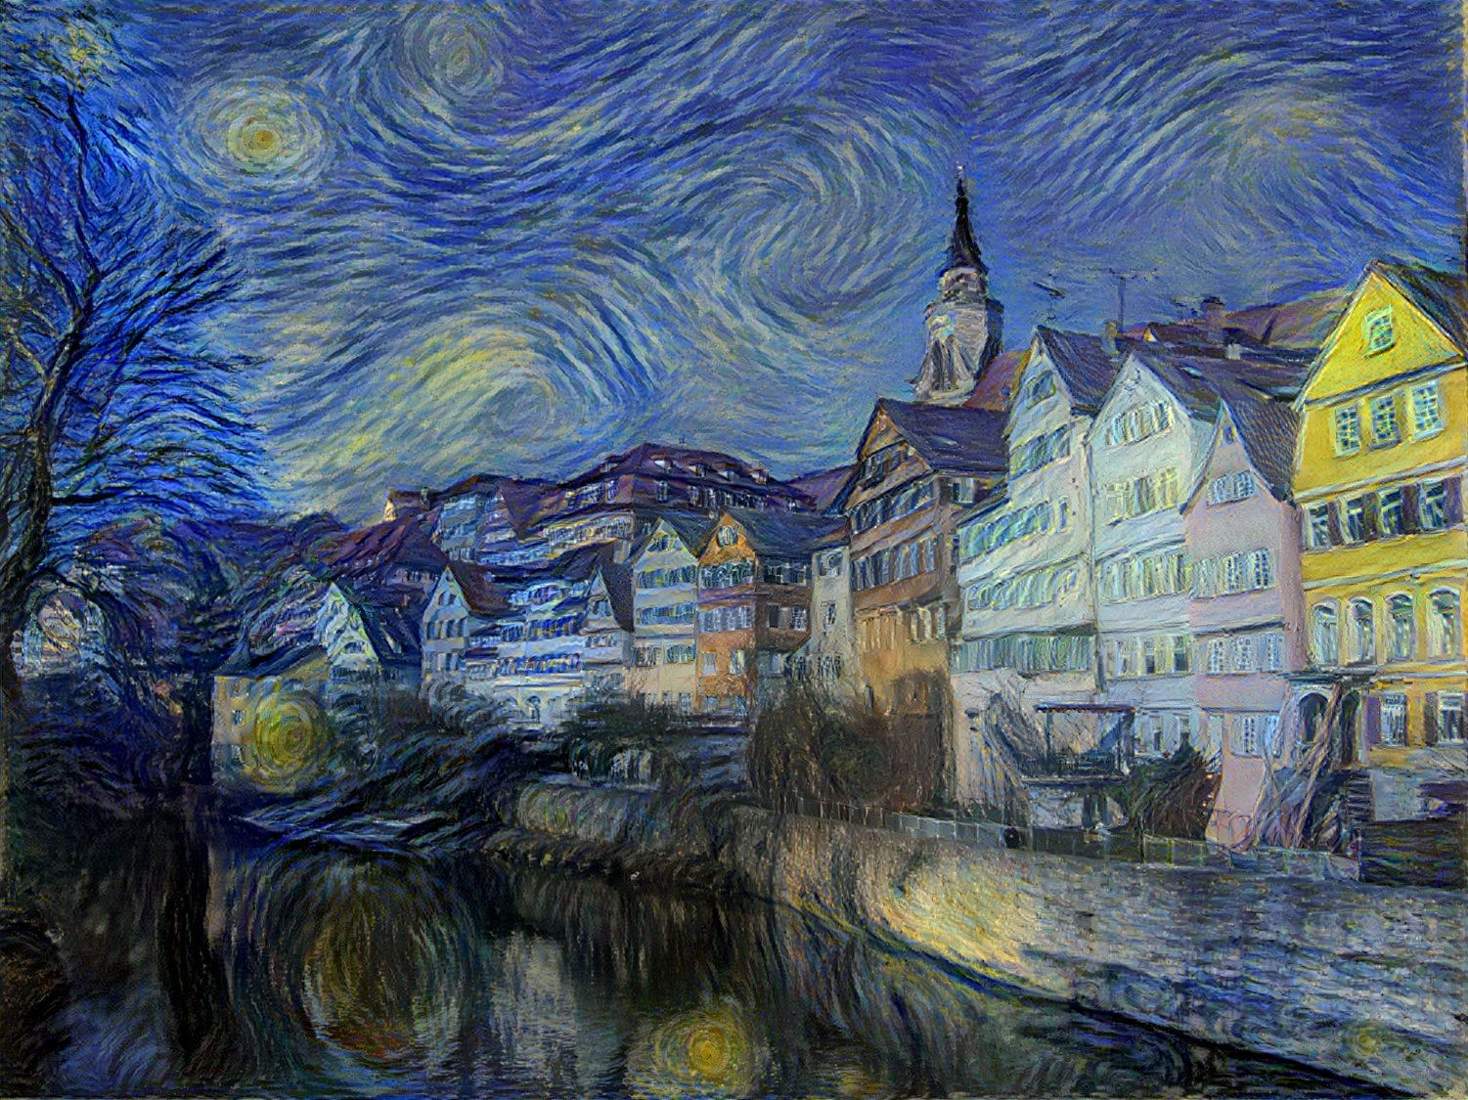
Generative Models of Images
CS180: Intro to Comp. Vision and Comp. Photo
Efros & Ng, UC Berkeley, Fall 2026
Slides from Steve Seitz,
Bill Freeman, Andrew Owens, etc.

Slide 2

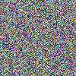
The Space of All Images
Lets consider the space of all 100x100 images
Now lets randomly sample that space…
Conclusion: Most images are noise
Question:
What do we expect a random uniform sample of all images to look like?
Slide source: Steve Seitz

Slide 3
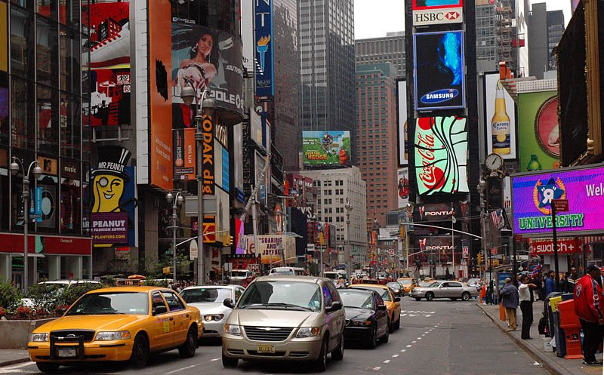
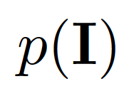
Statistical modeling of images
Notes:
One generic and useful class of images we may want to address is the set of all “natural images” which is a term we often use to represent images that are captured with an imaging system in the natural world, aka not synthetically generated images. However, this is, as you may now better understand after taking the class so far, a highly complex set!

Slide 4
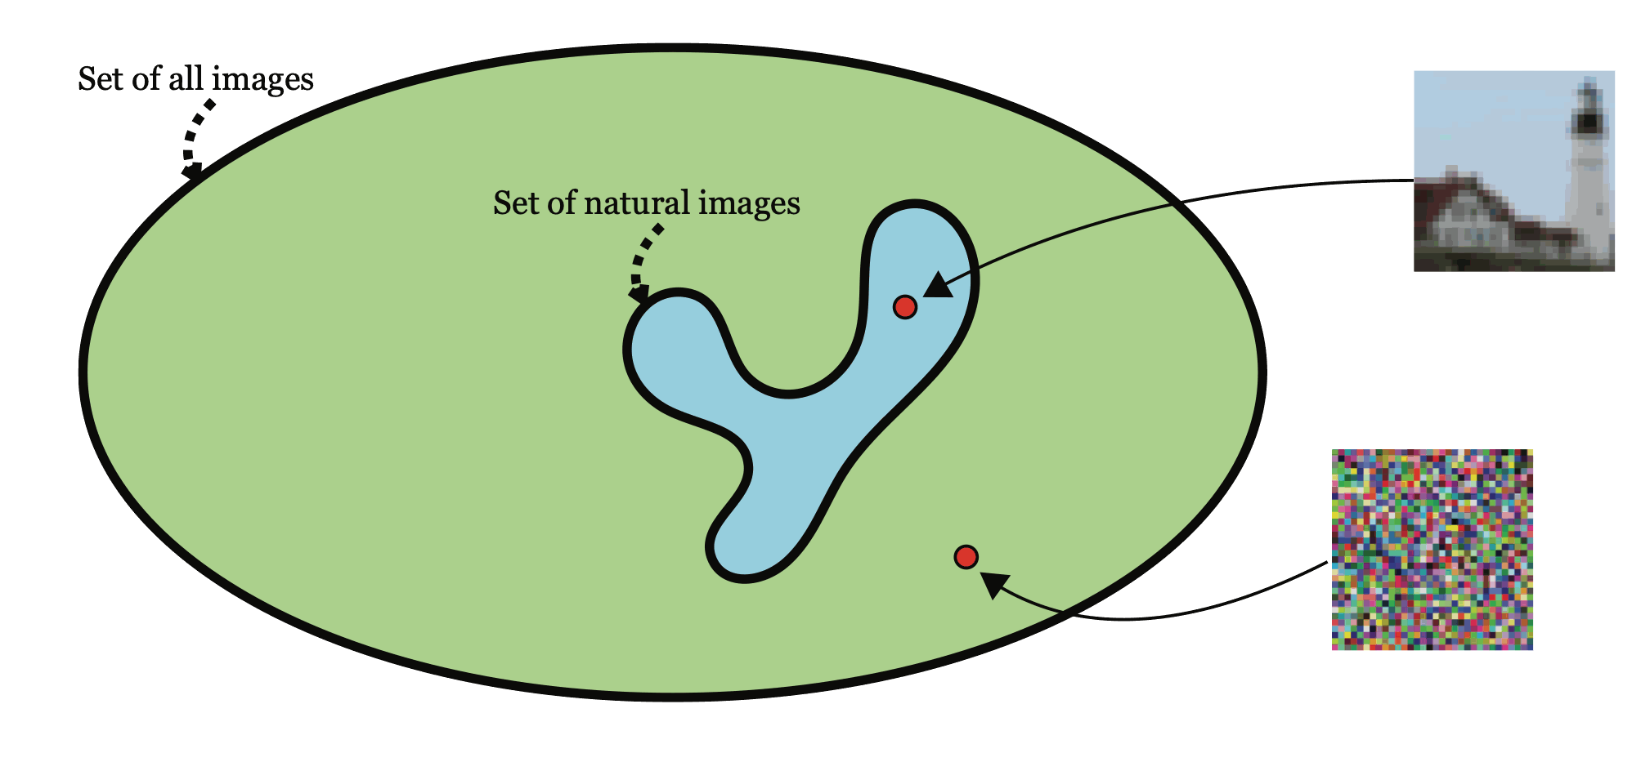
Statistical modeling of images
Notes:
The space of natural images is just very small part of the space of all possible images. In the case of color images with 32x32 pixels, most of the space is filled with images that look like noise.

Slide 5
Visual Worlds
Notes:
One way to tackle difficult problems is to make simplifying mathematical assumptions. One simplifying assumption might be to break down all possible images into subsets:

Slide 6
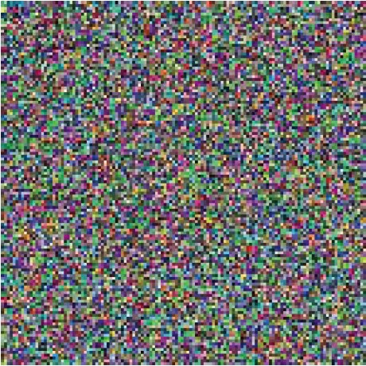
Visual Worlds
Notes:
For example, one visual world might be the set of all images that look like this. This isn’t a useful or interesting set of images per-se. Here we assume that all pixels are independent and are drawn from the same distribution at random. These assumptions make it very easy to do calculations about images in this world, but those calculations aren’t particularly meaningful

Slide 7
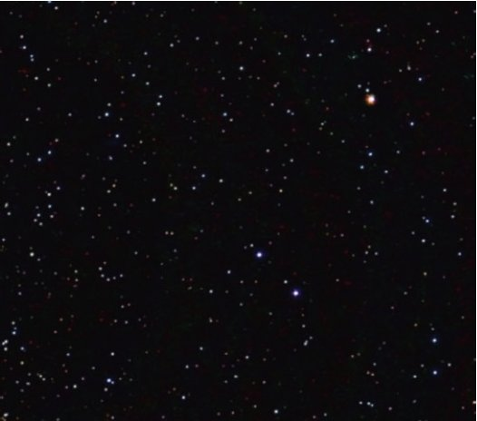
Visual Worlds
Notes:
Here’s another visual world - the world of astronomical imaging. These images have a completely different “look” than the previous set, but you could imagine making some simplifying assumptions that would be useful in this world. Can anyone think of an example of such an assumption here?

Slide 8
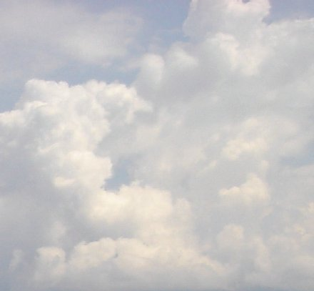
Visual Worlds
Notes:
Or for example, you might also consider the visual world of images of clouds! We’ll be going through several examples image priors one can build in this lecture, and one of them turns out to be pretty great at modeling images that look like clouds

Slide 9
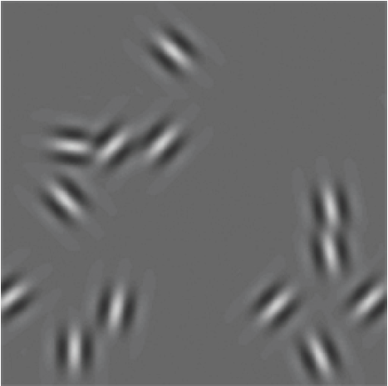
Visual Worlds
Notes:
Another class of images, used by early psychophysical experimenters to learn about the human visual system. It is believed, based on their experiments, that early stage image processing in the human visual system consists of representing what is seen as a sum of these little Gabor wavelets.

Slide 10
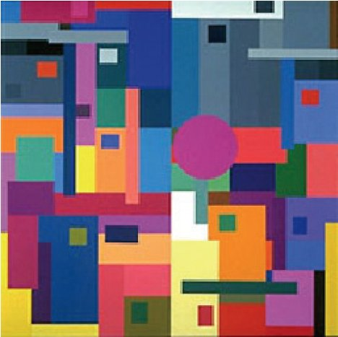
Visual Worlds
Notes:
This is a world that is often used in color perception study, which has only two dimensions and is made up of these splats of different colored rectangles and circles. Because this bears some similarity to paintings by Mondrian, this is often referred to as the class of “Mondrians”

Slide 11
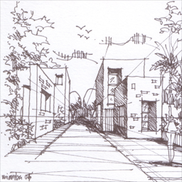
Visual Worlds
Notes:
You could imagine a visual world made up of all possible line drawings

Slide 12
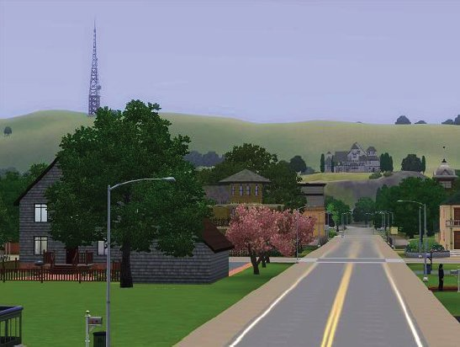
Visual Worlds
Notes:
Or all possible computer generated images generated by a specific graphics engine, such as UNREAL, this is often easy to study because we can generate many examples from this class inexpensively, but it isn’t truly “the natural world”

Slide 13
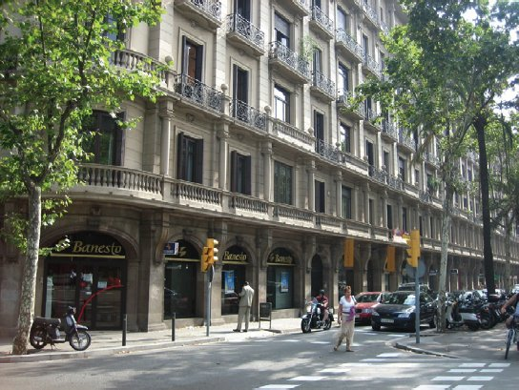
Visual Worlds
Notes:
And then we can move up to, for example natural scenes. There is also an entire additional dimension of complexity that we won’t touch on in this lecture, but is important to us, and that is the set of all possible motions within or around this scene (ie video). We’ll restrict ourselves to still images for this class

Slide 14
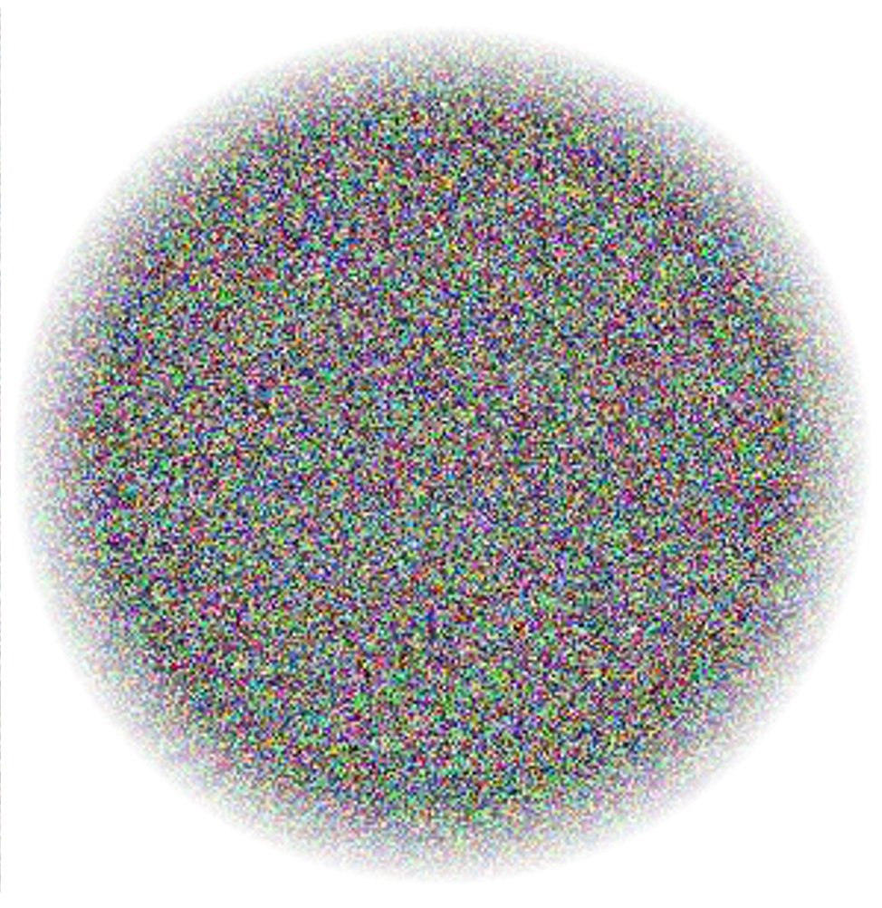
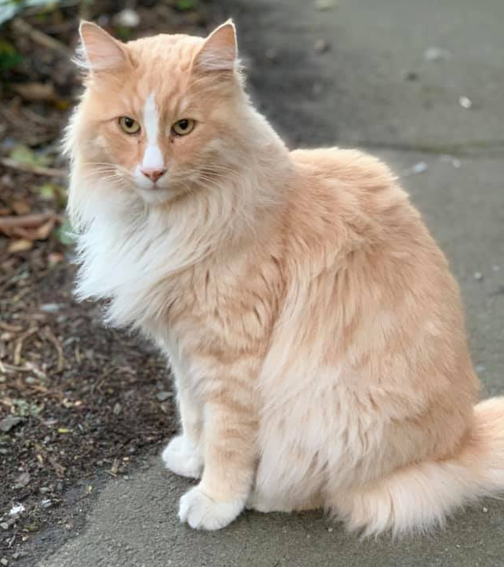
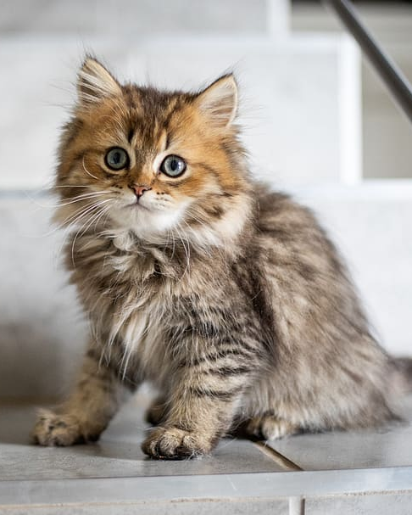
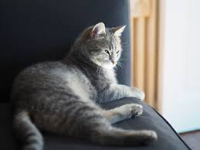
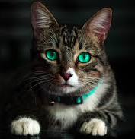
Natural Image Manifolds
Most images are “noise”
“Meaningful” images tend to form some manifold within the space of all images
The Space of All Images
Slide source: Steve Seitz

Slide 15
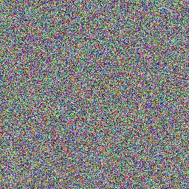
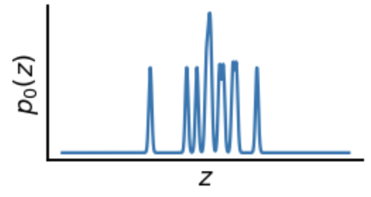
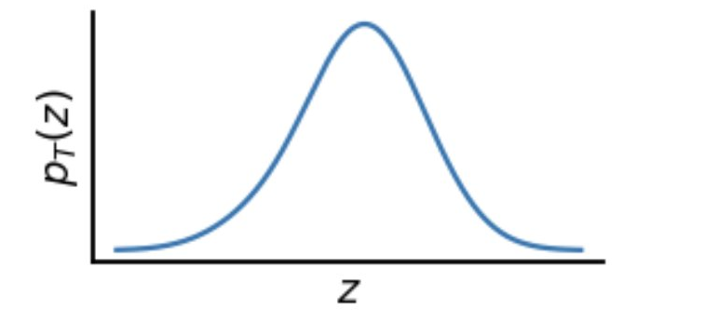
Generating Images from Noise
Random images
cat images
Noise to Images
Slide source: Steve Seitz

Slide 16
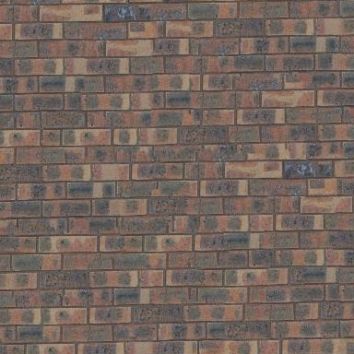
Let’s start with manifold of textures

Slide 17
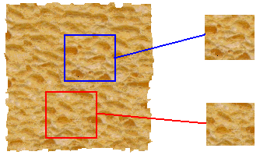
Parametric Texture Synthesis
input image
SYNTHESIS
True (infinite) texture
generated image
Goal: parametric generative model of the “infinite texture”

Slide 18
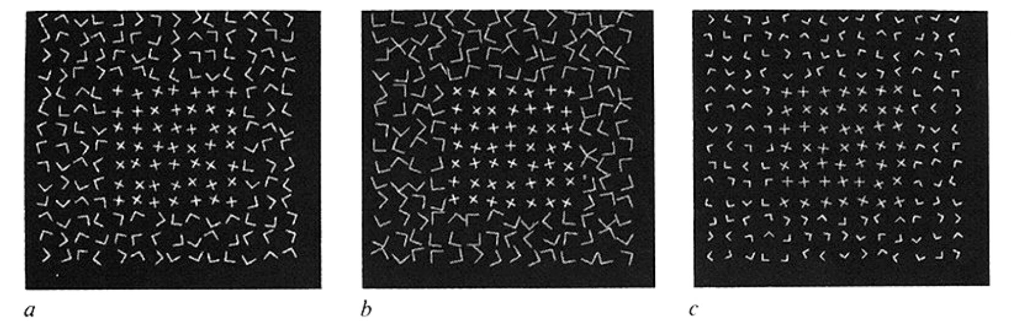
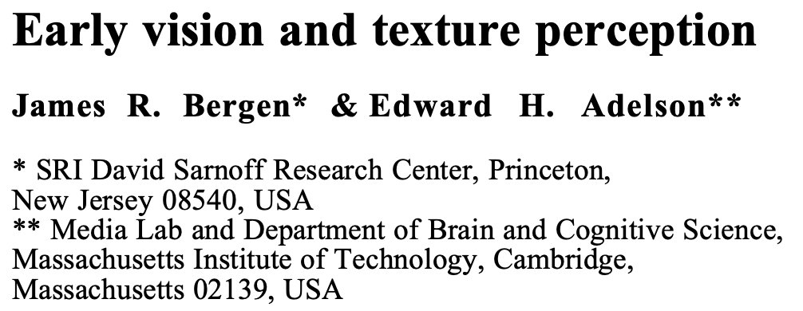
Making two textures more similar

Slide 19
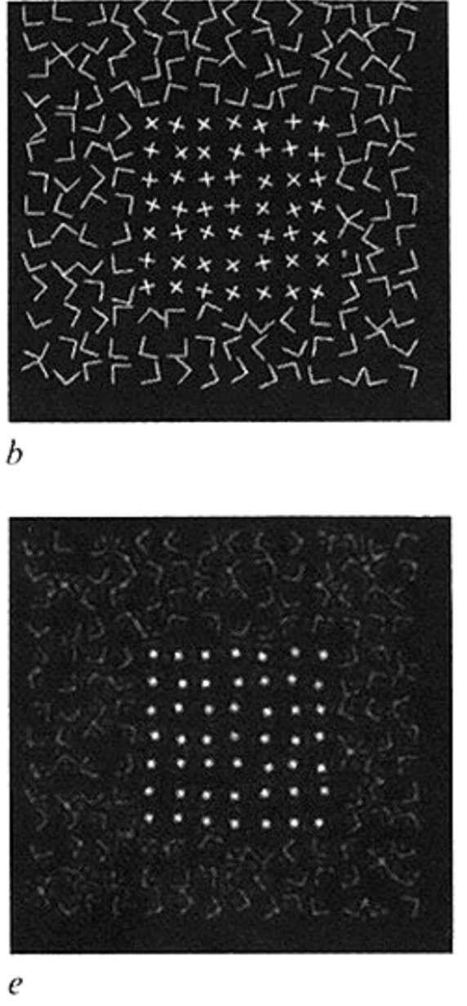
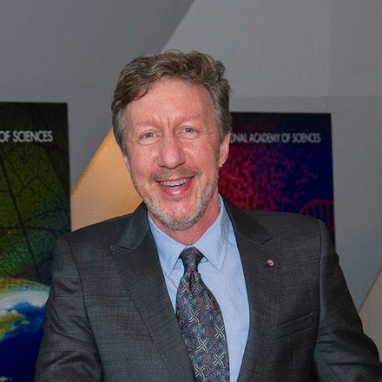
Jim Bergen’s conjecture
“If matching the mean amplitude of a bandpass spatial filter’s response goes a little way towards mimicking human texture perception, then maybe matching the histogram of the responses of filters (the marginal statistics) will do an even better job of capturing human texture perception.”
Dave Heeger’s response
“You mean if I took a pyramid of some random noise, and forced the histograms of each subband level to match those of some target texture, that the modified noise image would then look like that texture??? No way! I’ll prove it to you; here, let me try it out… hmm, gee, that worked pretty well…”

Slide 20
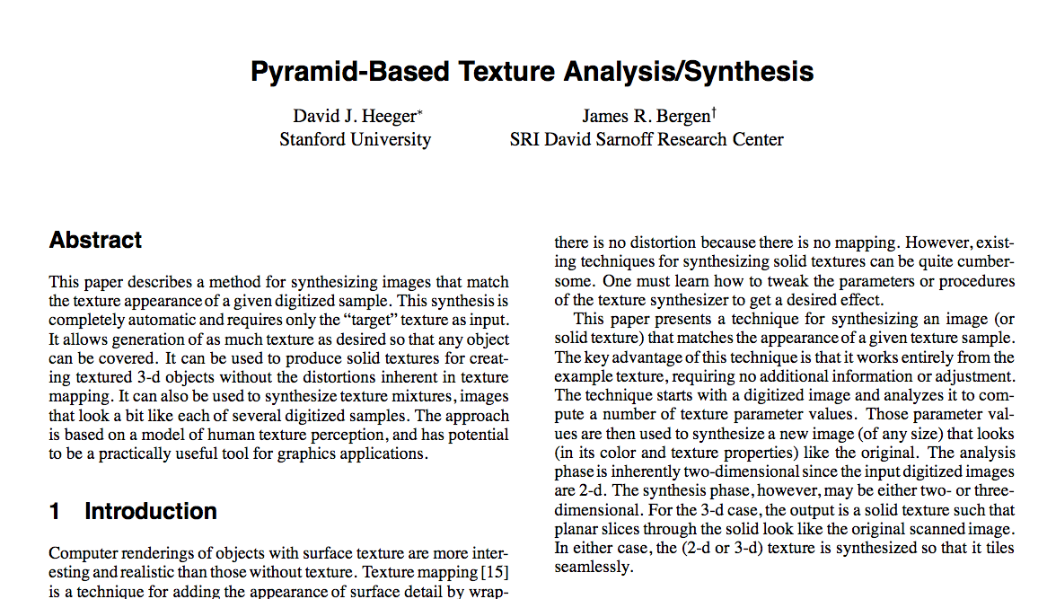
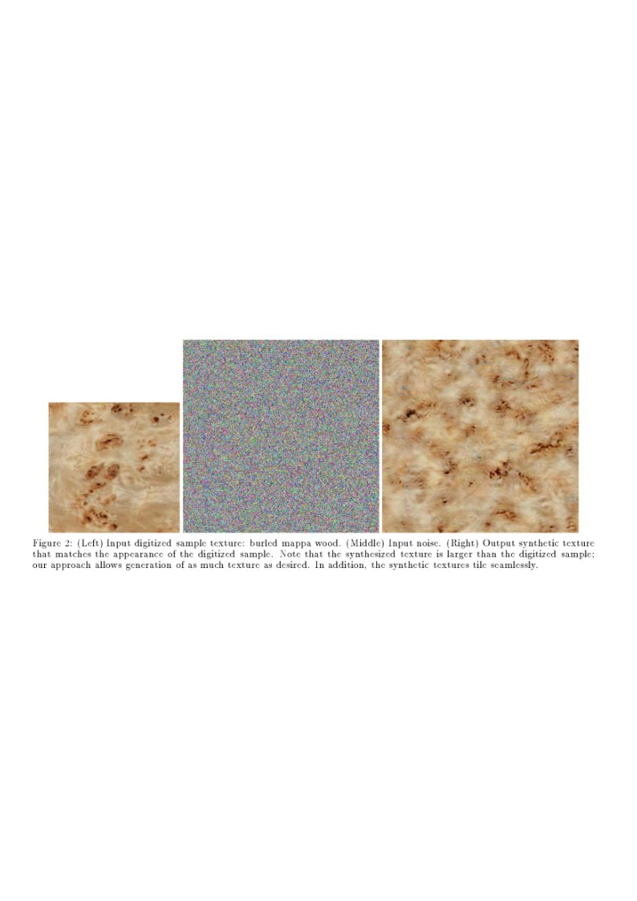
Heeger & Bergen (SIGGRAPH 1995)

Slide 21
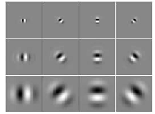
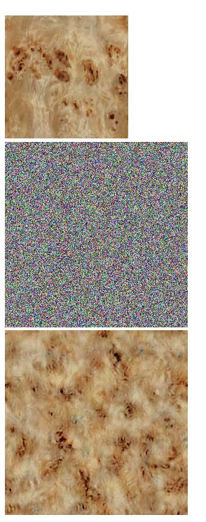
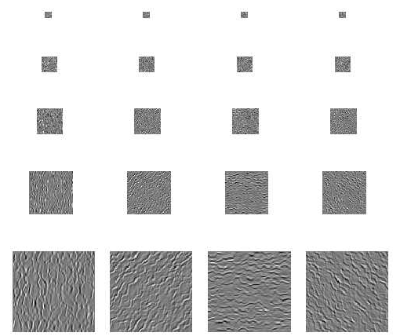
Step 1: Compute Pyramid Features
input
Noise image

Slide 22
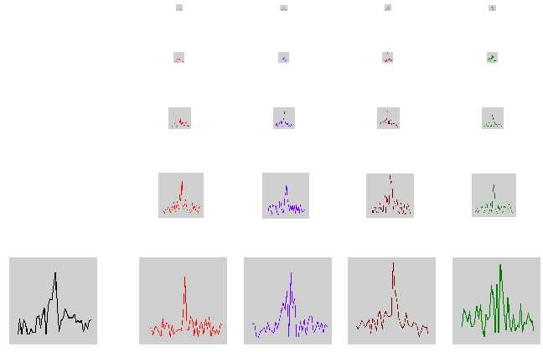
Step 2: match per--channel histograms
input
Noise image

Slide 23
Step 3: collapse pyramid and repeat!
input
Noise image

Slide 24
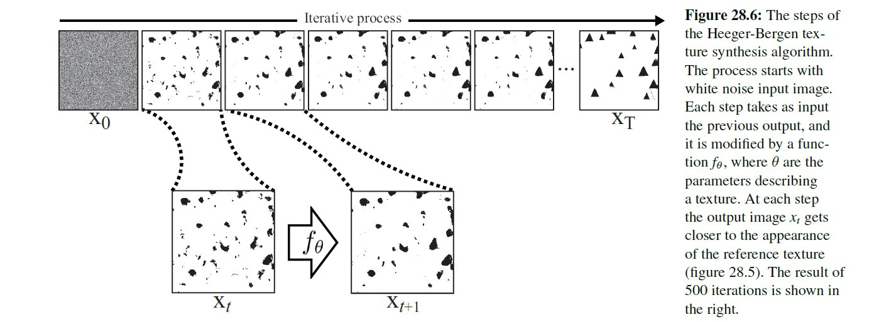
Texture-motivated Parametric
Generative Image Models!

Slide 25


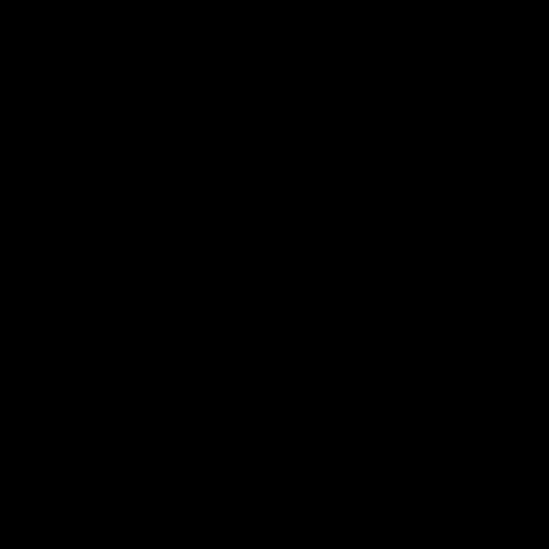
Parametric Texture Synthesis
Image Space
Model Space
Images with equal
model response
Heeger & Bergen, 1995
Portilla & Simoncelli, 2000
Gatys et al, 2015
Portilla & Simoncelli (2000)
Notes:
Stole this slide from Eero, because I think it gives a good intuition about what we are doing.

Slide 26
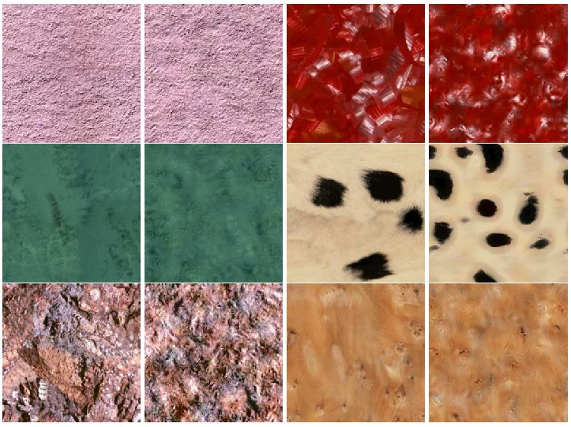
Heeger & Bergen, SIGGRAPH‘95

Slide 27
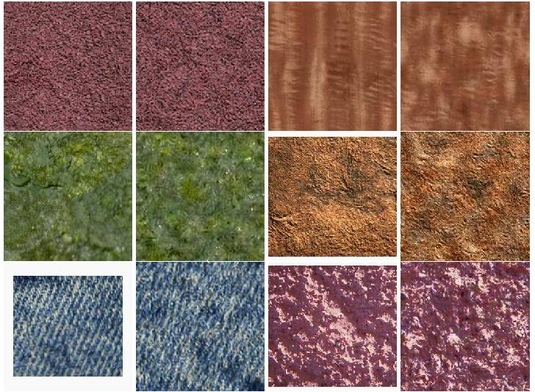

Slide 28
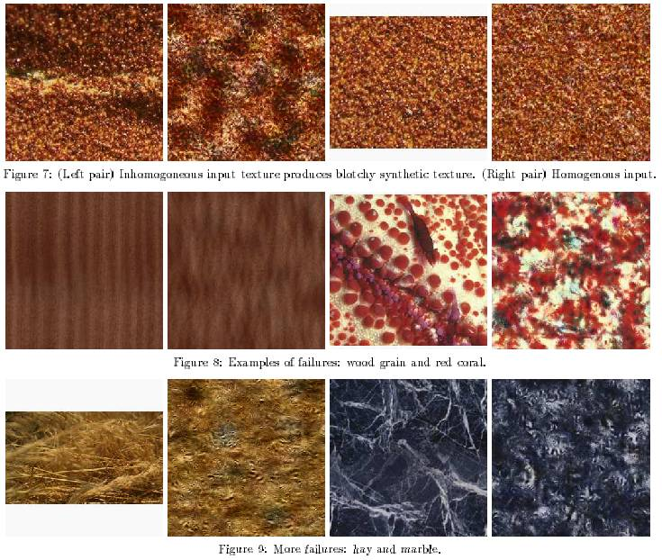

Slide 29
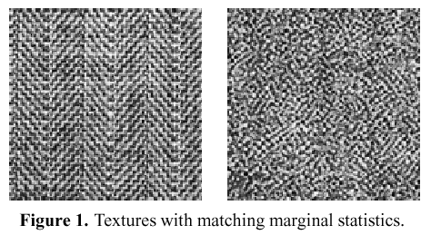
Simoncelli & Portilla ’98+
Marginal statistics are not enough
Neighboring filter responses are highly correlated
  an edge at low-res will cause an edge at high-res
Let’s match 2nd order statistics too!
J Portilla and E P Simoncelli. A Parametric Texture Model based on Joint Statistics of Complex Wavelet Coefficients. Int'l Journal of Computer Vision. 40(1):49-71, October, 2000.

Slide 30
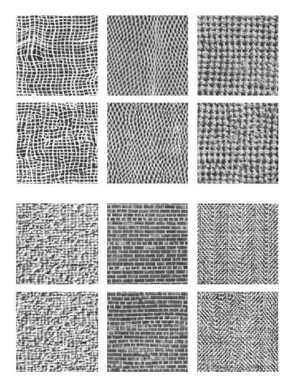
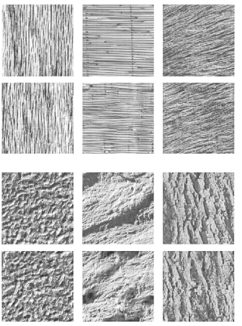

Slide 31
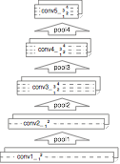
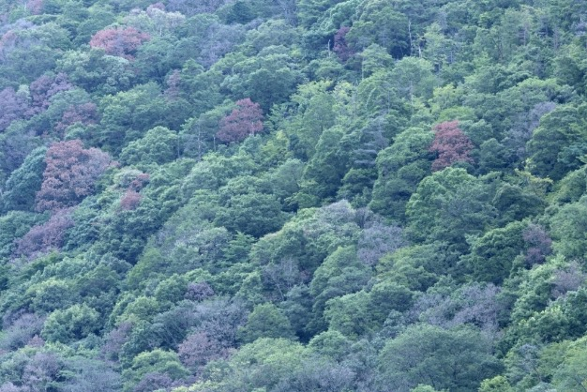
Convolutional Neural Network Texture Model
2.3
7.1
3.8
Convolutional Neural Network
Gatys et al. (NIPS 2015)
Notes:
Our work takes this one step further, instead of just modelling early vision in our texture model, we use a fully trained CNN that can be seen as a functional model of the ventral stream.

Slide 32
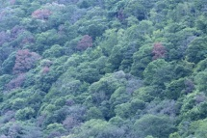
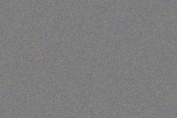
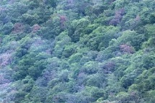
Texture Synthesis
Image Space
Model Space
Images with equal
model response
Portilla & Simoncelli (2000)
Notes:
Stole this slide from Eero, because I think it gives a good intuition about what we are doing.

Slide 33






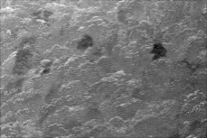
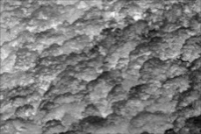
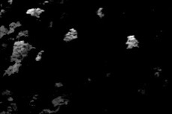
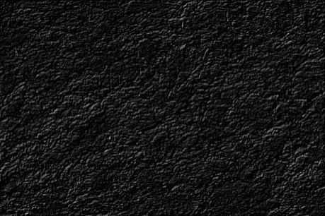



CNN - Multiscale Filter Bank
# features
pool4
512
pool3
256
pool2
128
pool1
64
conv1_1
64
Notes:
Can think of CNN as a multi scale non-linear filter bank.
Each feature map is the output of a complex non-linear image filter.
Spatial extend decreases but number of features increase (effective downsampling by a factor of 2 after each pooling)

Slide 34
















CNN - Texture Features
Notes:
For texture model we need spatial summary statistics
F is matrix of vectorised feature maps
We compute correlations between feature responses, where the average is taken over the spatial extend of the image.
Mathematically we take dot products between vectorised feature maps (gram matrix)
each entry in gram matrix is the correlation between two features in response to a particular texture

Slide 35





CNN-Texture Features
Gram Matrices
# features
512
256
128
64
64
Notes:
For texture model we need spatial summary statistics
We compute correlations between feature responses, where the average is taken over the spatial extend of the image.
Mathematically we take dot products between vectorised feature maps (gram matrix)
each entry in gram matrix is the correlation between two features in response to a particular texture

Slide 36



Texture Synthesis
Notes:
In short: we will do gradient descent on the pixels but I will elaborate a little on the details.
First show the example texture to the network, compute feature maps, compute gram matrices from the feature maps and store them

Slide 37
Texture Synthesis
Notes:
Then show white noise image and also get the gram matrices
Then we can compute some distance measure between both gram matrices, we use elementwise mean squared distance
Do that on each layer you include in your model and define a total loss function as a weighted sum of the losses on each layer

Slide 38
Texture Synthesis
Notes:
Can compute derivative of this loss wrt layers activations

Slide 39
Texture Synthesis
Notes:
then pass that derivative down just using normal back propagation

Slide 40

Texture Synthesis
Notes:
and do that for all layers to get the gradient of the total loss wrt pixel values

Slide 41

Texture Synthesis
Notes:
gradient descent on the image

Slide 42
Texture Synthesis
Notes:
until the loss converges.
In general the forward/backward pass of the network gives you the function value and the gradient and you can use that as an input into the optimiser of your choice. (we use LBFGS, seems to work well)

Slide 43








Gatys Texture Synthesis
Notes:
Here are the results.
Pretty decent job.

Slide 44


ImageNet Recognition
is just Texture Recognition
Convolutional Neural Network
“Shetland
Sheepdog”
image X
label Y

Slide 45



ImageNet Recognition
is just Texture Recognition
Convolutional Neural Network
“Shetland
Sheepdog”
image X
label Y
Gatys et al, 2017

Slide 46




A Neural Algorithm of Artistic Style
Gatys, Ecker, Bethge (arXiv 2015)

Slide 47


Slide 48
Van Gogh (1889)

Slide 49

Picasso (1910)

Slide 50

Munch (1893)

Slide 51

Turner (1805)

Slide 52

Kandinsky (1913)

Slide 53



















CNN - Texture Synthesis
Gatys et al. (NIPS 2015)
Notes:
Can think of CNN as a multi scale non-linear filter bank.
Each feature map is the output of a complex non-linear image filter.
Spatial extend decreases but number of features increase (effective downsampling by a factor of 2 after each pooling)

Slide 54




Artistic Style Transfer

Slide 55



Artistic Style Transfer

Slide 56
Artistic Style Transfer

Slide 57

Artistic Style Transfer

Slide 58
Artistic Style Transfer

Slide 59
Artistic Style Transfer

Slide 60
Artistic Style Transfer

Slide 61
Artistic Style Transfer

Slide 62
Artistic Style Transfer

Slide 63


Artistic Style Transfer

Slide 64
Artistic Style Transfer

Slide 65

Artistic Style Transfer

Slide 66




Relative Weighting of Content and Style
1e-4
1e-3
1e-2
1e-1
Notes:
Used normalised VGG-Network
Used LBFG-S optimiser (seems to work best)

Slide 67


Different Reconstruction Layers
Conv2_2
Conv4_2

Slide 68
Different Reconstruction Layers
Conv2_2
Conv4_2

Slide 69

Different Reconstruction Layers
Original
Conv2_2
Conv4_2

Slide 70


General Style Transfer

Slide 71


General Style Transfer

Slide 72


Slide 73


Slide 74


Slide 75



Slide 77


GANs as generative models
G tries to synthesize fake images that fool the best D
D tries to identify the fakes
Source: Isola, Freeman, Torralba

Slide 78

GANs can “walk” on the manifold

Slide 79


GANs as Texture Synthesis?
Conjecture: GANs might be learning the “right” features to match for natural images

Slide 80
Projecting onto the “Image Manifold”
Image Space
Model Space
Images with equal
model response
Portilla & Simoncelli (2000)
Notes:
Stole this slide from Eero, because I think it gives a good intuition about what we are doing.

Slide 81


Diffusion / Flow Matching
Notes:
Welcome back to Part 2 of our video on Text to Image Generation!
We’ll talk about something called Diffusion,
which powers systems like Imagen and Dall-E 2

Slide 82
Generate 100 images
slide from Steve Seitz’s video
Notes:
How does an Image Generator work?
Well, suppose I asked you to generate 100 new images.
How would you do it?
The simplest way is to just choose a random value for each pixel.
That produces noise patterns like this.
It’s like what you see on your TV, when you tune into the wrong channel.

Slide 83

Generate 100 images
slide from Steve Seitz’s video
Notes:
How does an Image Generator work?
Well, suppose I asked you to generate 100 new images.
How would you do it?
The simplest way is to just choose a random value for each pixel.
That produces noise patterns like this.
It’s like what you see on your TV, when you tune into the wrong channel.

Slide 84
Generate 100 images of raspberries
slide from Steve Seitz’s video
Notes:
Now suppose I asked you to create 100 images of raspberries.
That’s a lot harder!

Slide 85


hard
raspberry
images
easy
random
images
slide from Steve Seitz’s video
Notes:
Conceptually, you can think of two distributions — random images
and raspberry images.
Each point
here represents an image.
Random images are easy
to generate, raspberry images are hard.
But suppose we had a magical way to turn random images into raspberry images.
This is what diffusion does —
it’s a method for transforming one distribution into another.

Slide 86
diffusion
raspberry
images
random
images
slide from Steve Seitz’s video
Notes:
Conceptually, you can think of two distributions — random images
and raspberry images.
Each point
here represents an image.
Random images are easy
to generate, raspberry images are hard.
But suppose we had a magical way to turn random images into raspberry images.
This is what diffusion does —
it’s a method for transforming one distribution into another.

Slide 87
hard
raspberry
images
random
images
slide from Steve Seitz’s video
Notes:
How does this work?
Well it’s pretty hard to turn a random image into a raspberry image
But it’s relatively easy to go the other way

Slide 88
easy
raspberry
images
random
images
slide from Steve Seitz’s video
Notes:
How does this work?
Well it’s pretty hard to turn a random image into a raspberry image
But it’s relatively easy to go the other way

Slide 89

raspberry
images
random
images
slide from Steve Seitz’s video
Notes:
We just need to add more and more noise until the pixels become totally random

Slide 90




raspberry
images
random
images
slide from Steve Seitz’s video
Notes:
You can think of the animation I just showed as a path through the space of images
where each frame is a single step towards more randomness

Slide 91

raspberry
images
random
images
slide from Steve Seitz’s video
Notes:
Now, what if we play this animation in reverse?

Slide 92
Key insight
Globally, creation is much harder than destruction
But locally, they are almost reversable!

Slide 93
raspberry
images
random
images
slide from Steve Seitz’s video
Notes:
This defines a path from a random image to a raspberry image

Slide 94


Denoising neural network
Image
Denoiser
This network can be a U-Net or other suitable image-to-image network
Slide source: Steve Seitz

Slide 95







Training U-Net Denoiser
$$x_{t}$$
$$\overset{ˆ}{x}$$
Loss:
$${\left\|x_{clean}−\overset{ˆ}{x}\right\|}^{2}$$
+
$$x_{clean}$$
$$ε$$
Image Denoising

Slide 96

Training U-Net Denoiser
$$x_{t}$$
$$\overset{ˆ}{ε}$$
Loss:
$${\left\|ε−\overset{ˆ}{ε}\right\|}^{2}$$
+
$$x_{clean}$$
$$ε$$
Image Diffusion

Slide 97







Training U-Net Denoiser
$$x_{t}$$
$$\overset{ˆ}{v}$$
Loss:
$${\left\|v−\overset{ˆ}{v}\right\|}^{2}$$
$$v=\frac{x_{clean}−x_{t}}{\left(1−t\right)}$$
+
Velocity:
$$v=x_{clean}−ε$$
$$x_{clean}$$
$$ε$$
-
Flow Matching
$$x_{clean}$$
$$ε$$

Slide 98

raspberry
images
random
images
diffusion
neural
network
slide from Steve Seitz’s video
Notes:
Now we can use this trained network to generate new raspberry images.
Here’s now.
Let’s start with a random image,
represented by this point
If we feed it into
the diffusion neural network, it outputs an arrow
If we now step
along this arrow, and feed the new point back into the network
we get the second step. And so on.

Slide 99
raspberry
images
random
images
diffusion
neural
network
diffusion
neural
network
slide from Steve Seitz’s video
Notes:
Now we can use this trained network to generate new raspberry images.
Here’s now.
Let’s start with a random image,
represented by this point
If we feed it into
the diffusion neural network, it outputs an arrow
If we now step
along this arrow, and feed the new point back into the network
we get the second step. And so on.

Slide 100
raspberry
images
random
images
diffusion
neural
network
slide from Steve Seitz’s video
Notes:
Now we can use this trained network to generate new raspberry images.
Here’s now.
Let’s start with a random image,
represented by this point
If we feed it into
the diffusion neural network, it outputs an arrow
If we now step
along this arrow, and feed the new point back into the network
we get the second step. And so on.

Slide 101
raspberry
images
random
images
diffusion
neural
network
slide from Steve Seitz’s video
Notes:
Now we can use this trained network to generate new raspberry images.
Here’s now.
Let’s start with a random image,
represented by this point
If we feed it into
the diffusion neural network, it outputs an arrow
If we now step
along this arrow, and feed the new point back into the network
we get the second step. And so on.

Slide 102
raspberry
images
random
images
diffusion
neural
network
slide from Steve Seitz’s video
Notes:
Now we can use this trained network to generate new raspberry images.
Here’s now.
Let’s start with a random image,
represented by this point
If we feed it into
the diffusion neural network, it outputs an arrow
If we now step
along this arrow, and feed the new point back into the network
we get the second step. And so on.

Slide 103
raspberry
images
random
images
diffusion
neural
network
slide from Steve Seitz’s video
Notes:
Now we can use this trained network to generate new raspberry images.
Here’s now.
Let’s start with a random image,
represented by this point
If we feed it into
the diffusion neural network, it outputs an arrow
If we now step
along this arrow, and feed the new point back into the network
we get the second step. And so on.

Slide 104
raspberry
images
random
images
diffusion
neural
network
slide from Steve Seitz’s video
Notes:
Now we can use this trained network to generate new raspberry images.
Here’s now.
Let’s start with a random image,
represented by this point
If we feed it into
the diffusion neural network, it outputs an arrow
If we now step
along this arrow, and feed the new point back into the network
we get the second step. And so on.

Slide 105
raspberry
images
random
images
diffusion
neural
network
slide from Steve Seitz’s video
Notes:
Now we can use this trained network to generate new raspberry images.
Here’s now.
Let’s start with a random image,
represented by this point
If we feed it into
the diffusion neural network, it outputs an arrow
If we now step
along this arrow, and feed the new point back into the network
we get the second step. And so on.

Slide 106
raspberry
images
random
images
diffusion
neural
network
slide from Steve Seitz’s video
Notes:
Now we can use this trained network to generate new raspberry images.
Here’s now.
Let’s start with a random image,
represented by this point
If we feed it into
the diffusion neural network, it outputs an arrow
If we now step
along this arrow, and feed the new point back into the network
we get the second step. And so on.

Slide 107
raspberry
images
random
images
diffusion
neural
network
slide from Steve Seitz’s video
Notes:
Now we can use this trained network to generate new raspberry images.
Here’s now.
Let’s start with a random image,
represented by this point
If we feed it into
the diffusion neural network, it outputs an arrow
If we now step
along this arrow, and feed the new point back into the network
we get the second step. And so on.

Slide 108

raspberry
images
random
images
diffusion
neural
network
slide from Steve Seitz’s video
Notes:
Now we can use this trained network to generate new raspberry images.
Here’s now.
Let’s start with a random image,
represented by this point
If we feed it into
the diffusion neural network, it outputs an arrow
If we now step
along this arrow, and feed the new point back into the network
we get the second step. And so on.

Slide 109

Image Diffusion
Image Space
Model Space
+
Images with equal
model response
Notes:
Stole this slide from Eero, because I think it gives a good intuition about what we are doing.

Slide 110














Flow Matching
denoise
blend

Slide 111



raspberry
images
random
images
slide from Steve Seitz’s video
Notes:
And if we repeat this with another raspberry image, we get another path
which we can reverse in the same way

Slide 112
raspberry
images
random
images
slide from Steve Seitz’s video
Notes:
And if we repeat this with another raspberry image, we get another path
which we can reverse in the same way

Slide 113
raspberry
images
random
images
slide from Steve Seitz’s video
Notes:
So with lots of raspberry images, we get many of these paths
And we can use them to train a neural network
to predict all these arrows

Slide 114
raspberry
images
random
images
diffusion
neural
network
slide from Steve Seitz’s video
Notes:
So with lots of raspberry images, we get many of these paths
And we can use them to train a neural network
to predict all these arrows

Slide 115
raspberry
images
random
images
diffusion
neural
network
Training
slide from Steve Seitz’s video
Notes:
So with lots of raspberry images, we get many of these paths
And we can use them to train a neural network
to predict all these arrows

Slide 116
raspberry
images
random
images
diffusion
neural
network
Training
slide from Steve Seitz’s video
Notes:
So with lots of raspberry images, we get many of these paths
And we can use them to train a neural network
to predict all these arrows

Slide 117
raspberry
images
random
images
diffusion
neural
network
Training
slide from Steve Seitz’s video
Notes:
So with lots of raspberry images, we get many of these paths
And we can use them to train a neural network
to predict all these arrows

Slide 118
raspberry
images
random
images
diffusion
neural
network
Training
slide from Steve Seitz’s video
Notes:
So with lots of raspberry images, we get many of these paths
And we can use them to train a neural network
to predict all these arrows

Slide 119
raspberry
images
random
images
diffusion
neural
network
Training
slide from Steve Seitz’s video
Notes:
So with lots of raspberry images, we get many of these paths
And we can use them to train a neural network
to predict all these arrows

Slide 120
raspberry
images
random
images
diffusion
neural
network
Training
slide from Steve Seitz’s video
Notes:
So with lots of raspberry images, we get many of these paths
And we can use them to train a neural network
to predict all these arrows

Slide 121
raspberry
images
random
images
diffusion
neural
network
Training
slide from Steve Seitz’s video
Notes:
So with lots of raspberry images, we get many of these paths
And we can use them to train a neural network
to predict all these arrows

Slide 122
raspberry
images
random
images
diffusion
neural
network
Training
slide from Steve Seitz’s video
Notes:
So with lots of raspberry images, we get many of these paths
And we can use them to train a neural network
to predict all these arrows

Slide 123
raspberry
images
random
images
diffusion
neural
network
slide from Steve Seitz’s video
Notes:
Great, we now have a neural network that can help us generate raspberry images.
But what if we now want apples?
Or peaches?
Or mangos?
We could train a different diffusion network for each of these.
But there’s a better solution!

Slide 124
Curious property of Diffusion
We are training the model to reconstruct the training set
  But it fails!
  Instead, it generate novel images
  Which is what makes it great
Perhaps it models images as textures
  Keeping important correlations and throwing away the rest
  But we don’t know the “model space” of these textures

Slide 125
apple
images
peach
images
raspberry
images
random
images
mango
images
slide from Steve Seitz’s video
Notes:
Great, we now have a neural network that can help us generate raspberry images.
But what if we now want apples?
Or peaches?
Or mangos?
We could train a different diffusion network for each of these.
But there’s a better solution!

Slide 126
apple
images
peach
images
raspberry
images
random
images
mango
images
slide from Steve Seitz’s video
Notes:
Great, we now have a neural network that can help us generate raspberry images.
But what if we now want apples?
Or peaches?
Or mangos?
We could train a different diffusion network for each of these.
But there’s a better solution!

Slide 127
“apple”
apple
images
peach
images
diffusion
neural
network
raspberry
images
random
images
mango
images
slide from Steve Seitz’s video
Notes:
Let’s train a single diffusion network
that takes the name of the fruit as input
So if we specify apple
it gives this vector
But mango
outputs a different vector
This is called conditioning the network

Slide 128
“mango”
apple
images
peach
images
diffusion
neural
network
raspberry
images
random
images
mango
images
slide from Steve Seitz’s video
Notes:
Let’s train a single diffusion network
that takes the name of the fruit as input
So if we specify apple
it gives this vector
But mango
outputs a different vector
This is called conditioning the network

Slide 129
raspberry beret
diffusion
neural
network
slide from Steve Seitz’s video
Notes:
What we really want is to condition on phrases or sentences
For example, this sounds
a bit like a fruity dish
But it’s actually a type of hat. Here the word raspberry refers instead to the color of the hat.
To capture this level of subtlety, we need a language model.
Now when we prompt with “raspberry beret”, the language model converts these words
into a knowledge representation which guides the diffusion model.

Slide 130
Large
Language
Model
diffusion
neural
network
raspberry beret
slide from Steve Seitz’s video
Notes:
What we really want is to condition on phrases or sentences
For example, this sounds
a bit like a fruity dish
But it’s actually a type of hat. Here the word raspberry refers instead to the color of the hat.
To capture this level of subtlety, we need a language model.
Now when we prompt with “raspberry beret”, the language model converts these words
into a knowledge representation which guides the diffusion model.

Slide 131

raspberry beret
slide from Steve Seitz’s video
Notes:
And that, in a nutshell, is how Imagen works
Let’s try some examples!

Slide 132


raspberry beret
slide from Steve Seitz’s video
Notes:
Here are a couple of raspberry berets generated by Imagen.

Slide 133
beret of raspberries
slide from Steve Seitz’s video
Notes:
For fun, let’s try this instead: “beret of raspberries”
Now it’s a hat that’s made out of actual raspberries!
And here’s another one
I love how it worked in the leaves of the raspberry plant into the hat on the right

Slide 134

beret of raspberries
slide from Steve Seitz’s video
Notes:
For fun, let’s try this instead: “beret of raspberries”
Now it’s a hat that’s made out of actual raspberries!
And here’s another one
I love how it worked in the leaves of the raspberry plant into the hat on the right

Slide 135

beret of raspberries
slide from Steve Seitz’s video
Notes:
For fun, let’s try this instead: “beret of raspberries”
Now it’s a hat that’s made out of actual raspberries!
And here’s another one
I love how it worked in the leaves of the raspberry plant into the hat on the right

Slide 136

An astronaut riding a horse in a photorealistic style (Dall-E 2)
slide from Steve Seitz’s video
Notes:
You may have heard of Dall-E 2.
This is a popular text-to-image system by Open AI

Slide 137





Impressive compositionality:
DALL-E + Danielle Baskin

Slide 138
Project 3 out!

Slide 139




Can generative models make Multi-View Optical Illusions?
Salvador Dalí,
Paranoiac Face. 1937.

Slide 140




Visual Anagrams: Generating Multi-View Optical Illusions with Diffusion Models
Daniel Geng
Aaron Park
Andrew Owens
University of Michigan
CVPR 2024
https://dangeng.github.io/visual_anagrams/

Slide 141


Slide 142


Slide 143


Slide 144








Diffusion Models
“a photo of a puffin”

Slide 145










Method
“an oil painting of people around a campfire”
“an oil painting of an old man”

Slide 146








Method

