Slide 1
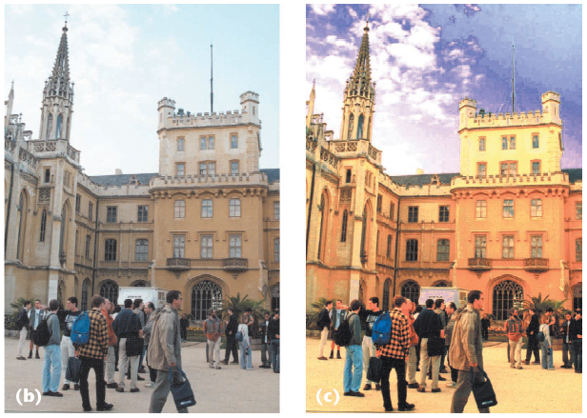
Image Processing 1
CS180: Intro to Comp. Vision, and Comp. Photo
Alexei Efros, Ren Ng, UC Berkeley, Fall 2026

Slide 2
What is an image?
We can think of an image as a function, f, from R² to R:
  f( x, y ) gives the intensity at position ( x, y )
  Realistically, we expect the image only to be defined over a rectangle, with a finite range:
    f: [a,b]x[c,d] → [0,1]
A color image is just three functions pasted together. We can write this as a “vector-valued” function:
Notes:
As opposed to [0..255]

Slide 3
Images as functions
Notes:
Render with scanalyze????

Slide 4
How does a pixel get its value?
Light emitted
Fraction of light reflects into camera
Lens
Sensor

Slide 5
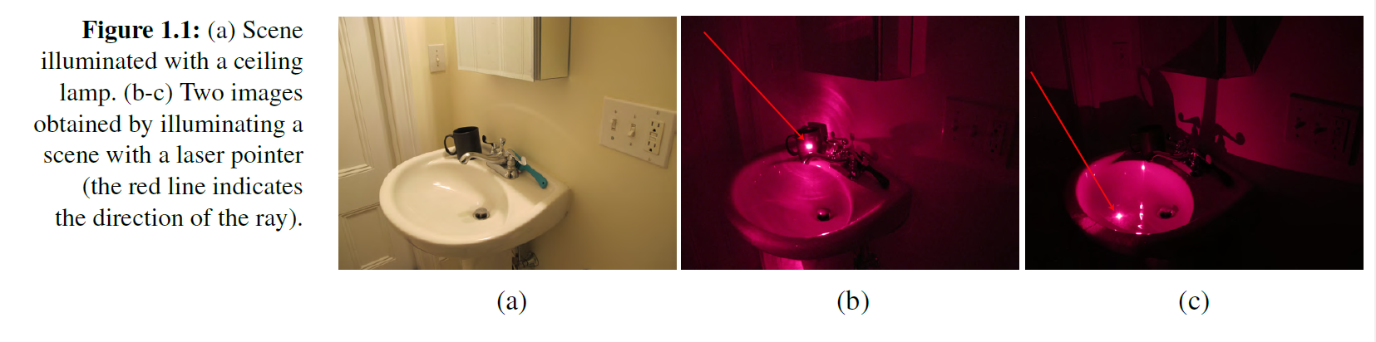
How does a pixel get its value?
Major factors
  Illumination strength and direction
  Surface geometry
  Surface material
  Nearby surfaces
  Camera gain/exposure
Light emitted
Light reflected to camera
Sensor

Slide 6


Basic models of reflection
Specular: light bounces off at the incident angle
  E.g., mirror
Diffuse: light scatters in all directions
  E.g., brick, cloth, rough wood
specular reflection
incoming light
$$Θ$$
$$Θ$$
diffuse reflection
incoming light

Slide 7
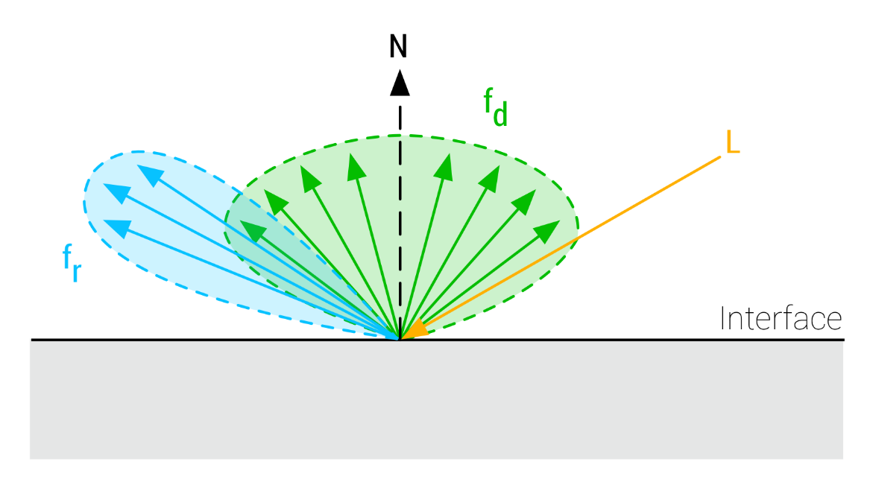
Diffuse vs. Specular

Slide 8



Lambertian reflectance model
Some light is absorbed (function of albedo$ρ$)
Remaining light is scattered (diffuse reflection)
Examples: soft cloth, concrete, matte paints
light source
light source
diffuse reflection
$$ρ$$
absorption
$$(1−ρ)$$
Notes:
albedo is the fraction of light reflected

Slide 9
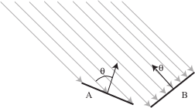
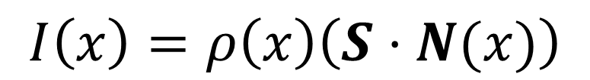
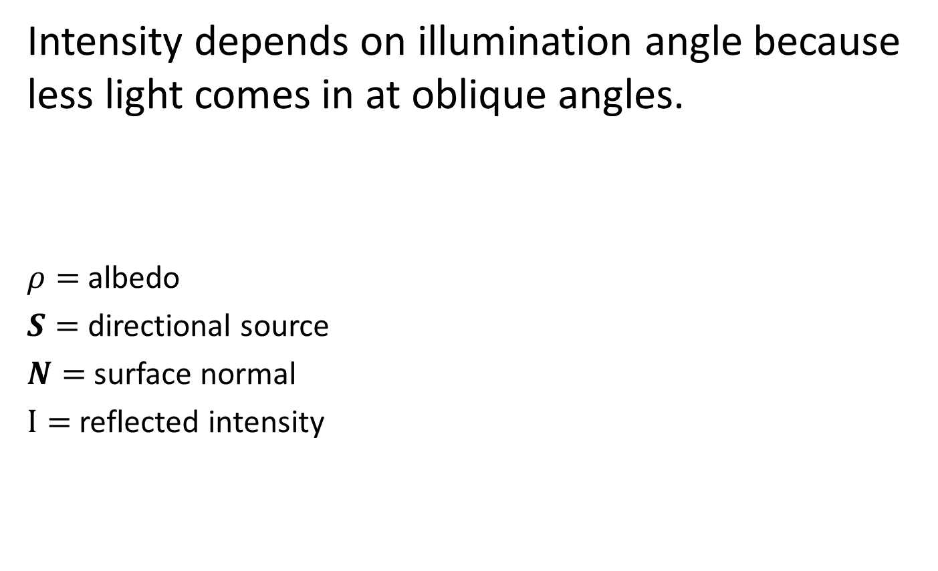
Intensity and Surface Orientation
Intensity depends on illumination angle because less light comes in at oblique angles.
$ρ=$albedo
$S=$ directional source
$N=$ surface normal
$I=$ reflected intensity
$$I\left(x\right)=ρ\left(x\right)\left(S⋅N(x)\right)$$
Slide: Forsyth

Slide 10
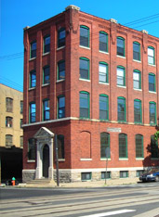
1
2

Slide 11

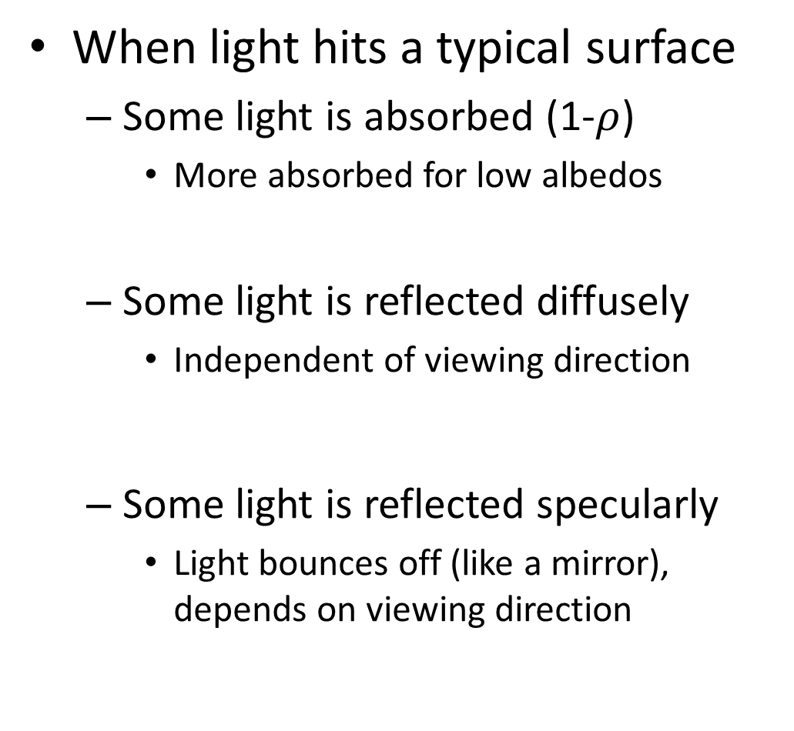

Recap
When light hits a typical surface
  Some light is absorbed (1-$ρ$)
    More absorbed for low albedos
  Some light is reflected diffusely
    Independent of viewing direction
  Some light is reflected specularly
    Light bounces off (like a mirror), depends on viewing direction
absorption
diffuse reflection
specular reflection
$$Θ$$
$$Θ$$

Slide 12
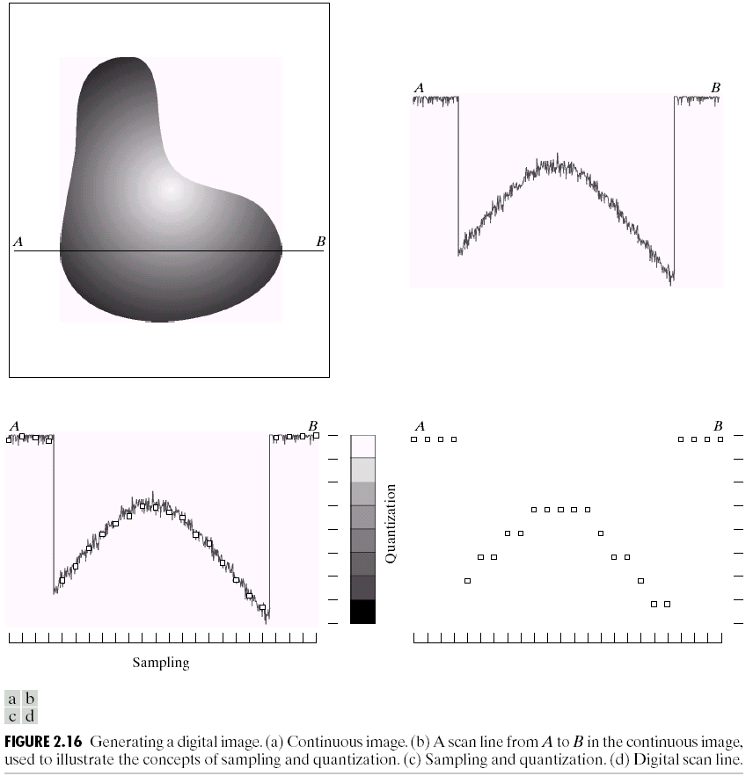
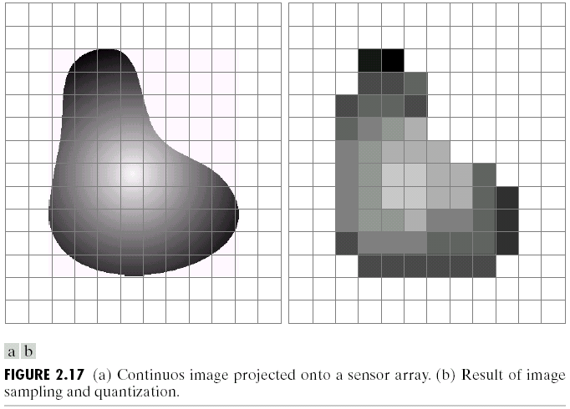
Sampling and Quantization

Slide 13
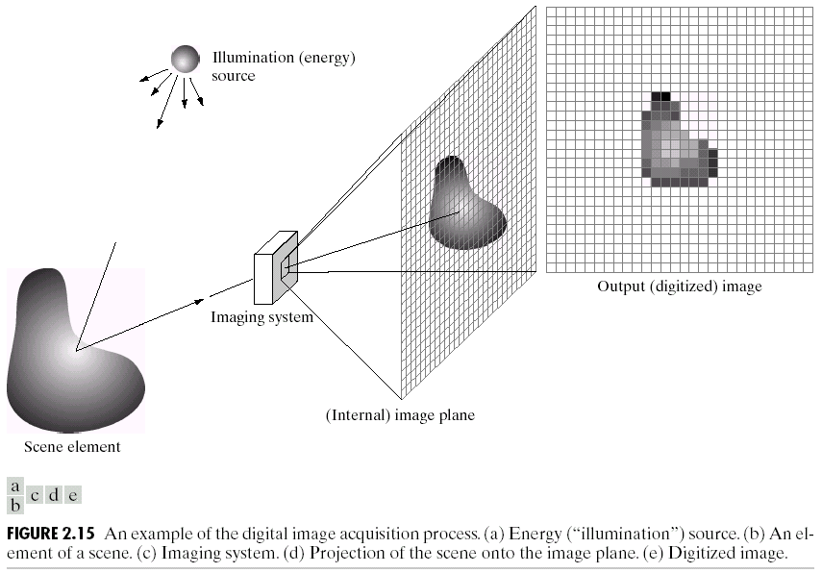
Image Formation
f(x,y) = reflectance(x,y) * illumination(x,y)
Reflectance in [0,1], illumination in [0,inf]

Slide 14
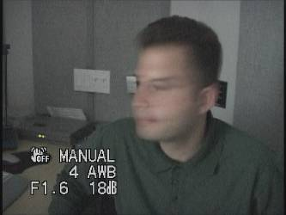
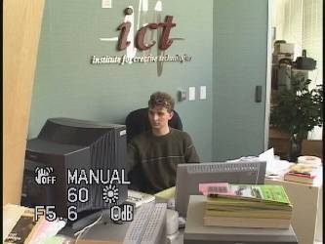
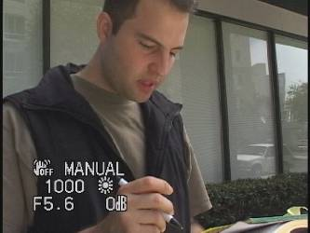
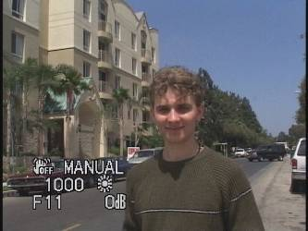
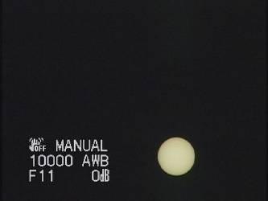
Problem: Dynamic Range
The real world is
High dynamic range
1
1500
25,000
400,000
2,000,000,000

Slide 15
Long Exposure
10⁻⁶
High dynamic range
10⁶
Real world
10⁻⁶
10⁶
Picture
^{0 to 255}

Slide 16
Short Exposure
10⁻⁶
High dynamic range
10⁶
Real world
10⁻⁶
10⁶
Picture
^{0 to 255}

Slide 17
Image Acquisition Pipeline
Lens
Shutter
scene
radiance
(W/sr/m )
sensor
irradiance
∫
sensor
exposure
2
Δt
CCD
ADC
Remapping
analog
voltages
digital
values
pixel
values
Notes:
3

Slide 18
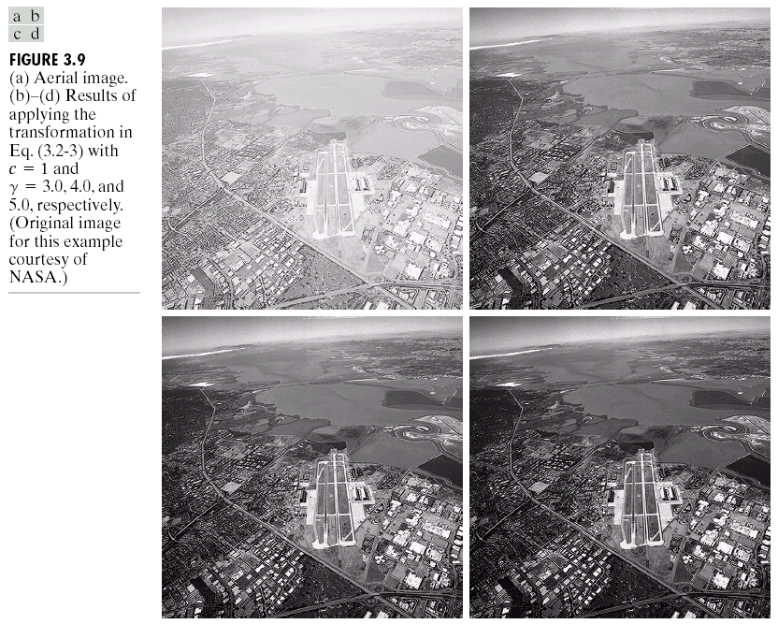
Simple Point Processing: Enhancement

Slide 19
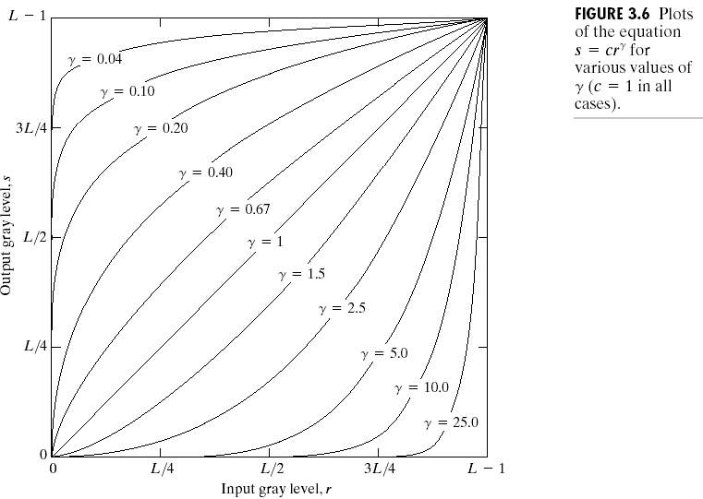

Power-law transformations
$$s=crγ$$

Slide 20
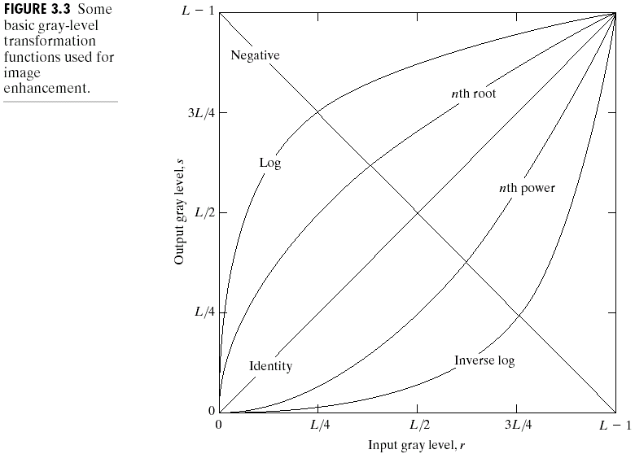
Basic Point Processing

Slide 21
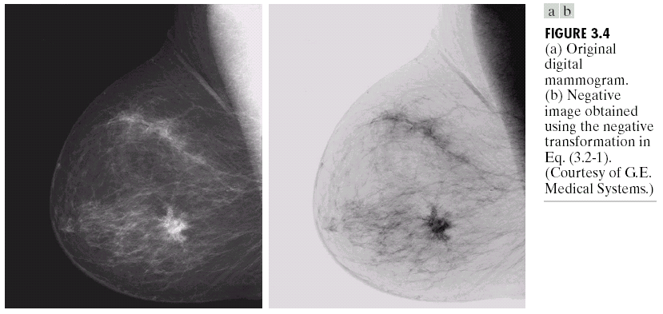
Negative

Slide 22
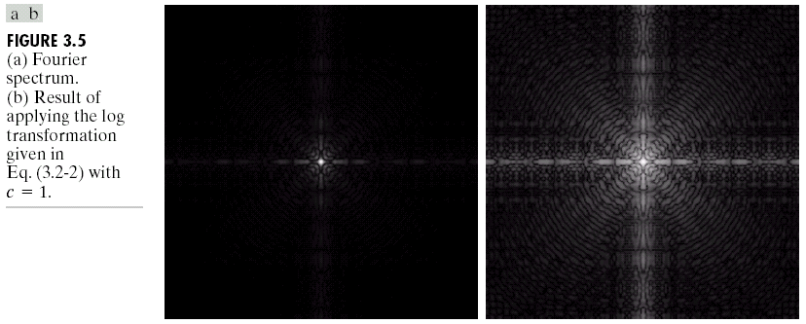
Log

Slide 23
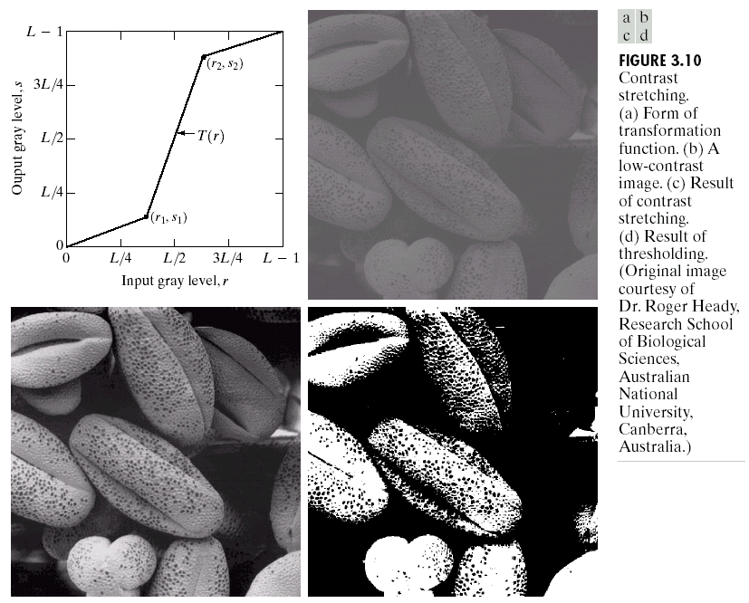
Contrast Stretching

Slide 24
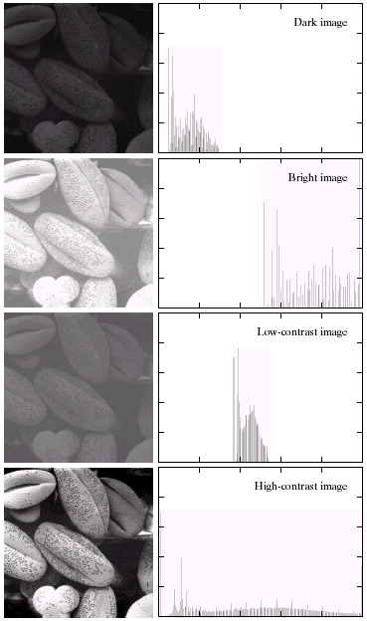
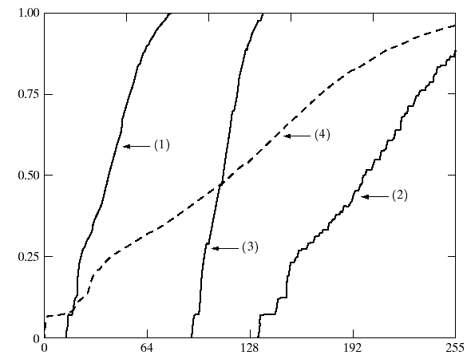

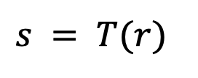
Image Histograms
Cumulative Histograms
$$s = T(r)$$

Slide 25
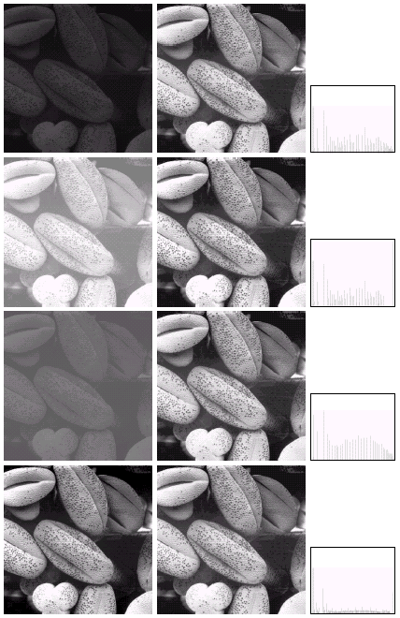

Histogram Equalization

Slide 26
Color Transfer [Reinhard, et al, 2001]
Erik Reinhard, Michael Ashikhmin, Bruce Gooch, Peter Shirley, Color Transfer between Images. IEEE Computer Graphics and Applications, 21(5), pp. 34–41. September 2001.

Slide 27
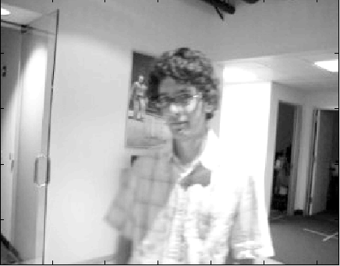
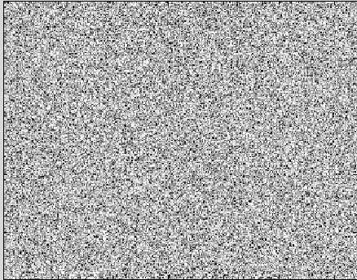
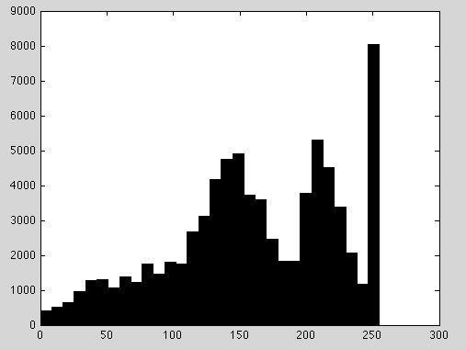
Limitations of Point Processing…
Slide by Erik Learned-Miller

Slide 28
Sampling and Reconstruction

Slide 29
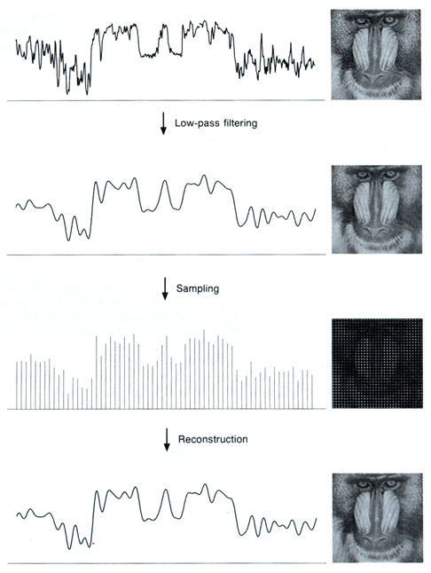
Sampled representations
How to store and compute with continuous functions?
Common scheme for representation: samples
  write down the function’s values at many points
[FvDFH fig.14.14b / Wolberg]

Slide 30
Reconstruction
Making samples back into a continuous function
  for output (need realizable method)
  for analysis or processing (need mathematical method)
  amounts to “guessing” what the function did in between
[FvDFH fig.14.14b / Wolberg]

Slide 31
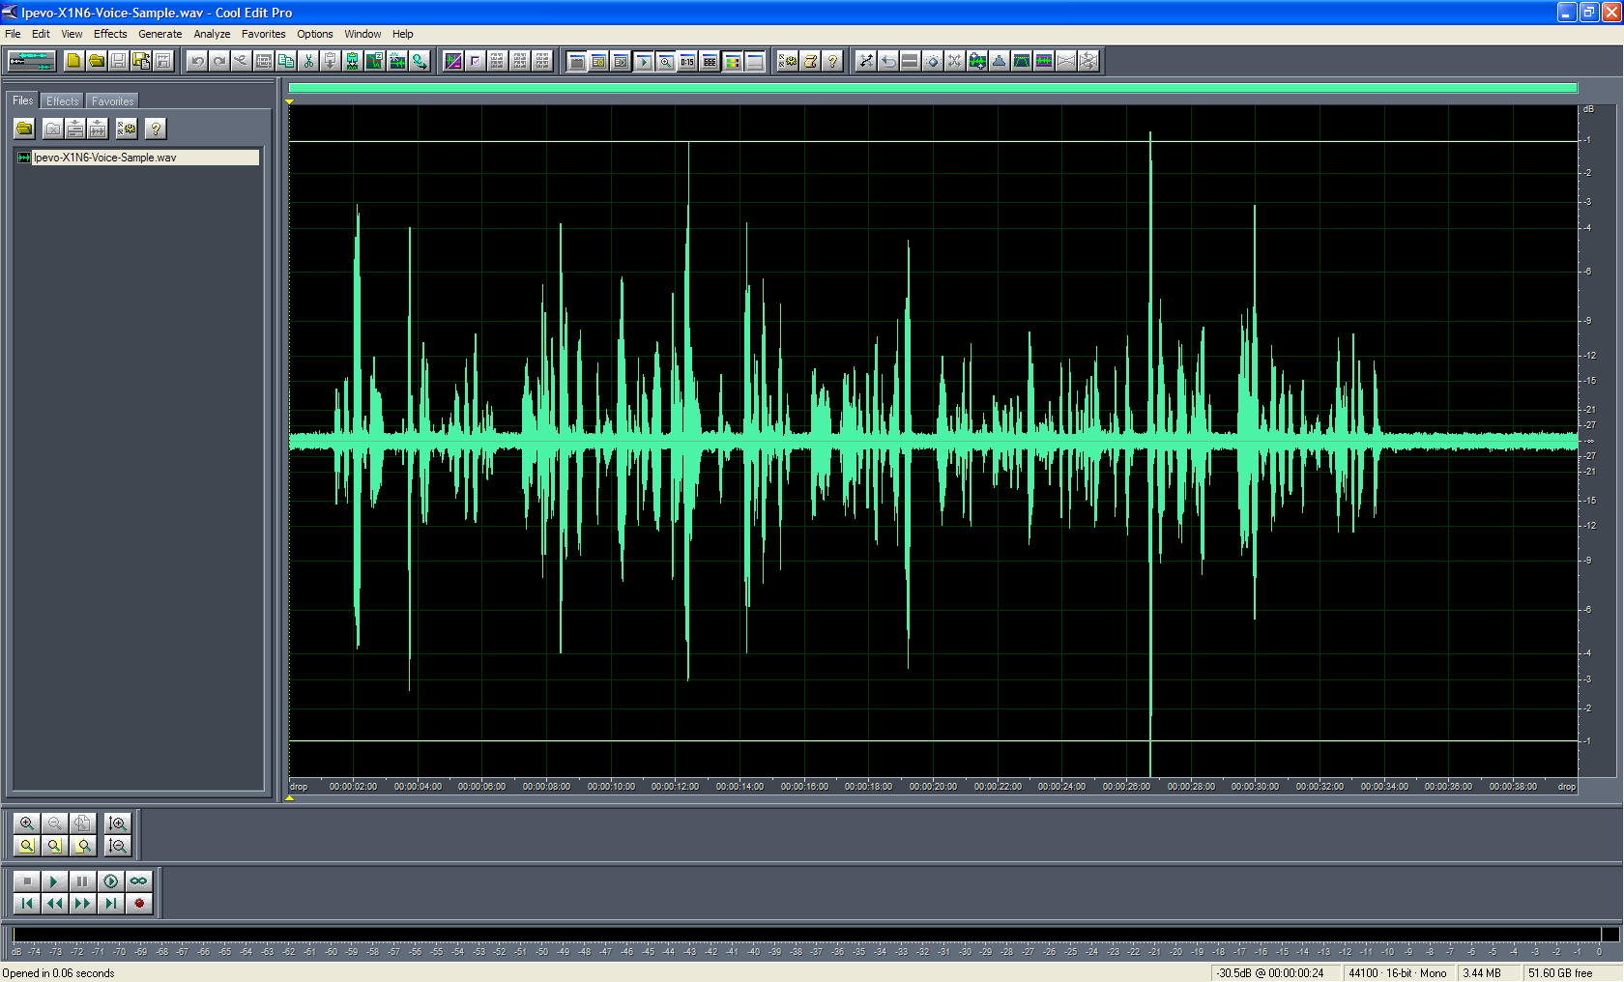
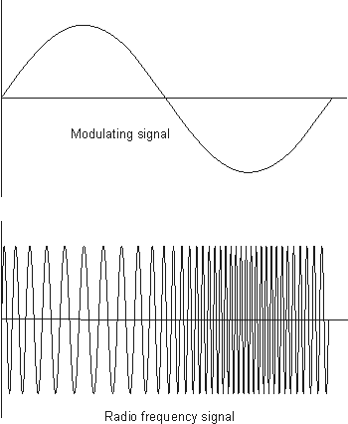
1D Example: Audio
low
high
frequencies

Slide 32
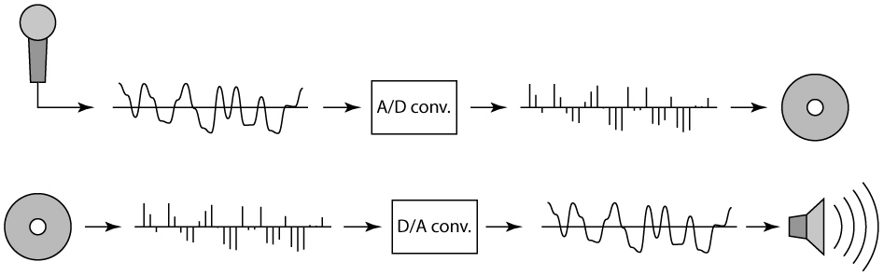
Sampling in digital audio
Recording: sound to analog to samples to disc
Playback: disc to samples to analog to sound again
  how can we be sure we are filling in the gaps correctly?

Slide 33
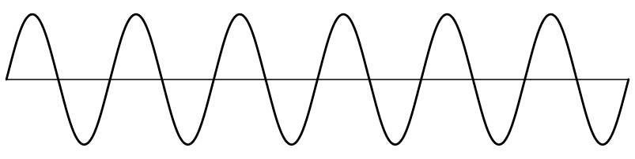
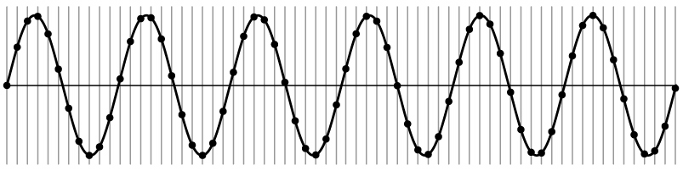
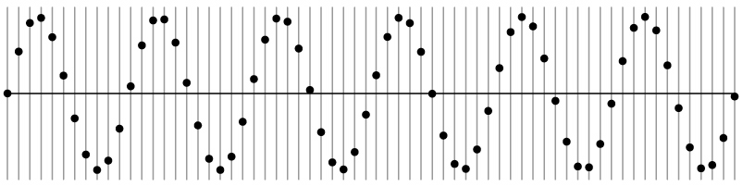
Sampling and Reconstruction
Simple example: a sign wave

Slide 34
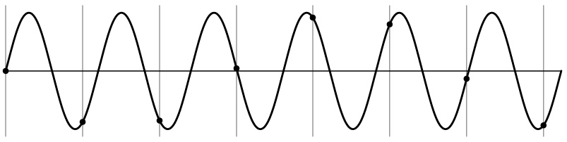
Undersampling
What if we “missed” things between the samples?
Simple example: undersampling a sine wave
  unsurprising result: information is lost

Slide 35
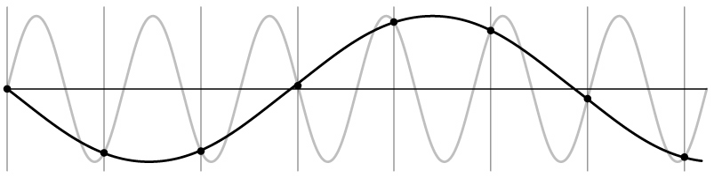
Undersampling
What if we “missed” things between the samples?
Simple example: undersampling a sine wave
  unsurprising result: information is lost
  surprising result: indistinguishable from lower frequency

Slide 36
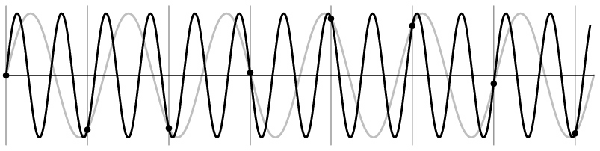
Undersampling
What if we “missed” things between the samples?
Simple example: undersampling a sine wave
  unsurprising result: information is lost
  surprising result: indistinguishable from lower frequency
  also, was always indistinguishable from higher frequencies
  aliasing: signals “traveling in disguise” as other frequencies

Slide 37
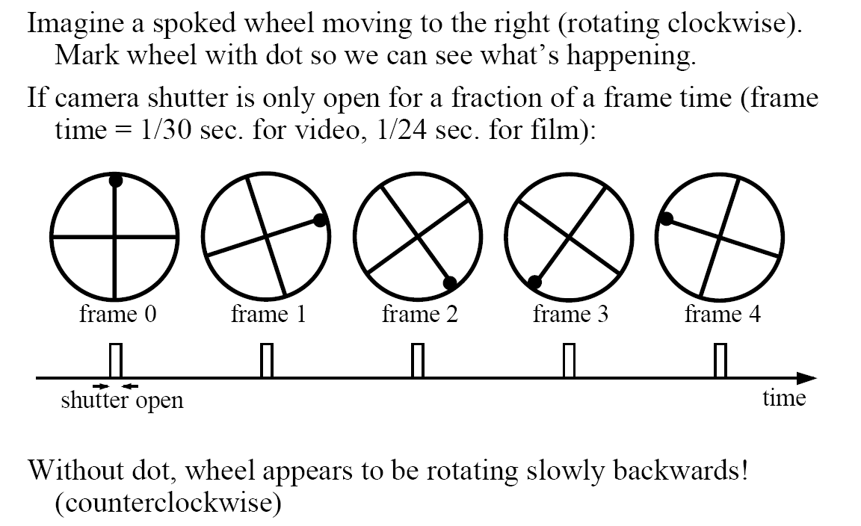
Aliasing in video
Slide by Steve Seitz

Slide 38
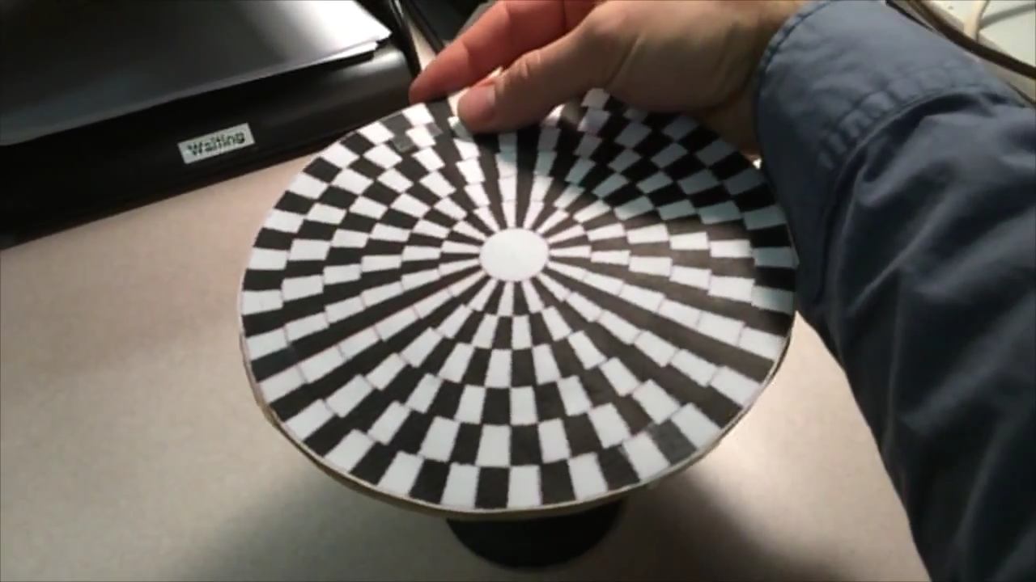
Wagon Wheel Illusion (False Motion)
Created by Jesse Mason, https://www.youtube.com/watch?v=QOwzkND_ooU

Slide 39
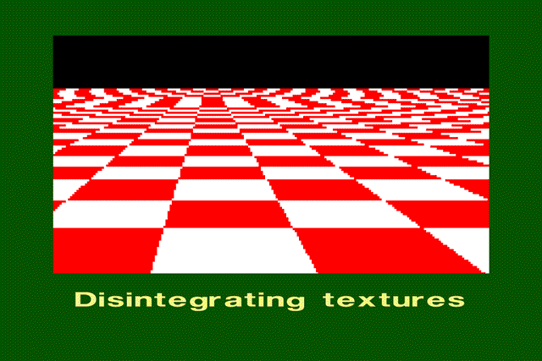
Aliasing in Synthetic Images

Slide 40
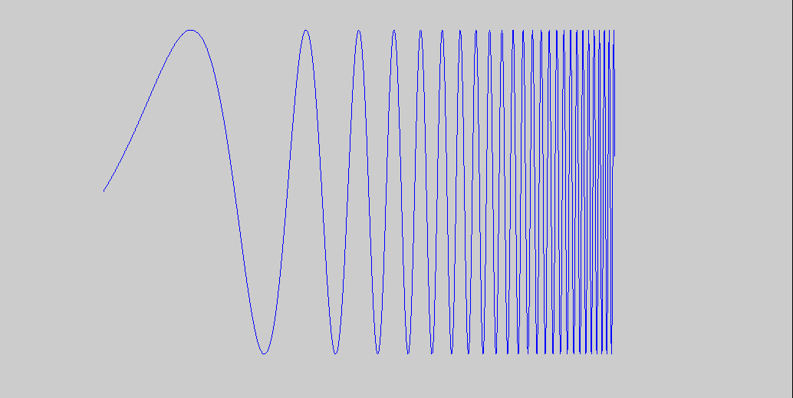
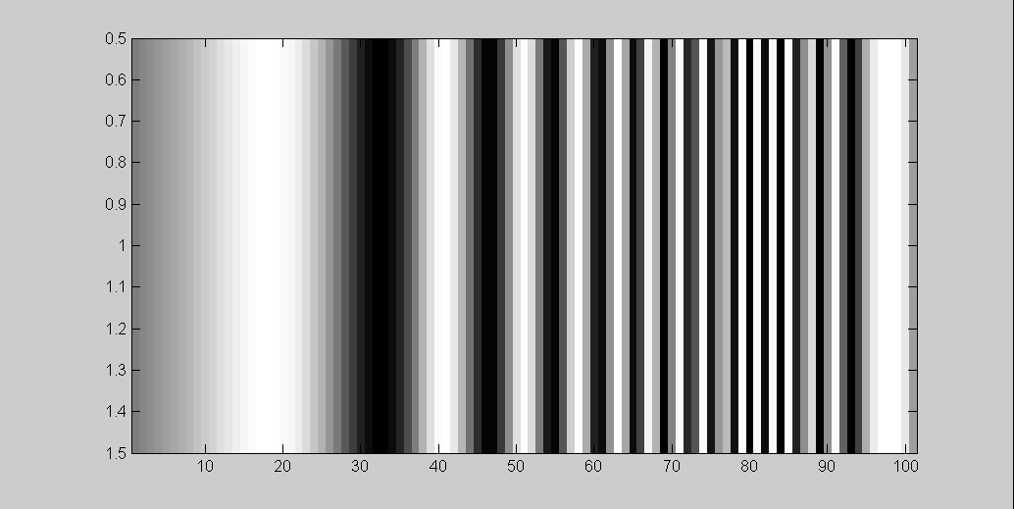
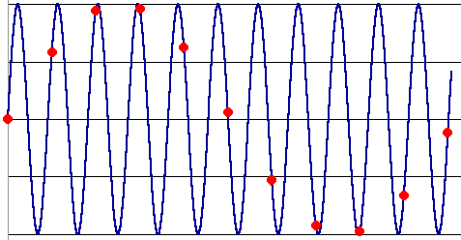
What’s Happening?
Input signal:
Plot as image:
x = 0:.05:5; imagesc(sin((2.^x).*x))
Alias!
Not enough samples

Slide 41
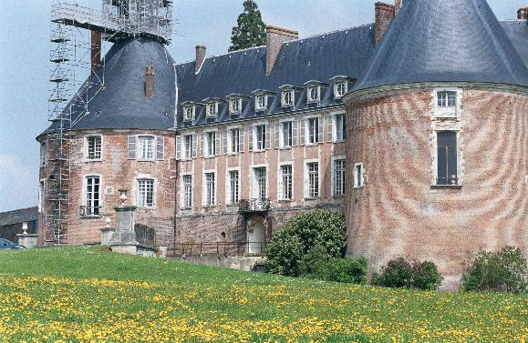
Aliasing in Natural Imagery

Slide 42


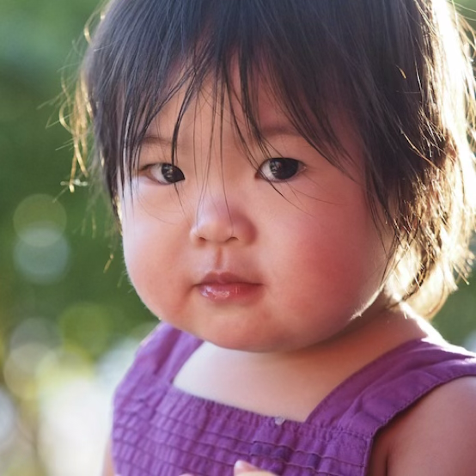
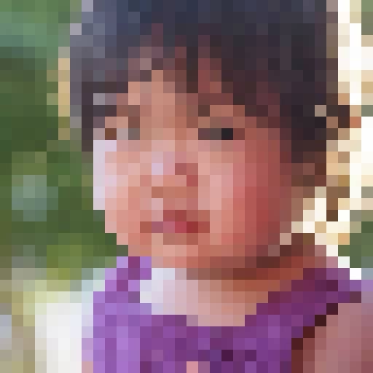
Aliasing in Image Processing
512 x 512
original
lystit.com
32 x 32
thumbnail
(subsampled)
All sensor pixels
Delete odd rows and columns

Slide 43
Antialiasing
What can we do about aliasing?
Sample more often
  Join the Mega-Pixel craze of the photo industry
  But this can’t go on forever
Make the signal less “wiggly”
  Get rid of some high frequencies
  Will loose information
  But it’s better than aliasing

Slide 44
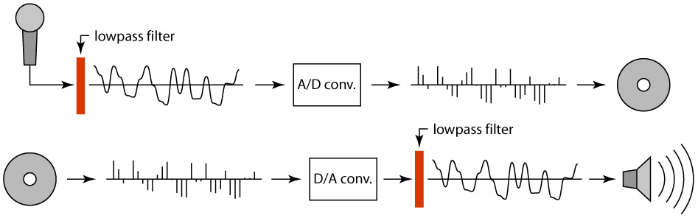
Preventing aliasing
Introduce lowpass filters:
  remove high frequencies leaving only safe, low frequencies
  choose lowest frequency in reconstruction (disambiguate)

Slide 45
Linear filtering: a key idea
Transformations on signals; e.g.:
  bass/treble controls on stereo
  blurring/sharpening operations in image editing
  smoothing/noise reduction in tracking
Key properties
  linearity: filter(f + g) = filter(f) + filter(g)
  shift invariance: behavior invariant to shifting the input
    delaying an audio signal
    sliding an image around
Can be modeled mathematically by convolution

Slide 46





Moving Average
basic idea: define a new function by averaging over a sliding window
a simple example to start off: smoothing

Slide 47

Moving Average
Can add weights to our moving average
Weights […, 0, 1, 1, 1, 1, 1, 0, …] / 5

Slide 48

In 2D: box filter
1
1
1
1
1
1
1
1
1
Slide credit: David Lowe (UBC)

Slide 49
Image filtering
1
1
1
1
1
1
1
1
1
0 | 0 | 0 | 0 | 0 | 0 | 0 | 0 | 0 | 0
0 | 0 | 0 | 0 | 0 | 0 | 0 | 0 | 0 | 0
0 | 0 | 0 | 90 | 90 | 90 | 90 | 90 | 0 | 0
0 | 0 | 0 | 90 | 90 | 90 | 90 | 90 | 0 | 0
0 | 0 | 0 | 90 | 90 | 90 | 90 | 90 | 0 | 0
0 | 0 | 0 | 90 | 0 | 90 | 90 | 90 | 0 | 0
0 | 0 | 0 | 90 | 90 | 90 | 90 | 90 | 0 | 0
0 | 0 | 0 | 0 | 0 | 0 | 0 | 0 | 0 | 0
0 | 0 | 90 | 0 | 0 | 0 | 0 | 0 | 0 | 0
0 | 0 | 0 | 0 | 0 | 0 | 0 | 0 | 0 | 0
 | 0
0 | 0 | 0 | 0 | 0 | 0 | 0 | 0 | 0 | 0
0 | 0 | 0 | 0 | 0 | 0 | 0 | 0 | 0 | 0
0 | 0 | 0 | 90 | 90 | 90 | 90 | 90 | 0 | 0
0 | 0 | 0 | 90 | 90 | 90 | 90 | 90 | 0 | 0
0 | 0 | 0 | 90 | 90 | 90 | 90 | 90 | 0 | 0
0 | 0 | 0 | 90 | 0 | 90 | 90 | 90 | 0 | 0
0 | 0 | 0 | 90 | 90 | 90 | 90 | 90 | 0 | 0
0 | 0 | 0 | 0 | 0 | 0 | 0 | 0 | 0 | 0
0 | 0 | 90 | 0 | 0 | 0 | 0 | 0 | 0 | 0
0 | 0 | 0 | 0 | 0 | 0 | 0 | 0 | 0 | 0
Credit: S. Seitz
Notes:
ones, divide by 9

Slide 50
Image filtering
1
1
1
1
1
1
1
1
1
0 | 0 | 0 | 0 | 0 | 0 | 0 | 0 | 0 | 0
0 | 0 | 0 | 0 | 0 | 0 | 0 | 0 | 0 | 0
0 | 0 | 0 | 90 | 90 | 90 | 90 | 90 | 0 | 0
0 | 0 | 0 | 90 | 90 | 90 | 90 | 90 | 0 | 0
0 | 0 | 0 | 90 | 90 | 90 | 90 | 90 | 0 | 0
0 | 0 | 0 | 90 | 0 | 90 | 90 | 90 | 0 | 0
0 | 0 | 0 | 90 | 90 | 90 | 90 | 90 | 0 | 0
0 | 0 | 0 | 0 | 0 | 0 | 0 | 0 | 0 | 0
0 | 0 | 90 | 0 | 0 | 0 | 0 | 0 | 0 | 0
0 | 0 | 0 | 0 | 0 | 0 | 0 | 0 | 0 | 0
 | 0 | 10
0 | 0 | 0 | 0 | 0 | 0 | 0 | 0 | 0 | 0
0 | 0 | 0 | 0 | 0 | 0 | 0 | 0 | 0 | 0
0 | 0 | 0 | 90 | 90 | 90 | 90 | 90 | 0 | 0
0 | 0 | 0 | 90 | 90 | 90 | 90 | 90 | 0 | 0
0 | 0 | 0 | 90 | 90 | 90 | 90 | 90 | 0 | 0
0 | 0 | 0 | 90 | 0 | 90 | 90 | 90 | 0 | 0
0 | 0 | 0 | 90 | 90 | 90 | 90 | 90 | 0 | 0
0 | 0 | 0 | 0 | 0 | 0 | 0 | 0 | 0 | 0
0 | 0 | 90 | 0 | 0 | 0 | 0 | 0 | 0 | 0
0 | 0 | 0 | 0 | 0 | 0 | 0 | 0 | 0 | 0
Credit: S. Seitz
Notes:
ones, divide by 9

Slide 51
Image filtering
1
1
1
1
1
1
1
1
1
0 | 0 | 0 | 0 | 0 | 0 | 0 | 0 | 0 | 0
0 | 0 | 0 | 0 | 0 | 0 | 0 | 0 | 0 | 0
0 | 0 | 0 | 90 | 90 | 90 | 90 | 90 | 0 | 0
0 | 0 | 0 | 90 | 90 | 90 | 90 | 90 | 0 | 0
0 | 0 | 0 | 90 | 90 | 90 | 90 | 90 | 0 | 0
0 | 0 | 0 | 90 | 0 | 90 | 90 | 90 | 0 | 0
0 | 0 | 0 | 90 | 90 | 90 | 90 | 90 | 0 | 0
0 | 0 | 0 | 0 | 0 | 0 | 0 | 0 | 0 | 0
0 | 0 | 90 | 0 | 0 | 0 | 0 | 0 | 0 | 0
0 | 0 | 0 | 0 | 0 | 0 | 0 | 0 | 0 | 0
 | 0 | 10 | 20
0 | 0 | 0 | 0 | 0 | 0 | 0 | 0 | 0 | 0
0 | 0 | 0 | 0 | 0 | 0 | 0 | 0 | 0 | 0
0 | 0 | 0 | 90 | 90 | 90 | 90 | 90 | 0 | 0
0 | 0 | 0 | 90 | 90 | 90 | 90 | 90 | 0 | 0
0 | 0 | 0 | 90 | 90 | 90 | 90 | 90 | 0 | 0
0 | 0 | 0 | 90 | 0 | 90 | 90 | 90 | 0 | 0
0 | 0 | 0 | 90 | 90 | 90 | 90 | 90 | 0 | 0
0 | 0 | 0 | 0 | 0 | 0 | 0 | 0 | 0 | 0
0 | 0 | 90 | 0 | 0 | 0 | 0 | 0 | 0 | 0
0 | 0 | 0 | 0 | 0 | 0 | 0 | 0 | 0 | 0
Credit: S. Seitz
Notes:
ones, divide by 9

Slide 52
Image filtering
1
1
1
1
1
1
1
1
1
0 | 0 | 0 | 0 | 0 | 0 | 0 | 0 | 0 | 0
0 | 0 | 0 | 0 | 0 | 0 | 0 | 0 | 0 | 0
0 | 0 | 0 | 90 | 90 | 90 | 90 | 90 | 0 | 0
0 | 0 | 0 | 90 | 90 | 90 | 90 | 90 | 0 | 0
0 | 0 | 0 | 90 | 90 | 90 | 90 | 90 | 0 | 0
0 | 0 | 0 | 90 | 0 | 90 | 90 | 90 | 0 | 0
0 | 0 | 0 | 90 | 90 | 90 | 90 | 90 | 0 | 0
0 | 0 | 0 | 0 | 0 | 0 | 0 | 0 | 0 | 0
0 | 0 | 90 | 0 | 0 | 0 | 0 | 0 | 0 | 0
0 | 0 | 0 | 0 | 0 | 0 | 0 | 0 | 0 | 0
 | 0 | 10 | 20 | 30
0 | 0 | 0 | 0 | 0 | 0 | 0 | 0 | 0 | 0
0 | 0 | 0 | 0 | 0 | 0 | 0 | 0 | 0 | 0
0 | 0 | 0 | 90 | 90 | 90 | 90 | 90 | 0 | 0
0 | 0 | 0 | 90 | 90 | 90 | 90 | 90 | 0 | 0
0 | 0 | 0 | 90 | 90 | 90 | 90 | 90 | 0 | 0
0 | 0 | 0 | 90 | 0 | 90 | 90 | 90 | 0 | 0
0 | 0 | 0 | 90 | 90 | 90 | 90 | 90 | 0 | 0
0 | 0 | 0 | 0 | 0 | 0 | 0 | 0 | 0 | 0
0 | 0 | 90 | 0 | 0 | 0 | 0 | 0 | 0 | 0
0 | 0 | 0 | 0 | 0 | 0 | 0 | 0 | 0 | 0
Credit: S. Seitz
Notes:
ones, divide by 9

Slide 53
Image filtering
1
1
1
1
1
1
1
1
1
0 | 0 | 0 | 0 | 0 | 0 | 0 | 0 | 0 | 0
0 | 0 | 0 | 0 | 0 | 0 | 0 | 0 | 0 | 0
0 | 0 | 0 | 90 | 90 | 90 | 90 | 90 | 0 | 0
0 | 0 | 0 | 90 | 90 | 90 | 90 | 90 | 0 | 0
0 | 0 | 0 | 90 | 90 | 90 | 90 | 90 | 0 | 0
0 | 0 | 0 | 90 | 0 | 90 | 90 | 90 | 0 | 0
0 | 0 | 0 | 90 | 90 | 90 | 90 | 90 | 0 | 0
0 | 0 | 0 | 0 | 0 | 0 | 0 | 0 | 0 | 0
0 | 0 | 90 | 0 | 0 | 0 | 0 | 0 | 0 | 0
0 | 0 | 0 | 0 | 0 | 0 | 0 | 0 | 0 | 0
 | 0 | 10 | 20 | 30 | 30
Credit: S. Seitz
Notes:
ones, divide by 9

Slide 54
Image filtering
1
1
1
1
1
1
1
1
1
0 | 0 | 0 | 0 | 0 | 0 | 0 | 0 | 0 | 0
0 | 0 | 0 | 0 | 0 | 0 | 0 | 0 | 0 | 0
0 | 0 | 0 | 90 | 90 | 90 | 90 | 90 | 0 | 0
0 | 0 | 0 | 90 | 90 | 90 | 90 | 90 | 0 | 0
0 | 0 | 0 | 90 | 90 | 90 | 90 | 90 | 0 | 0
0 | 0 | 0 | 90 | 0 | 90 | 90 | 90 | 0 | 0
0 | 0 | 0 | 90 | 90 | 90 | 90 | 90 | 0 | 0
0 | 0 | 0 | 0 | 0 | 0 | 0 | 0 | 0 | 0
0 | 0 | 90 | 0 | 0 | 0 | 0 | 0 | 0 | 0
0 | 0 | 0 | 0 | 0 | 0 | 0 | 0 | 0 | 0
 | 0 | 10 | 20 | 30 | 30
?
Credit: S. Seitz
Notes:
ones, divide by 9

Slide 55
Image filtering
1
1
1
1
1
1
1
1
1
0 | 0 | 0 | 0 | 0 | 0 | 0 | 0 | 0 | 0
0 | 0 | 0 | 0 | 0 | 0 | 0 | 0 | 0 | 0
0 | 0 | 0 | 90 | 90 | 90 | 90 | 90 | 0 | 0
0 | 0 | 0 | 90 | 90 | 90 | 90 | 90 | 0 | 0
0 | 0 | 0 | 90 | 90 | 90 | 90 | 90 | 0 | 0
0 | 0 | 0 | 90 | 0 | 90 | 90 | 90 | 0 | 0
0 | 0 | 0 | 90 | 90 | 90 | 90 | 90 | 0 | 0
0 | 0 | 0 | 0 | 0 | 0 | 0 | 0 | 0 | 0
0 | 0 | 90 | 0 | 0 | 0 | 0 | 0 | 0 | 0
0 | 0 | 0 | 0 | 0 | 0 | 0 | 0 | 0 | 0
 | 0 | 10 | 20 | 30 | 30
 |  |  |  | 50
?
Credit: S. Seitz
Notes:
ones, divide by 9

Slide 56
Image filtering
1
1
1
1
1
1
1
1
1
0 | 0 | 0 | 0 | 0 | 0 | 0 | 0 | 0 | 0
0 | 0 | 0 | 0 | 0 | 0 | 0 | 0 | 0 | 0
0 | 0 | 0 | 90 | 90 | 90 | 90 | 90 | 0 | 0
0 | 0 | 0 | 90 | 90 | 90 | 90 | 90 | 0 | 0
0 | 0 | 0 | 90 | 90 | 90 | 90 | 90 | 0 | 0
0 | 0 | 0 | 90 | 0 | 90 | 90 | 90 | 0 | 0
0 | 0 | 0 | 90 | 90 | 90 | 90 | 90 | 0 | 0
0 | 0 | 0 | 0 | 0 | 0 | 0 | 0 | 0 | 0
0 | 0 | 90 | 0 | 0 | 0 | 0 | 0 | 0 | 0
0 | 0 | 0 | 0 | 0 | 0 | 0 | 0 | 0 | 0
 | 0 | 10 | 20 | 30 | 30 | 30 | 20 | 10
 | 0 | 20 | 40 | 60 | 60 | 60 | 40 | 20
 | 0 | 30 | 60 | 90 | 90 | 90 | 60 | 30
 | 0 | 30 | 50 | 80 | 80 | 90 | 60 | 30
 | 0 | 30 | 50 | 80 | 80 | 90 | 60 | 30
 | 0 | 20 | 30 | 50 | 50 | 60 | 40 | 20
 | 10 | 20 | 30 | 30 | 30 | 30 | 20 | 10
 | 10 | 10 | 10 | 0 | 0 | 0 | 0 | 0
Credit: S. Seitz

Slide 57





Cross-correlation
Let be the image, be the kernel (of size 2k+1 x 2k+1), and be the output image
Can think of as a “dot product” between local neighborhood and kernel for each pixel
This is called a cross-correlation operation:

Slide 58
Box Filter
What does it do?
Replaces each pixel with an average of its neighborhood
Achieve smoothing effect (remove sharp features)
1
1
1
1
1
1
1
1
1
Slide credit: David Lowe (UBC)

Slide 59


Linear filters: examples
1
1
1
=
1
1
1
1
1
1
Original
Blur (with a mean filter)
Source: D. Lowe

Slide 60
Practice with linear filters
0
0
0
?
0
1
0
0
0
0
Original
Source: D. Lowe

Slide 61
Practice with linear filters
0
0
0
0
1
0
0
0
0
Original
Filtered
(no change)
Source: D. Lowe

Slide 62
Practice with linear filters
0
0
0
?
0
0
1
0
0
0
Original
Source: D. Lowe

Slide 63
Practice with linear filters
0
0
0
0
0
1
0
0
0
Original
Shifted left
By 1 pixel
Source: D. Lowe

Slide 64


Other filters
1
0
-1
2
0
-2
1
0
-1
Sobel
Vertical Edge
(absolute value)

Slide 65

Other filters
Q?
1
2
1
0
0
0
-1
-2
-1
Sobel
Horizontal Edge
(absolute value)
Notes:
Questions at this point?
65

Slide 66


Back to the box filter

Slide 67
Moving Average
Can add weights to our moving average
Weights […, 0, 1, 1, 1, 1, 1, 0, …] / 5

Slide 68

Weighted Moving Average
bell curve (gaussian-like) weights […, 1, 4, 6, 4, 1, …]

Slide 69


Moving Average In 2D
What are the weights H?
0 | 0 | 0 | 0 | 0 | 0 | 0 | 0 | 0 | 0
0 | 0 | 0 | 0 | 0 | 0 | 0 | 0 | 0 | 0
0 | 0 | 0 | 90 | 90 | 90 | 90 | 90 | 0 | 0
0 | 0 | 0 | 90 | 90 | 90 | 90 | 90 | 0 | 0
0 | 0 | 0 | 90 | 90 | 90 | 90 | 90 | 0 | 0
0 | 0 | 0 | 90 | 0 | 90 | 90 | 90 | 0 | 0
0 | 0 | 0 | 90 | 90 | 90 | 90 | 90 | 0 | 0
0 | 0 | 0 | 0 | 0 | 0 | 0 | 0 | 0 | 0
0 | 0 | 90 | 0 | 0 | 0 | 0 | 0 | 0 | 0
0 | 0 | 0 | 0 | 0 | 0 | 0 | 0 | 0 | 0
Slide by Steve Seitz
Notes:
ones, divide by 9

Slide 70



Gaussian filtering
A Gaussian kernel gives less weight to pixels further from the center of the window
This kernel is an approximation of a Gaussian function:
0 | 0 | 0 | 0 | 0 | 0 | 0 | 0 | 0 | 0
0 | 0 | 0 | 0 | 0 | 0 | 0 | 0 | 0 | 0
0 | 0 | 0 | 90 | 90 | 90 | 90 | 90 | 0 | 0
0 | 0 | 0 | 90 | 90 | 90 | 90 | 90 | 0 | 0
0 | 0 | 0 | 90 | 90 | 90 | 90 | 90 | 0 | 0
0 | 0 | 0 | 90 | 0 | 90 | 90 | 90 | 0 | 0
0 | 0 | 0 | 90 | 90 | 90 | 90 | 90 | 0 | 0
0 | 0 | 0 | 0 | 0 | 0 | 0 | 0 | 0 | 0
0 | 0 | 90 | 0 | 0 | 0 | 0 | 0 | 0 | 0
0 | 0 | 0 | 0 | 0 | 0 | 0 | 0 | 0 | 0
1 | 2 | 1
2 | 4 | 2
1 | 2 | 1
Slide by Steve Seitz

Slide 71

Mean (Box) vs. Gaussian filtering
Slide by Steve Seitz

Slide 72


Important filter: Gaussian
Weight contributions of neighboring pixels by nearness
0.003 0.013 0.022 0.013 0.003
0.013 0.059 0.097 0.059 0.013
0.022 0.097 0.159 0.097 0.022
0.013 0.059 0.097 0.059 0.013
0.003 0.013 0.022 0.013 0.003
5 x 5, σ = 1
Slide credit: Christopher Rasmussen
Notes:
72

Slide 73





Gaussian Kernel
σ = 2 with 30 x 30 kernel
σ = 5 with 30 x 30 kernel
Standard deviation σ: determines extent of smoothing
Source: K. Grauman
Notes:
what happens if sigma is small? in the limit?
how about if sigma = infinite ?
sigma > kernel size

Slide 74










Gaussian filters
= 1 pixel
= 5 pixels
= 10 pixels
= 30 pixels

Slide 75
Choosing kernel width
The Gaussian function has infinite support, but discrete filters use finite kernels
Source: K. Grauman
Notes:
sigma is the main Acontrolling parameter, need to make sure that the kernel size is appropriate
These are both not great gaussians, why?

Slide 76
Practical matters
How big should the filter be?
Values at edges should be near zero
Rule of thumb for Gaussian: set filter half-width to about 3 σ
Side by Derek Hoiem
Notes:
76

