Slide 1
Announcements
Midterm: 10/15 at 2PM, in the regular lecture hall.
Material covered through this week is in scope.
Review session: Monday 10/12 (details TBD).
DSP Accommodations to be announced.
Review projects, discussions, quizzes and lectures.
Final Projects:
Groups of 4
Start looking for partners and thinking of projects early (See Ed thread for finding groups).
Presentations will be during RRR: 12/8 and 12/10 during class hours. Short ~3-5 mins/group.
Also: Reminder Final Exam is Dec 15 at 8:00am

Slide 2
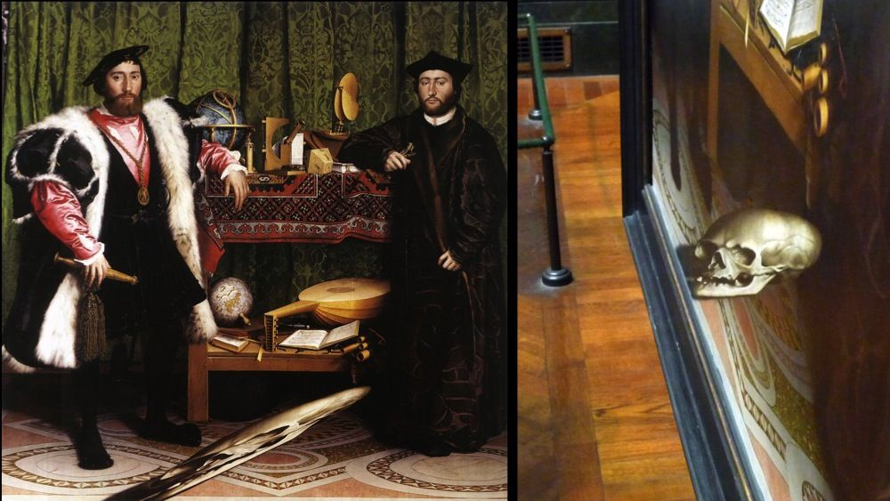
Image Transformations
The Ambassadors (Holbein), 1533
CS180: Intro to Computer Vision and Comp. Photo
Alexei Efros & Ren Ng, UC Berkeley, Fall 2026
Some slides from Steve Seitz
Notes:
Gallery in London
Hidden reminder that even if you are rich enough to have someone paint your portrait, still death finds us all.

Slide 3
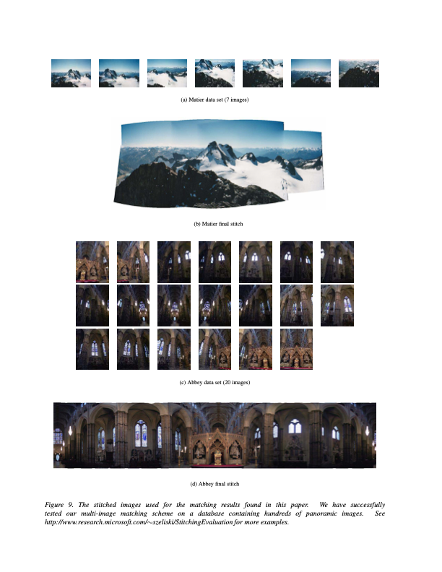
You will learn how to make panoramas
Brown et al., Multi-Image Matching using Multi-Scale Oriented Patches
Notes:
3min

Slide 4
You will learn how to make panoramas
Brown et al., Multi-Image Matching using Multi-Scale Oriented Patches
Notes:
3min

Slide 5
Image Transformations
image filtering: change range of image
g(x) = T(f(x))
f
f
T
x
x
image warping: change domain of image
g(x) = f(T(x))
f
f
T
x
x

Slide 6
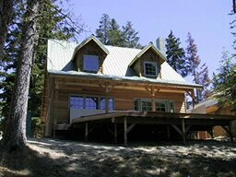
Image Transformations
image filtering: change range of image
g(x) = T(f(x))
f
g
T
image warping: change domain of image
g(x) = f(T(x))
f
g
T

Slide 7
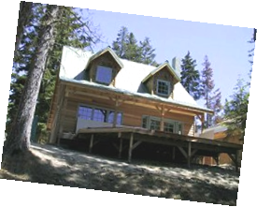
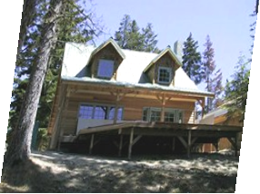
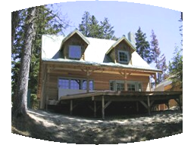
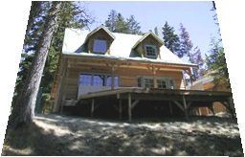
Parametric (global) warping
Examples of parametric warps:
translation
rotation
aspect
perspective
affine
cylindrical

Slide 8
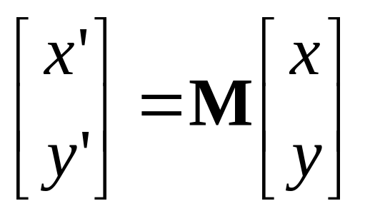
Parametric (global) warping
T
p = (x,y)
p’ = (x’,y’)
Transformation T is a coordinate-changing machine:
p’ = T(p)
What does it mean that T is global?
  Is the same for any point p
  can be described by just a few numbers (parameters)
Let’s represent a linear T as a matrix:
p’ = Mp

Slide 9
Scaling
Scaling a coordinate means multiplying each of its components by a scalar
Uniform scaling means this scalar is the same for all components:
× 2

Slide 10
Scaling
Non-uniform scaling: different scalars per component:
X × 2,
Y × 0.5

Slide 11
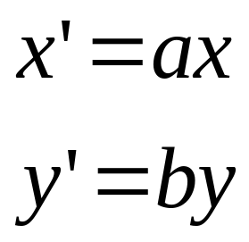
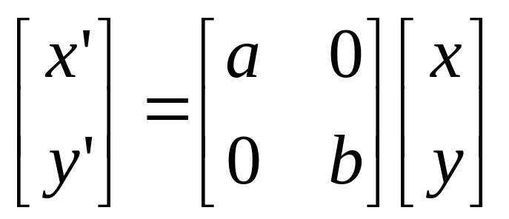
Scaling
Scaling operation:
Or, in matrix form:
scaling matrix S
What’s inverse of S?

Slide 12
2-D Rotation
(x’, y’)
(x, y)
x’ = x cos(θ) – y sin(θ)
y’ = x sin(θ) + y cos(θ)
θ

Slide 13
2-D Rotation
x = r cos (φ)
y = r sin (φ)
x’ = r cos (φ + θ)
y’ = r sin (φ + θ)
(x’, y’)
(x, y)
θ
φ

Slide 14
2-D Rotation
x = r cos (φ)
y = r sin (φ)
x’ = r cos (φ + θ)
y’ = r sin (φ + θ)
Trig Identity…
x’ = r cos(φ) cos(θ) – r sin(φ) sin(θ)
y’ = r sin(φ) cos(θ) + r cos(φ) sin(θ)
(x’, y’)
(x, y)
θ
φ

Slide 15
2-D Rotation
x = r cos (φ)
y = r sin (φ)
x’ = r cos (φ + θ)
y’ = r sin (φ + θ)
Trig Identity…
x’ = r cos(φ) cos(θ) – r sin(φ) sin(θ)
y’ = r sin(φ) cos(θ) + r cos(φ) sin(θ)
Substitute…
x’ = x cos(θ) – y sin(θ)
y’ = x sin(θ) + y cos(θ)
(x’, y’)
(x, y)
θ
φ

Slide 16
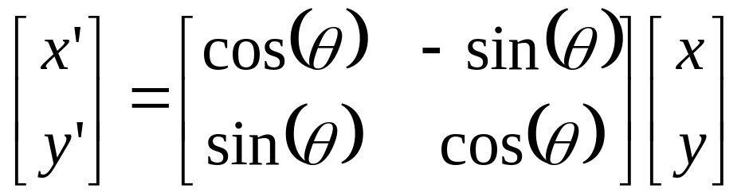

2-D Rotation
This is easy to capture in matrix form:
Is this a linear transformation?
Even though sin(θ) and cos(θ) are nonlinear functions of θ,
  x’ is a linear combination of x and y
  y’ is a linear combination of x and y
What is the inverse transformation?
  Rotation by –θ
  For rotation matrices
R

Slide 17
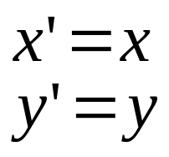
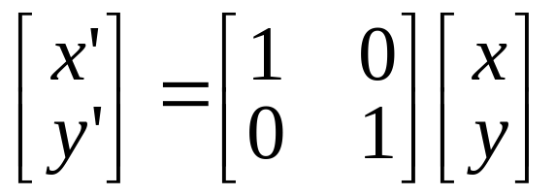
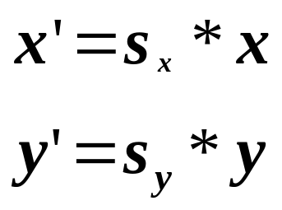
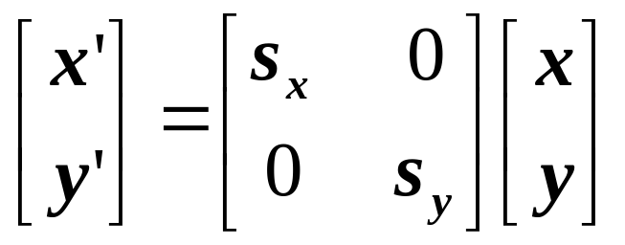
2x2 Matrices
What types of transformations can be
represented with a 2x2 matrix?
2D Identity?
2D Scale around (0,0)?

Slide 18
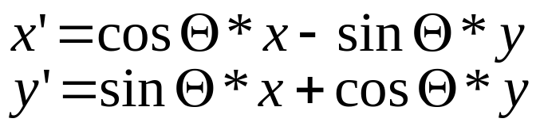
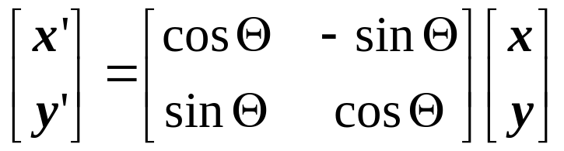
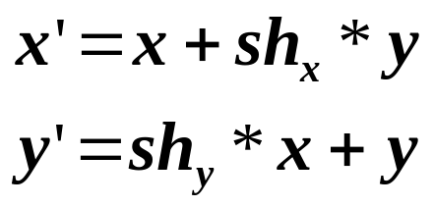
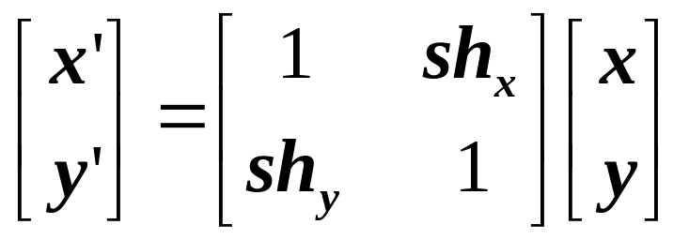
2x2 Matrices
What types of transformations can be
represented with a 2x2 matrix?
2D Rotate around (0,0)?
2D Shear?

Slide 19
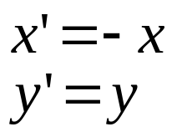
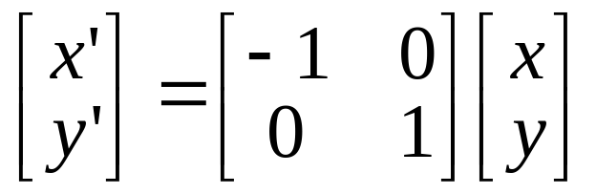
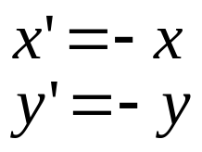
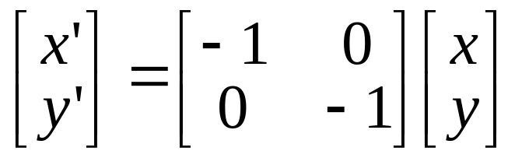
2x2 Matrices
What types of transformations can be
represented with a 2x2 matrix?
2D Mirror about Y axis?
2D Mirror over (0,0)?

Slide 20
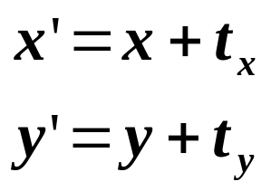
2x2 Matrices
What types of transformations can be
represented with a 2x2 matrix?
2D Translation?
NO!
Only linear 2D transformations
can be represented with a 2x2 matrix

Slide 21
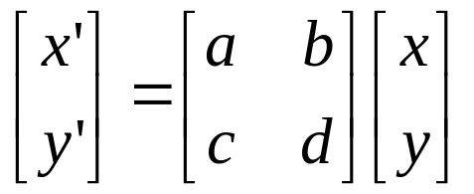
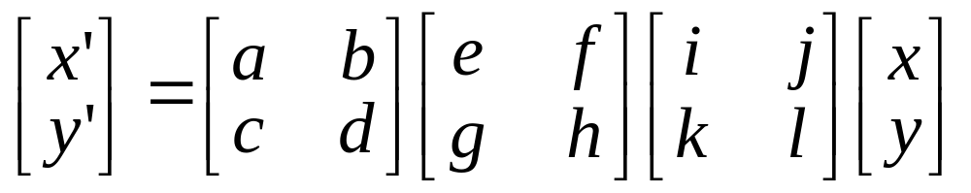
All 2D Linear Transformations
Linear transformations are combinations of …
  Scale,
  Rotation,
  Shear, and
  Mirror
Properties of linear transformations:
  Origin maps to origin
  Lines map to lines
  Parallel lines remain parallel
  Ratios are preserved
  Closed under composition

Slide 22
Consider a different Basis
j =(0,1)
v =(v_{x},v_{y})
p
q
u=(u_{x},u_{y})
i =(1,0)
q=4i+3j = (4,3)
p=4u+3v

Slide 23

Linear Transformations as Change of Basis
v =(v_{x},v_{y})
j =(0,1)
p_{i}=4u_{x}+3v_{x}
p_{j}=4u_{y}+3v_{y}
p^{uv}
p^{ij}
u=(u_{x},u_{y})
i =(1,0)
p^{uv} = (4,3)
p^{ij} = 4u+3v
⎡
u
v
⎡
4
⎡
u
v
p^{ij}
=
⎢
x
x
=
⎢
x
x
p^{uv}
⎢
⎣
u
v
⎣
3
⎣
u
v
y
y
y
y
Transformation from uv to ij basis
Any linear transformation is a basis!!!
Notes:
The column vectors are your new basis

Slide 24
What’s the inverse transform?
j =(0,1)
v =(v_{x},v_{y})
p^{ij}
p^{uv}
u=(u_{x},u_{y})
i =(1,0)
p^{ij} = (5,4)
= p_{x}u + p_{y}v
p^{uv} = (p_{x},p_{y}) = ?
–1
–1
⎡
u
v
⎡
5
⎡
u
v
p^{uv}
=
⎢
x
x
=
⎢
x
x
p^{ij}
⎢
⎣
u
v
⎣
4
⎣
u
v
y
y
y
y
How can we change from any basis to any basis?
What if the bases are orthonormal?

Slide 25
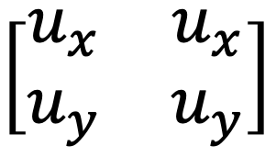
Projection onto orthonormal basis
j =(0,1)
v =(v_{x},v_{y})
p^{ij}
p^{uv}
u=(u_{x},u_{y})
i =(1,0)
p^{ij} = (5,4)
p^{uv} = (u·p^{ij}, v·p^{ij})
⎡
u
u
⎡
5
⎡
u
u
$$\left[\begin{matrix}u_{x} & u_{x} \\ u_{y} & u_{y}\end{matrix}\right]$$
=
x
y
=
x
y
p^{uv}
⎢
⎢
⎢
p^{ij}
⎣
v
v
⎣
4
⎣
v
v
y
y
x
y

Slide 26
Homogeneous Coordinates
Q: How can we represent translation as a 3x3 matrix?

Slide 27
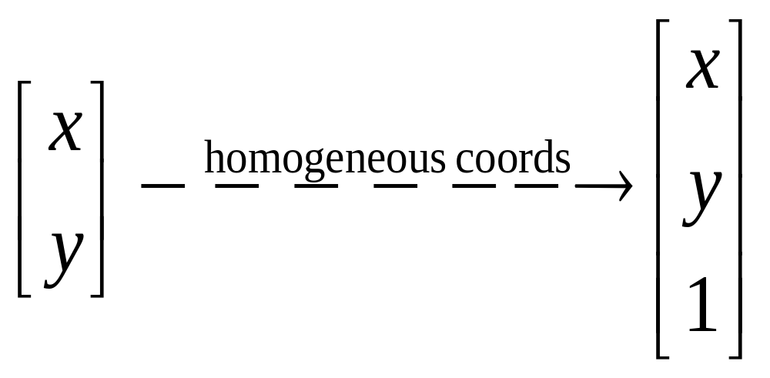
Homogeneous Coordinates
Homogeneous coordinates
  represent coordinates in 2 dimensions with a 3-vector

Slide 28
Homogeneous Coordinates
Add a 3rd coordinate to every 2D point
  (x, y, w) represents a point at location (x/w, y/w)
  (x, y, 0) represents a point at infinity
  (0, 0, 0) is not allowed
y
2
(2,1,1)
or (4,2,2)
or (6,3,3)
1
1
2
x
Convenient tool to
express translation as a linear transform

Slide 29
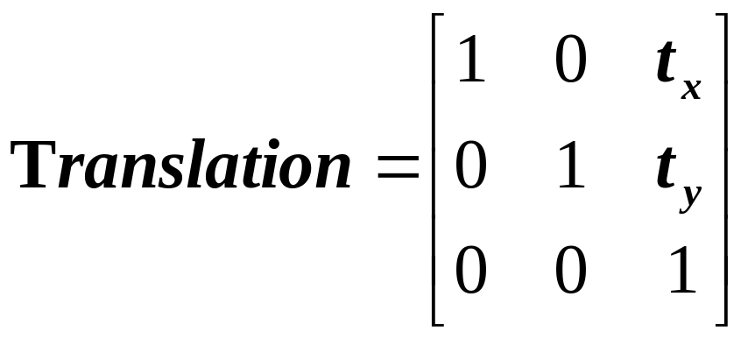
Homogeneous Coordinates
Q: How can we represent translation as a 3x3 matrix?
A: Using the rightmost column:

Slide 30
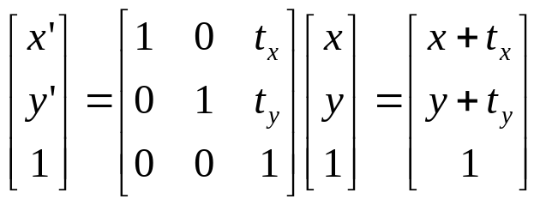
Translation
Example of translation
Homogeneous Coordinates
t_{x} = 2
t_{y} = 1

Slide 31
Homogeneous Coordinates
Add a 3rd coordinate to every 2D point
  (x, y, w) represents a point at location (x/w, y/w)
  (x, y, 0) represents a point at infinity
  (0, 0, 0) is not allowed
y
2
(2,1,1)
or (4,2,2)
or (6,3,3)
1
Convenient coordinate system to
represent many useful transformations
x
1
2

Slide 32
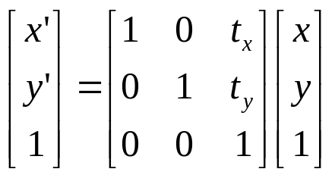
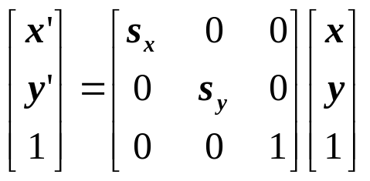
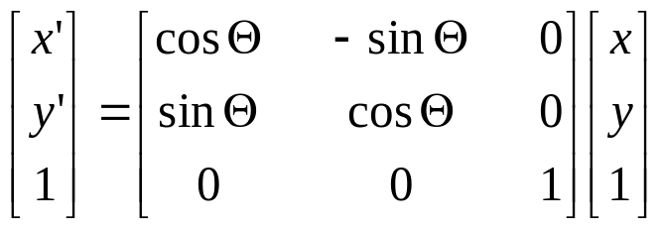
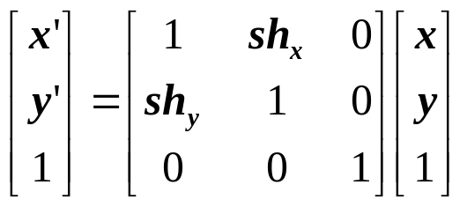
Basic 2D Transformations
Basic 2D transformations as 3x3 matrices
Translate
Scale
Rotate
Shear

Slide 33
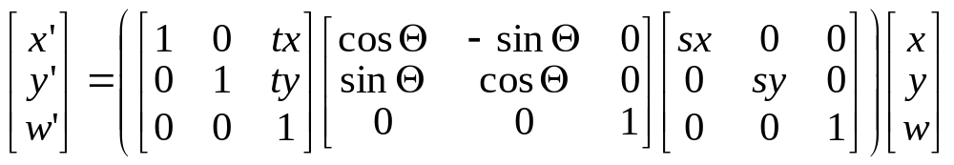
Matrix Composition
Transformations can be combined by
matrix multiplication
p’ = T(t_{x},t_{y}) R(Θ) S(s_{x},s_{y}) p
Does the order of multiplication matter?

Slide 34
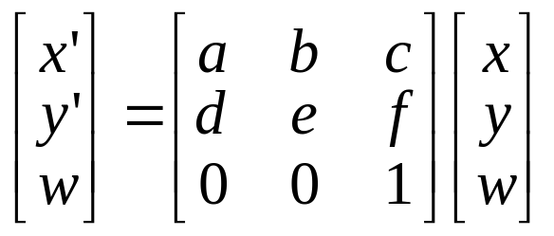
Affine Transformations
Affine transformations are combinations of …
  Linear transformations, and
  Translations
Properties of affine transformations:
  Origin does not necessarily map to origin
  Lines map to lines
  Parallel lines remain parallel
  Ratios are preserved
  Closed under composition
  Models change of coordinates
Will the last coordinate w always be 1?

Slide 35
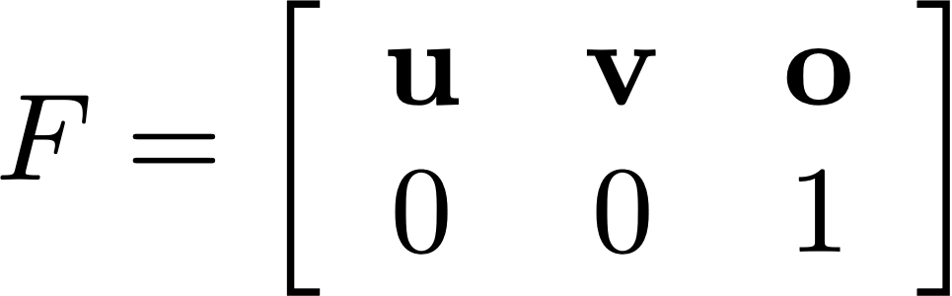

Coordinate System Transform
In general, a new coordinate frame is defined by an origin (point) and two unit axes (vectors)
Given coordinates in the (o,u,v) reference frame, what is the transform to coordinates in the (x,y) frame?
Notes:
Just change of basis + offset

Slide 36
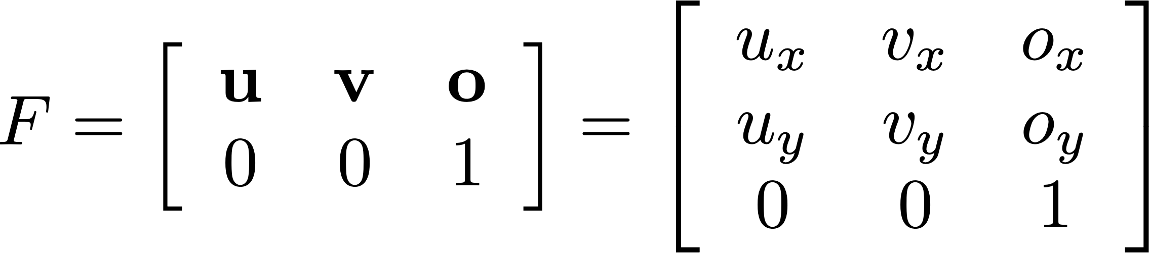
Coordinate System Transform Matrix
  Columns of matrix are defined by the reference frame’s coordinates in the world
  Gives a new way to “read off” columns of matrix
Notes:
Coordinates in frame: If I tell you the coordinates are (0,0,0), that’s here (at point o).
Frame to

Slide 37
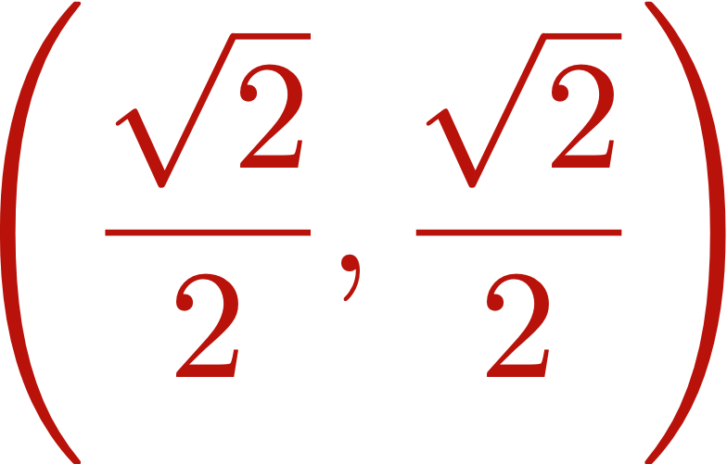


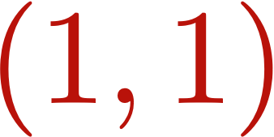
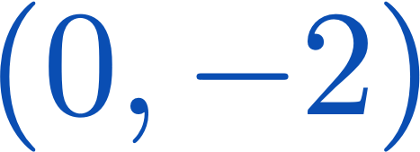
Coordinate System Transform - Example
Write down a matrix T representing this transform:
1
T
1
1

Slide 38
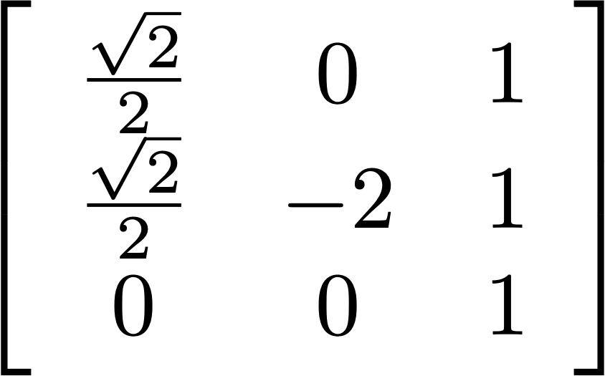
Coordinate System Transform - Example
Write down a matrix T representing this transform:
T

Slide 39
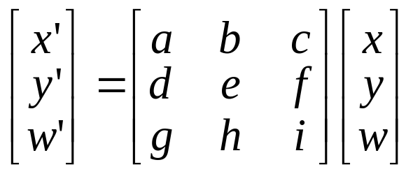
Projective Transformations
Projective transformations …
  Affine transformations, and
  Projective warps
Properties of projective transformations:
  Origin does not necessarily map to origin
  Lines map to lines
  Parallel lines do not necessarily remain parallel
  Ratios are not preserved
  Closed under composition
  Models change of coordinates

Slide 40
Projective Transformations
Projective transformations …
  Affine transformations, and
  Projective warps
Properties of projective transformations:
  Origin does not necessarily map to origin
  Lines map to lines
  Parallel lines do not necessarily remain parallel
  Ratios are not preserved
  Closed under composition
  Models change of coordinates
Notes:
Also called homographies

Slide 41
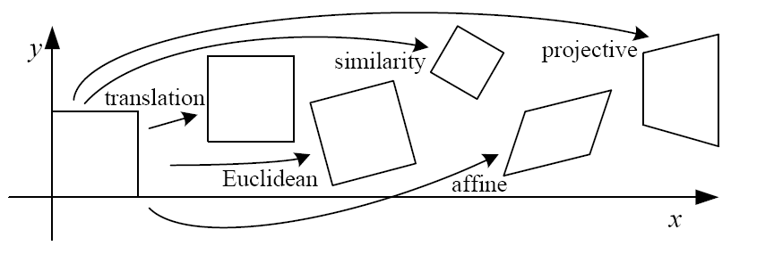
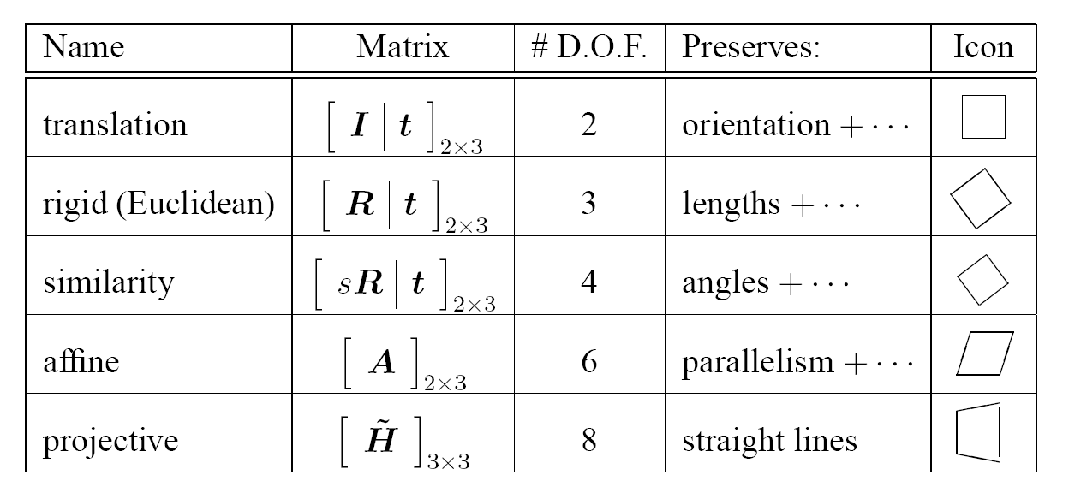

2D image transformations
These transformations are a nested set of groups
  Closed under composition and inverse is a member

Slide 42
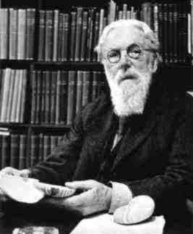
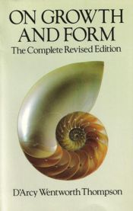
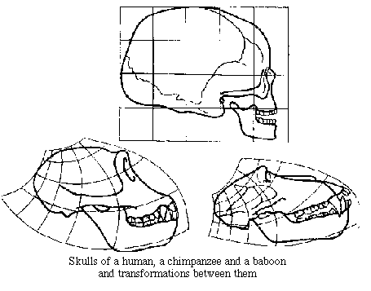
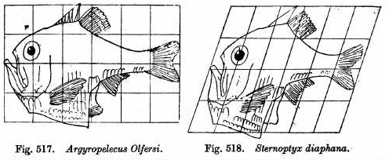
Image Transforms in Biology
D'Arcy Thompson
http://www-groups.dcs.st-and.ac.uk/~history/Miscellaneous/darcy.html
http://en.wikipedia.org/wiki/D'Arcy_Thompson
Importance of shape and structure in evolution
Slide by Durand and Freeman
Notes:
Excited by Darwinian theory of evolution.
Found a problem that didn’t square obviously with Darwin’s theory – which entailed small changes
Thompson found that [examples like here] were quite morphologically different.
Realized one can warp e.g. monkey skull into a human skull

Slide 43
Recovering Transformations
?
T(x,y)
y
y’
x
x’
f(x,y)
g(x’,y’)
What if we know f and g and want to recover the transform T?
  e.g. better align images from Project 1
  willing to let user provide correspondences
    How many do we need?
Notes:
Last lecture given source f and T, compute the target image g
Inverse problem

Slide 44
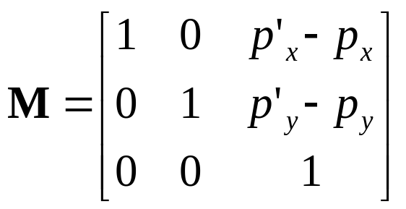
Translation: # correspondences?
?
T(x,y)
y
y’
x
x’
How many correspondences needed for translation?
How many Degrees of Freedom?
What is the transformation matrix?

Slide 45
Euclidian: # correspondences?
?
T(x,y)
y
y’
x
x’
How many correspondences needed for translation+rotation?
How many DOF?

Slide 46
Affine: # correspondences?
?
T(x,y)
y
y’
x
x’
How many correspondences needed for affine?
How many DOF?

Slide 47
Projective: # correspondences?
?
T(x,y)
y
y’
x
x’
How many correspondences needed for projective?
How many DOF?

Slide 48


Example: warping triangles
B
B’
?
T(x,y)
C’
A
C
A’
Source
Destination
Given two triangles: ABC and A’B’C’ in 2D (12 numbers)
Need to find transform T to transfer all pixels from one to the other.
What kind of transformation is T?
How can we compute the transformation matrix:
Two ways:
Algebraic and
geometric
Notes:
why affine? well how many orresp do we have
ASK: how do you go about solving for the 6 numbers? there are multiple ways
for a basis in 2D how many vectors do we need? do we see the basis vectors here? AB, AC → A’B’, A’C’

Slide 49


warping triangles (Barycentric Coordinates)
(0,1)
(0,0)
(1,0)
B
B’
Inverse
change
of basis
change
of basis
C’
A
C
A’
Source
Destination
Don’t forget to move the origin too!
Notes:
do it both ways and make sure you get the right answer!
Don’t forget to move the origin also! (A and A’ are not in the same place), so don’t forget to include the translation component
Proj3 harder! than proj 1 & 2. only 2 weeks
any matrix can be thought of as a change of basis matrix (vert cols)

